Slide 1
Supporting and Enhancing Mathematics and Statistics
Unit: Perimeter and Area of Shapes

Slide 2
Title
The unit of work is divided into the following six sections
Area
The Area and Perimeter of a Square
The Area and Perimeter of a Rectangle
The Area of Compound Shapes
The Area of a Triangle
The Area and Circumference of a Circle

Slide 3
Area
The easiest method to find an area of a shape, particularly if it is a simple shape made up of straight lines, is to count the squares inside it.
Example
Find the area of each of these shapes in terms of the square shown.
One Square
Solution
(a)
This can be divided into 5 of the squares, so its area is 5 square units.
We have 4 squares (labelled 1, 2, 3 and 4), and the two triangles (labelled 5a and 5b) can be joined together to form another square. So, in total, we have an area of 5 square units.
(b)

Slide 4

Skill Check: Area
Exercise
Draw around your hand on squared paper and find its area. Who has the largest hand in your class?
2. Find the areas of these shapes
1
1
2
3
4
1
1
1
2
3
5
6
1
8
7
1
1
1
1
1
1
4
5
9
10
6
7
1
1
1
1
1
1
8
9
1
1
1
1
1
1
1
1
10
11
1
1
1
1
1
1
1
1
1
1
1
By counting squares and part squares the area is approximately 40 squares
1
1
1
1
3. Find the area of this circle by counting squares.

Slide 5
Section 1: Review
You have completed the first section.
If you have completed and mastered this section,
click to start the next Section
If you need more examples and interactive practice,
press here
You might also find it helpful to look at:
Essential Information: press here

Slide 6
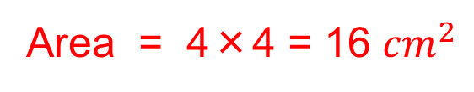
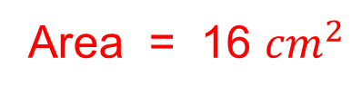
Area and Perimeter of a square
We now bring in standard units for measuring area and perimeter
The area of a square can be found by counting squares or multiplying the length of the sides.
Example
Area = 1 ${cm}^{2}$, Perimeter = 1 + 1 + 1 + 1= 4cm
Find the area and perimeter of the square
The perimeter of a square is the total length of the four sides.
1
2
3
4
5
6
7
8
9
10
11
12
Perimeter = 4 + 4 + 4 + 4
13
14
15
16
= 16 cm
Note:
Area = 16 ${cm}^{2}$
Area = 4×4 = 16 ${cm}^{2}$

Slide 7
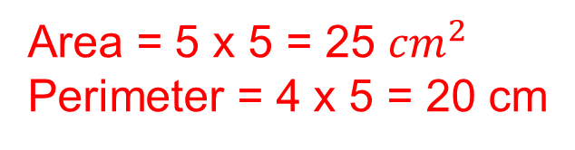
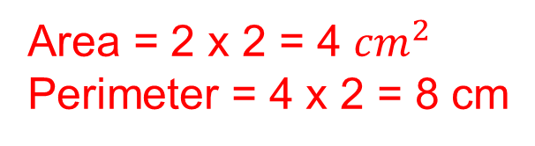
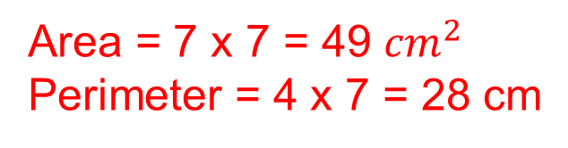
Skill Check: Area and Perimeter of a Square
1. Find the area and perimeter of each of these squares.
(a)
(b)
(c)
Area = 2 x 2 = 4 ${cm}^{2}$
Perimeter = 4 x 2 = 8 cm
Area = 5 x 5 = 25 ${cm}^{2}$
Perimeter = 4 x 5 = 20 cm
Area = 7 x 7 = 49 ${cm}^{2}$
Perimeter = 4 x 7 = 28 cm

Slide 8








Skill Check: Area and Perimeter of a Square
2. Find the area of squares with sides of length:
(a) 10 cm
$${100cm}^{2}$$
(b) 12 cm
$${144cm}^{2}$$
(c) 8 cm
$${64cm}^{2}$$
(d) 9 cm
$${81cm}^{2}$$
(e) 15 cm
$${225cm}^{2}$$
(f) 20 cm
$${400cm}^{2}$$
(g) 11 cm
$${121cm}^{2}$$
(h) 13 cm
$${169cm}^{2}$$
3. Find the perimeter of squares with sides of length:
(a) 13 cm
52 cm
(b) 8 cm
32 cm
(c) 16 cm
64 cm
(d) 19 cm
76 cm
(e) 9 cm
36 cm
(f) 18 cm
72 cm
(g) 20 cm
80 cm
(h) 15 cm
60 cm
4. Copy and complete each of these statements.
103
(c) 28 mm = cm
(a) 3.2 cm = mm
(b) 10.3 cm = mm
2.8
32
0.84
1.52
(f) 84 cm = m
(d) 216 mm = cm
(e) 152 cm = m
21.6
162
170
(i) 0.82 m = mm
(g) 1.62 m = cm
(h) 1.7 m = cm
820

Slide 9
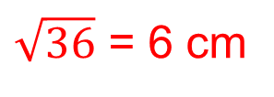

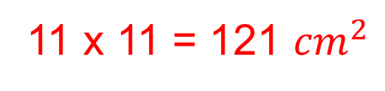

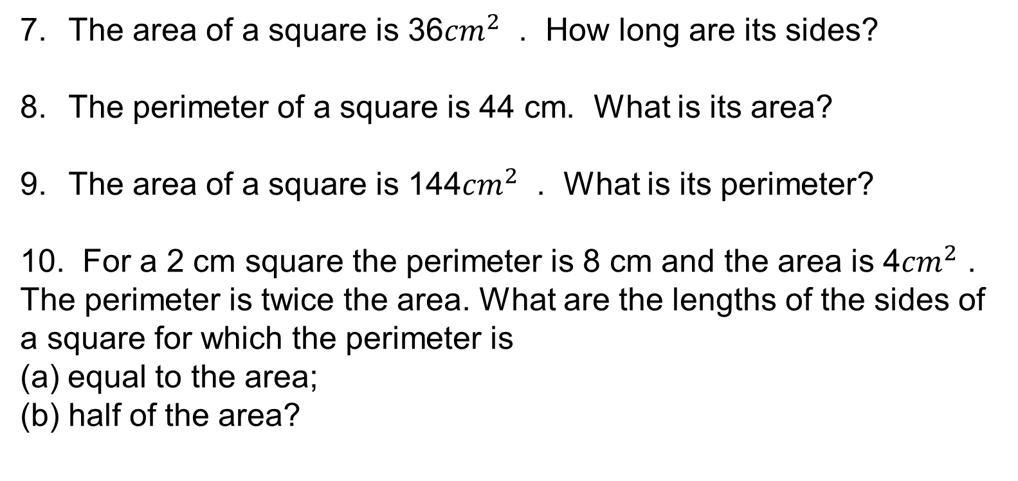
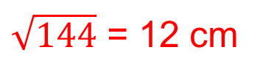
Skill Check: Area and Perimeter of a Square
5. A square has sides of length 20 mm. Find the area of the square in:
(a)
20 x 20 = 400
$${mm}^{2}$$
(b)
2 x 2 = 4
$${cm}^{2}$$
6. The perimeter of a square is 40 cm. How long are its sides?
40 ÷ 4 = 10 cm
The area of a square is 36${cm}^{2}$ . How long are its sides?
The perimeter of a square is 44 cm. What is its area?
The area of a square is 144${cm}^{2}$ . What is its perimeter?
10. For a 2 cm square the perimeter is 8 cm and the area is 4${cm}^{2}$ . The perimeter is twice the area. What are the lengths of the sides of a square for which the perimeter is
(a) equal to the area;
half of the area?
$\sqrt{36}$ = 6 cm
11 x 11 = 121 ${cm}^{2}$
$\sqrt{144}$ = 12 cm
Perimeter = 4 x 12 = 48cm
4 cm, 4 x 4 = 16, 4 + 4 + 4 + 4 = 16
8 cm, 8 x 8 = 64, 4 x 8 = 32

Slide 10
Section 2: Review
You have completed the second section.
If you have completed and mastered this section,
click to start the next Section
If you need more examples and interactive practice,
press here
You might also find it helpful to look at:
Essential Information: press here

Slide 11
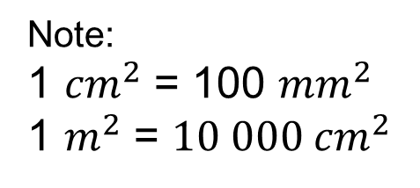
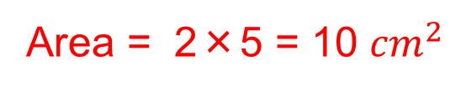

Area and Perimeter of a Rectangle
Example
For a rectangle, say 5 cm by 2 cm, we can proceed either by counting squares or multiplying the lengths.
Note:
1 ${cm}^{2}$ = 100 ${mm}^{2}$
1 $m^{2}$ = ${10 000 cm}^{2}$
Solution
The Area of this rectangle is 10 ${cm}^{2}$ from counting squares or, alternatively;
Area = 2×5 = 10 ${cm}^{2}$
The Perimeter of the rectangle is, 5 + 2 + 5 + 2 = 14cm by adding side lengths together or, alternatively;
Perimeter = 2 x (Length + Width) = 2 x (2 + 5 ) = 2 x 7 =14 cm

Slide 12
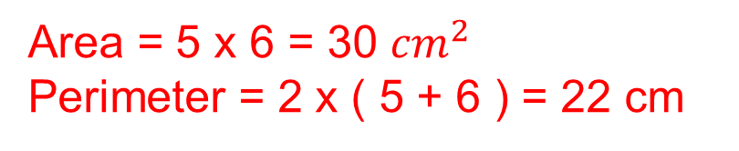
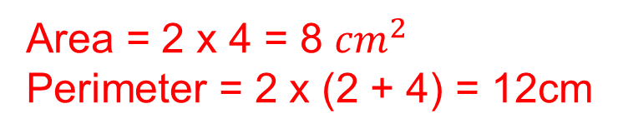
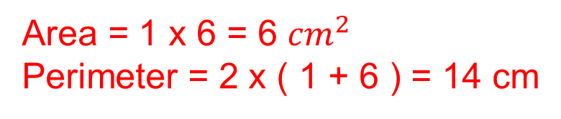
Skill Check: Area and Perimeter of a Rectangle
1. Find the Area and Perimeter of these rectangles.
(a)
Area = 2 x 4 = 8 ${cm}^{2}$
Perimeter = 2 x (2 + 4) = 12cm
(c)
Area = 1 x 6 = 6 ${cm}^{2}$
Perimeter = 2 x ( 1 + 6 ) = 14 cm
(b)
Area = 5 x 6 = 30 ${cm}^{2}$
Perimeter = 2 x ( 5 + 6 ) = 22 cm

Slide 13
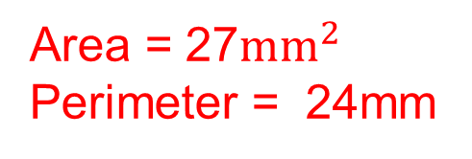
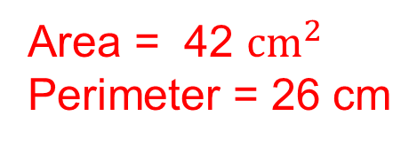
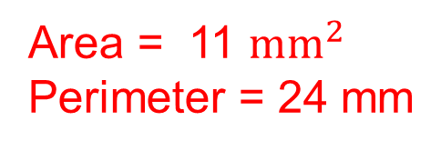
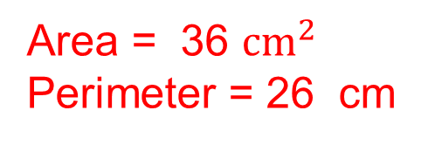
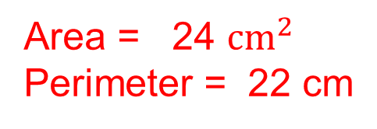
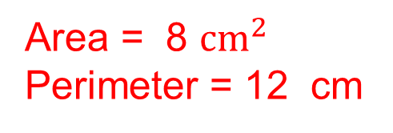
Skill Check: Area and Perimeter of a Rectangle
2. Find the area and perimeter of these rectangles in suitable units.
(a)
(b)
(c)
Area = 24 ${cm}^{2}$
Perimeter = 22 cm
Area = 8 ${cm}^{2}$
Perimeter = 12 cm
Area = 36 ${cm}^{2}$
Perimeter = 26 cm
(d)
(e)
(f)
Area = 11 ${mm}^{2}$
Perimeter = 24 mm
Area = 27${mm}^{2}$
Perimeter = 24mm
Area = 42 ${cm}^{2}$
Perimeter = 26 cm

Slide 14
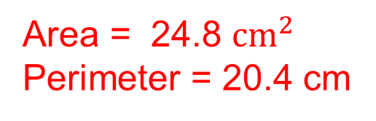
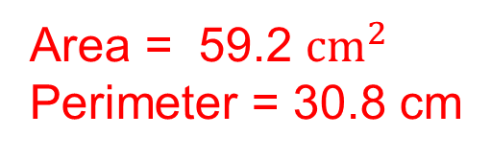
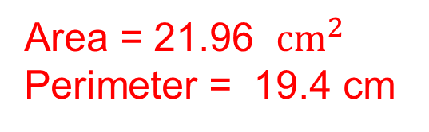
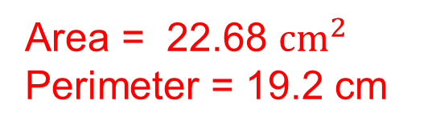
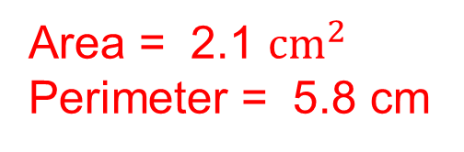
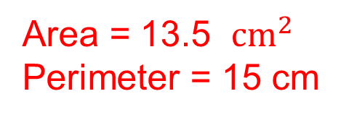
Skill Check: Area and Perimeter of a Rectangle
3. Find the area and perimeter of these rectangles.
(a)
(b)
(c)
Area = 13.5 ${cm}^{2}$
Perimeter = 15 cm
Area = 22.68 ${cm}^{2}$
Perimeter = 19.2 cm
Area = 24.8 ${cm}^{2}$
Perimeter = 20.4 cm
(e)
(f)
(d)
Area = 21.96 ${cm}^{2}$
Perimeter = 19.4 cm
Area = 59.2 ${cm}^{2}$
Perimeter = 30.8 cm
Area = 2.1 ${cm}^{2}$
Perimeter = 5.8 cm

Slide 15
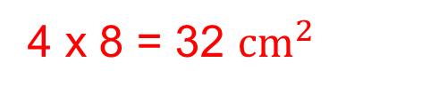
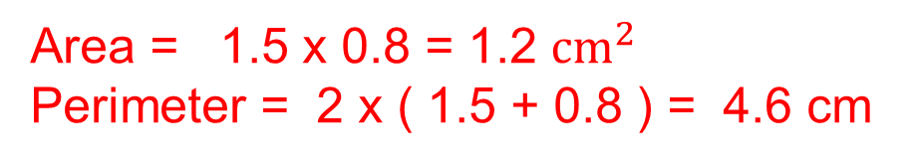
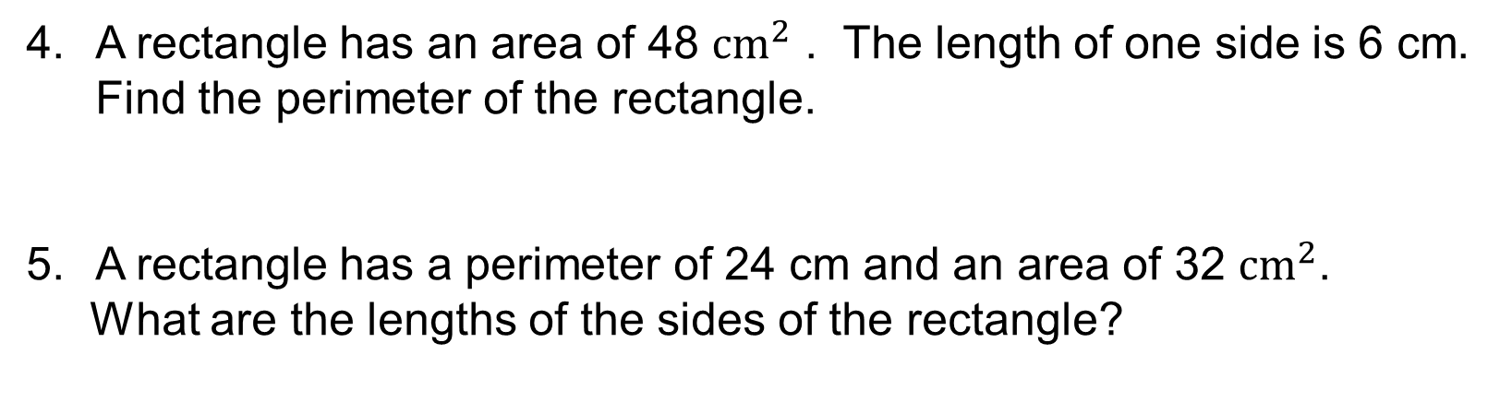
Skill Check: Area and Perimeter of a Rectangle
3. Find the perimeter and area of this rectangle making clear which units you have decided to use.
Area = 1.5 x 0.8 = 1.2 ${cm}^{2}$
Perimeter = 2 x ( 1.5 + 0.8 ) = 4.6 cm
A rectangle has an area of 48 ${cm}^{2}$ . The length of one side is 6 cm. Find the perimeter of the rectangle.
A rectangle has a perimeter of 24 cm and an area of 32 ${cm}^{2}$.
What are the lengths of the sides of the rectangle?
48 ÷ 6 = 8 cm
Perimeter = 2 x ( 6 + 8 ) = 28 cm
L + W = 24÷2 = 12 cm
4 + 8 = 12 cm
4 x 8 = 32 ${cm}^{2}$

Slide 16
Section 3: Review
You have completed the third section.
If you have completed and mastered this section,
click to start the next Section
If you need more examples and interactive practice,
press here
You might also find it helpful to look at:
Essential Information: press here

Slide 17
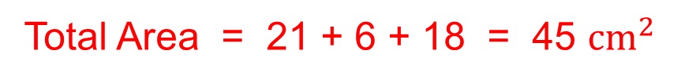
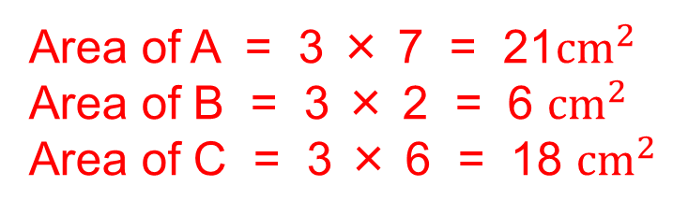
Area and Perimeter of Compound Shapes
We illustrate this method with an example.
Example
Find the area and perimeter of the shape shown below.
Solution
Divide the shape into rectangles
B
Area of A = 3 × 7 = 21${cm}^{2}$
Area of B = 3 × 2 = 6 ${cm}^{2}$
Area of C = 3 × 6 = 18 ${cm}^{2}$
A
C
Total Area = 21 + 6 + 18 = 45 ${cm}^{2}$
Perimeter = 7 + 3 + 3 + 3 + 6 + 3 + 4 + 3 + 5 + 3 = 40 cm

Slide 18


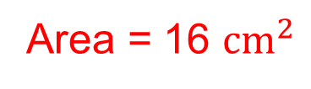

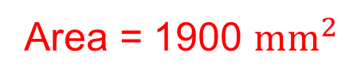
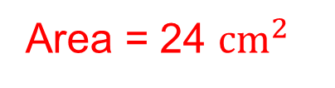



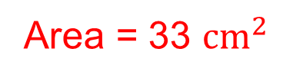


Skill Check: Area of Compound Shapes
1. Find the area of each of these shapes.
(a)
(b)
20${cm}^{2}$
4${cm}^{2}$
8${cm}^{2}$
8${cm}^{2}$
Area = 24 ${cm}^{2}$
(c)
Area = 16 ${cm}^{2}$
500${mm}^{2}$
(d)
24${cm}^{2}$
1400${mm}^{2}$
9${cm}^{2}$
Area = 1900 ${mm}^{2}$
Area = 33 ${cm}^{2}$

Slide 19
Skill Check: Area of Compound Shapes
2. Find the area and perimeter of each of these shapes.
(a)
(b)
3 cm
1cm
Perimeter = 22 cm
Perimeter = 20 cm
6 cm
4 cm
1cm
(c)
2 cm
(d)
10 mm
3 cm
Perimeter = 28 cm
60 mm
2 cm
3 cm
Perimeter = 190 mm
3 cm

Slide 20








Skill Check: Area of Compound Shapes
3. Find the area and perimeter of these shapes.
(a)
(b)
4 ${cm}^{2}$
9 ${cm}^{2}$
6 cm
8 ${cm}^{2}$
15 ${cm}^{2}$
2 cm
12 ${cm}^{2}$
3 cm
30 ${cm}^{2}$
Area = 24 ${cm}^{2}$
Area = 54 ${cm}^{2}$
Perimeter = 24 cm
Perimeter = 38 cm

Slide 21




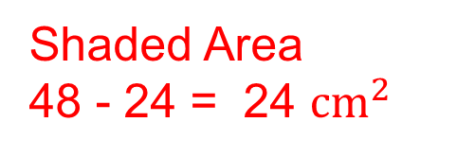

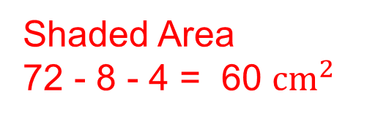


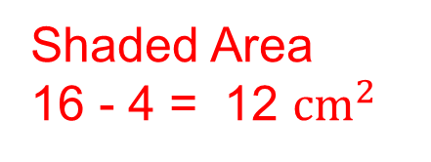
Skill Check: Area of Compound Shapes
4. Find the shaded area in each of the diagrams below.
(a)
(c)
48 ${cm}^{2}$
16 ${cm}^{2}$
Shaded Area
16 - 4 = 12 ${cm}^{2}$
24 ${cm}^{2}$
4 ${cm}^{2}$
(b)
Shaded Area
48 - 24 = 24 ${cm}^{2}$
72 ${cm}^{2}$
8 ${cm}^{2}$
Shaded Area
72 - 8 - 4 = 60 ${cm}^{2}$
4 ${cm}^{2}$

Slide 22

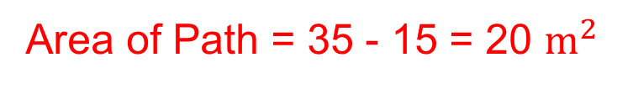

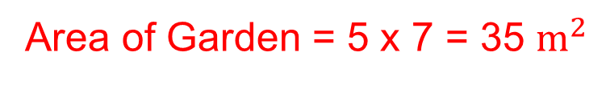
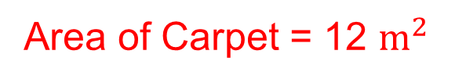
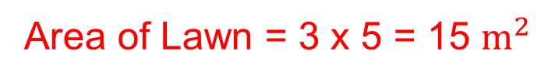
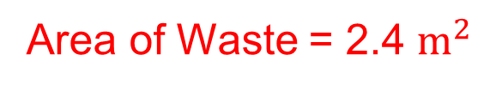
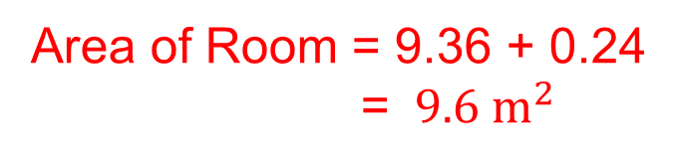
Skill Check: Area of Compound Shapes
5. A lawn is 3 m by 5 m. A path 1 m wide is laid around the lawn.
Find the area of the path.
Area of Lawn = 3 x 5 = 15 $m^{2}$
Area of Garden = 5 x 7 = 35 $m^{2}$
Area of Path = 35 - 15 = 20 $m^{2}$
6. Ben's dad buys a carpet that is 3 m wide and 4 m long.
This is the shape of Ben's room How much carpet is wasted?
Area of Carpet = 12 $m^{2}$
0.2
Area of Room = 9.36 + 0.24
= ${ 9.6 m}^{2}$
9.36 $m^{2}$
Area of Waste = 2.4 $m^{2}$
0.24 $m^{2}$

Slide 23
Section 4: Review
You have completed the fourth section.
If you have completed and mastered this section,
click to start the next Section
If you need more examples and interactive practice,
press here
You might also find it helpful to look at:
Essential Information: press here

Slide 24
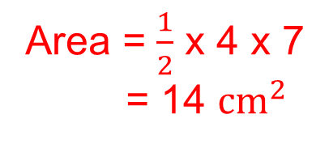
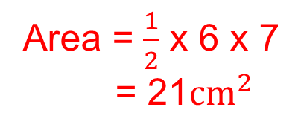

Area of a Triangle
The Area for a triangle,
Area = $\frac{1}{2}$ x base x perpendicular height
Example 1
Find the areas of the triangles shown below.
Area = $\frac{1}{2}$ x 6 x 7
= 21${cm}^{2}$
Area = $\frac{1}{2}$ x 4 x 7
= 14 ${cm}^{2}$

Slide 25
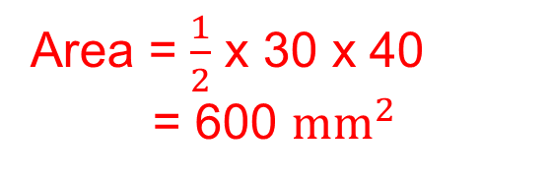
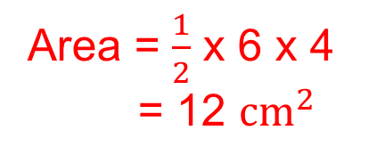
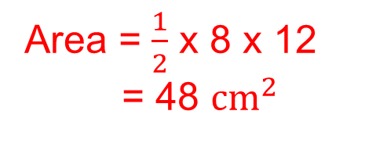
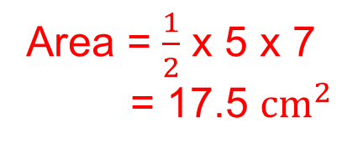

Skill Check: Area of a Triangle
1. Find the area of each of these triangles.
(a)
(d)
Area = $\frac{1}{2}$ x 6 x 8
= 24${ cm}^{2}$
Area = $\frac{1}{2}$ x 6 x 4
= 12 ${cm}^{2}$
(b)
Area = $\frac{1}{2}$ x 5 x 7
= 17.5 ${cm}^{2}$
(e)
(c)
Area = $\frac{1}{2}$ x 8 x 12
= 48 ${cm}^{2}$
Area = $\frac{1}{2}$ x 30 x 40
= 600 ${mm}^{2}$

Slide 26








Skill Check: Area of a Triangle
2. (a) Find the area of the shaded triangle.
Area Triangle = $\frac{1}{2}$ x 6 x 8
= 24${ cm}^{2}$
24${ cm}^{2}$
24${ cm}^{2}$
Area Parallelogram = 2 x 24
= 48${ cm}^{2}$
(b) What is the area of the parallelogram?
Area Parallelogram
base x vertical height
3. Find the area of this parallelogram.
Area Triangle = $\frac{1}{2}$ x 6 x 4
= 12${ cm}^{2}$
12${ cm}^{2}$
12${ cm}^{2}$
Area Parallelogram = 2 x 12
= 24${ cm}^{2}$

Slide 27












Skill Check: Area of a Triangle
4. Find the area of each of these shapes. They have not been drawn accurately.
(a)
(c)
6 cm
3cm
15${ cm}^{2}$
7.5${ cm}^{2}$
Area = 27.5${ cm}^{2}$
Area = 35${ cm}^{2}$
2${0 cm}^{2}$
20${ cm}^{2}$
(d)
(b)
1cm
Area = 52.5${ cm}^{2}$
3.5${ cm}^{2}$
12.5${ cm}^{2}$
Area = 38.5${ cm}^{2}$
5 cm
35${ cm}^{2}$
40${ cm}^{2}$

Slide 28
Section 5: Review
You have completed the fifth section.
If you have completed and mastered this section,
click to start the next Section
If you need more examples and interactive practice,
press here
You might also find it helpful to look at:
Essential Information: press here

Slide 29

Area and Circumference of a Circle
In this section we will start by looking first at lines that split circles into different parts
A chord joins any two points on the circumference of a circle.
A diameter is a chord that passes through the centre of the circle.
A radius joins the centre of the circle to any point on the circumference of the circle
chord
diameter
radius
The circumference is the distance round the outside of a circle.
The diameter will always divide into the circumference π times
Circumference = π x diameter
or
Circumference = 2 x radius x π
π = 3.14 (2 d.p.)
Area = π${ x radius}^{2}$

Slide 30


Area and Circumference of a Circle
Example 1
Find the area and circumference of a circle with a radius 6 cm.
(a) Circumference = π d
= π x 12
= 37.7 cm to 3 significant figures.
(b) Area = π $r^{2}$
= π x 6 x 6
= 113 ${cm}^{2}$ to 3 significant figures
6 cm
Example 2
Find the area and circumference of a circle with a diameter 7 cm.
(a) Circumference = π d
= π × 7
= 22.0 cm to 3 significant figures.
(b) Radius = 3.5 cm, Area = π $r^{2}$
= π ×3.5 x 3.5
= 38.5 ${cm}^{2}$ to 3 significant figures
7 cm

Slide 31




Skill Check: Area and Circumference of a Circle
1. A circle has radius 11 cm. Calculate:
(a) its diameter,
(b) its circumference,
its area.
2. Calculate the circumference and area of a circle with radius 8 cm.
3. Calculate the circumference and area of a circle with diameter 19 cm.
2 x 11= 22 cm
Use π = 3.14
22 x 3.14 = 69.08 cm
3.14 x 11 x 11 = 379.94 ${ cm}^{2}$
Circumference = 50.24 cm
Area = 200.96 ${cm}^{2}$
Circumference = 59.66 cm
Area = 283.385 ${cm}^{2}$
4. Determine the circumference and area
of the circle shown:
Circumference = 12 x 3.14 = 37.68 cm
Area = 6 x 6 x 3.14 = 113.04 ${cm}^{2}$

Slide 32








Skill Check: Area and Circumference of a Circle
5. Copy and complete the following table:
Use π = 3.14
12 cm
75.36 cm
452.16 ${cm}^{2}$
6.
2 cm
6.28 cm
${3.14 cm}^{2}$
3 mm
18.84 mm
28.26 ${mm}^{2}$
4.5 m
28.26 m
63.585 $m^{2}$
11.5 km
72.22 km
415.265 ${km}^{2}$
6. A circle is cut out of a rectangular piece of card, as shown:
(a) Calculate the area of the rectangle.
(b) Calculate the area of the circle.
(c) Calculate the area of the card left, when the circle has been cut out.
10 x 15 =150 ${cm}^{2}$
4 x 4 x 3.14 = 50.24 ${cm}^{2}$
150 – 50.24 = 99.76 ${cm}^{2}$

Slide 33


Skill Check: Area and Circumference of a Circle
7. Calculate the area and perimeter of the semi circle shown
Area of Semi Circle = 5 x 5 x 3.14 ÷ 2 = 78.5 ${cm}^{2}$
Perimeter = 10 + (3.14 x 10 ÷ 2) = 25.7 cm
Use π = 3.14
8. The circumference of a circle is 29 cm.
(a) Calculate the radius of the circle.
(b) Calculate the area of the circle.
Diameter = 29 ÷ 3.14 = 9.236 cm
Radius = 9.236 ÷ 2 = 4.618 cm
Area of Circle = 4.618 x 4.618 x 3.14 = 66.96 ${cm}^{2}$
9. The area of a circle is 48 ${cm}^{2}$. Calculate the radius and circumference of the circle.
Radius = $\sqrt{\text{(48 ÷ 3.14)}}$ = 3.91 cm
Circumference = 2 x 3.91 x 3.14 = 24. 5548 cm

Slide 34
Section 6: Review
You have completed the sixth section.
If you have completed and mastered this section,
click to start the next Section
If you need more examples and interactive practice,
press here
You might also find it helpful to look at:
Essential Information: press here

