Slide 1
Supporting and Enhancing Mathematics and Statistics
Unit: Angles and Turns

Slide 2
Co-ordinates
This unit of work is divided into the following eight sections
Angles and Turns
Measuring Angles
Classifying Angles
Angles on Lines and Angles at a Point
Constructing Triangles
Calculating Angles in Triangles
Angles in Polygons
Angles on Parallel Lines

Slide 3
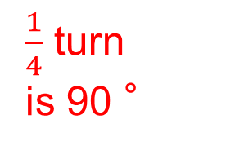

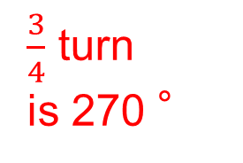
Angles and Turns
Angles are an important building block in geometry and trigonometry as you will see later. In this unit you will see how turns are related to angles, how to measure them and how to work out their size in particular problems.
You will need to understand clearly what the terms such as turn, half turn, etc. mean in terms of angles. There are 360 ° in one complete turn, so the following are true.
1 turn
is 360 °
$\frac{3}{4}$ turn
is 270 °
$\frac{1}{2}$ turn
is 180 °
$\frac{1}{4}$ turn
is 90 °

Slide 4



Angles and Turns
You also need to refer to compass points: (north (N), south (S), east (E), west (W), northeast (NE), southeast (SE), southwest (SW) and northwest (NW).
Turning from N to S is
180 °clockwise or anticlockwise
Turning from SW to NW is
90 ° clockwise
(or 270 ° anticlockwise)
Turning clockwise from NW to N is
45 °clockwise
(or 315 ° anticlockwise)

Slide 5
Skill Check: Angles and Turns
Exercises
1. John is standing on a hill. The church is north of the point where he stands.
(b) What angle does John turn through if he turns clockwise from looking at:
(i) the Church to the Farm,
(ii) the Oak Tree to the Bridge,
(iii) the TV mast to the Oak Tree,
(iv) the Bridge to the TV Mast,
(v) the TV Mast to the Church?
N
NE
90˚
270˚
NW
45˚
315˚
W
E
90˚
270˚
225˚
135˚
SW
s
SE
315˚
45˚
(a) In what direction is he facing if he looks at:
(c) Repeat (b) turning anti-clockwise
the chimney
the TV mast
the oak tree
W
(iv) the bridge
(v) the farm
S
NE
E
SE

Slide 6
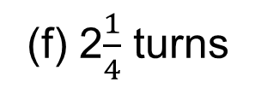
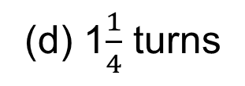
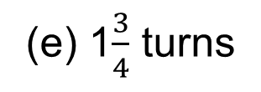

Skill Check: Angles and Turns
2. In a game, you spin a pointer and let it stop. What angle does the pointer turn through if it completes:
(a) 1 turn
(c) $\frac{3}{4}$ turn
270˚
(e) 1$\frac{3}{4}$ turns
630˚
360˚
(b) 2 turns
720˚
(d) 1$\frac{1}{4}$ turns
450˚
(f) 2$\frac{1}{4}$ turns
810˚
3. What angle do you turn through if you turn clockwise from facing:
(a) N to E
90˚
(d) NE to N
315˚
(g) S to SE
315˚
(b) W to NW
45˚
(e) W to NE
135˚
(h) SE to SW
90˚
(f) S to SW
45˚
(i) E to SW
135˚
(c) SE to NW
180˚
4. What angle do you turn through if you turn anticlockwise from facing:
(a) N to SW
(b) S to SW
(c) W to NW
(d) E to S
135˚
315˚
315˚
270˚

Slide 7
Skill Check: Angles and Turns
5. In what direction will you be facing if you turn:
(a) 180 ° clockwise from NE,
(b) 180 ° anticlockwise from SE,
(c) 90 ° clockwise from SW,
(d) 45 ° clockwise from N,
(e) 225 ° clockwise from SW,
(f)135 ° anticlockwise from N,
(g) 315° clockwise from SW?
SW
NW
NW
NE
E
SW
S
6. Using the diagram above
In what direction should you walk from the beach to get to the tower?
What is N of the shop?
What is W of the church?
(c) What is E of the church?
Church
North
Big Rock
In what direction should you walk from the beach to get to the church?
Windmill
North West

Slide 8
Skill Check: Angles and Turns
7. The map below shows part of East Anglia.
What is East of Acle?
What is North of Norwich and South of Cromer?
What is SE of Norwich?
What is NW of Acle?
What is West of Cromer?
What is West of Lowestoft and East of Bungay?
Great Yarmouth
Aylsham
Beccles
Aylsham
Holt
Beccles

Slide 9
Skill Check: Angles and Turns
8. The diagram shows the positions of Jason and Nadina.
Copy or trace the diagram.
Karen is west of Nadina and north of Jason. Mark Karen's position on your diagram.
Jenny is east of Jason and southeast of Nadina. Mark Jenny's position on your diagram.
Wendy is west of Jenny and southeast of Karen. Where is Wendy in relation to Nadina?
Jai is west of Jason and south west of Karen. Mark Jai’s position on your diagram
Karen
Wendy
Jenny
Jai
South

Slide 10
Section 1: Review
You have completed the first section.
If you have completed and mastered this section,
click to start the next Section
If you need more examples and interactive practice,
press here
You might also find it helpful to look at:
Essential Information: press here

Slide 11
Measuring Angles
A protractor can be used to measure or draw angles.
Note
The angle around a complete circle is 360 °
The angle around a point on a straight line is 180 °
A right angle is 90 °
Example 1
Measure the angle CAB in
the triangle shown.
47˚

Slide 12
Measuring Angles
Example 2
Measure this angle.
Solution
Using a protractor, the smaller angle is measured as 100 °.
So required angle = 360 °− 100 ° = 260 °
Example 3
Draw an angle of
(a) 120 °
Solution
Draw a horizontal line.
Place a protractor on top of the line and draw a mark at 120 °
Remove protractor

Slide 13
Skill Check: Measuring Angles
1. For each of the following angles, first estimate the size of the angle and then measure the angle to see how good your estimate was
(a)
(b)
(c)
340˚
85˚
20˚
60˚
2. (a) Measure each of the angles in this pie chart showing a
group’s favourite teams.
Explain how you can tell that Manchester United is the most popular of these teams.
35˚
160˚
75˚
Largest sector (largest angle)
50˚
Which is the second most popular team?
40˚
Chelsea

Slide 14
Skill Check: Measuring Angles
3. In which of these polygons are the angles all the same size?
No
No
4. (a) Draw the shape below, where O is the centre of the circle. Make the radius of your circle 6 cm.
(b) Measure the distances between
(i) AB,
(ii) BC
(iii) AC.
8.7 cm
9.2 cm
11.9 cm

Slide 15
Skill Check: Measuring Angles
5. Ravinder finds out the favourite sports or members of his class. He works out the angles in the list shown opposite for a pie chart.
Draw the pie chart.
Solution
Sport Angle
Football
Swimming
Tennis
Rugby
Hockey
Badminton
Other
110˚
70˚
80˚
40˚
30˚
10˚
20˚
40˚
10˚
30˚
20˚
80˚
70˚
110˚
360˚

Slide 16
Section 2: Review
You have completed the second section.
If you have completed and mastered this section,
click to start the next Section
If you need more examples and interactive practice,
press here
You might also find it helpful to look at:
Essential Information: press here

Slide 17
Classifying Angles
Angles of less than 90 ° are acute angles
Angles between 90 ° and 180 ° are obtuse angles
Angles between 180 ° and 360 ° are reflex angles
So you can easily identify the three types of angle. Here are some examples.
Obtuse
Acute
Acute
Obtuse
Reflex
Reflex
Acute
Reflex

Slide 18
Skill Check: Classifying Angles
1. Is each angle below acute, obtuse or reflex?
2. For each shape below state whether the angle at each corner is acute, obtuse or reflex

Slide 19
Skill Check: Classifying Angles
Draw a triangle with:
(a) one obtuse angle.
no obtuse angles.
4. Draw a four-sided shape with:
(a) one reflex angle,
one obtuse angles.
(b)
(a)
(a)
(b)

Slide 20
Section 3: Review
You have completed the third section.
If you have completed and mastered this section,
click to start the next Section
If you need more examples and interactive practice,
press here
You might also find it helpful to look at:
Essential Information: press here

Slide 21
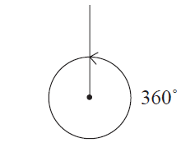
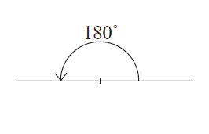
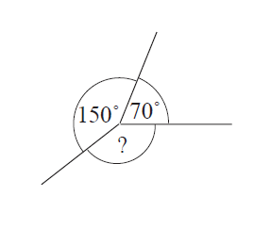
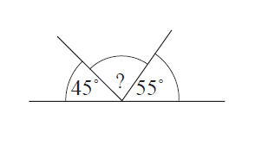
Angles on a Line and Angles at a Point
(a) angles on a line add up to 180 °
(b) angles at a point add up to 360 °
80°
What is the size of the angle marked ?
Solution
Example 1
Example 2
140°
What is size of the angle marked ?
Solution
70 °+ 150 °= 220 °
So angle = 360˚−220˚
45 ˚+ 55 °= 100 °
So angle = 180˚- 100˚
= 140°
= 80°

Slide 22
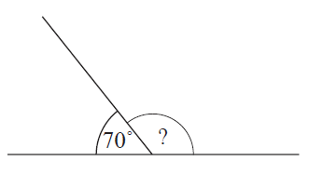
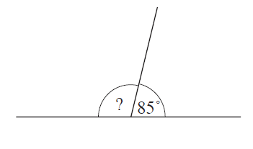
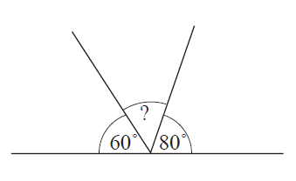
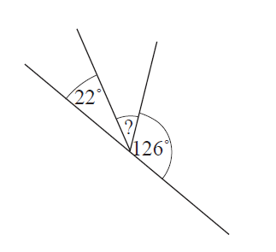
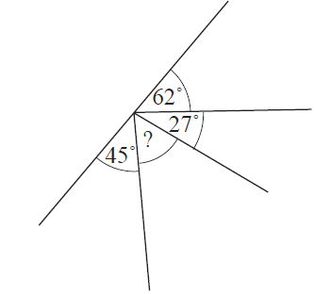
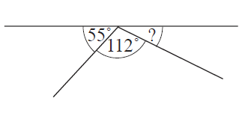
Skill Check: Angles on a Line and Angles at a Point
1. Calculate the unknown angle in each of the following diagrams.
(a)
(b)
(c)
95°
40°
110°
(e)
(f)
(d)
32°
13°
46°

Slide 23
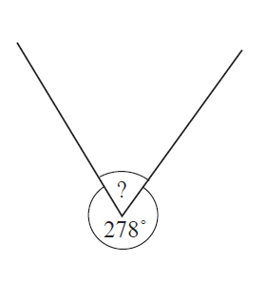
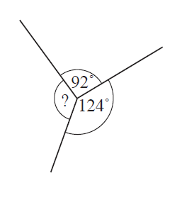
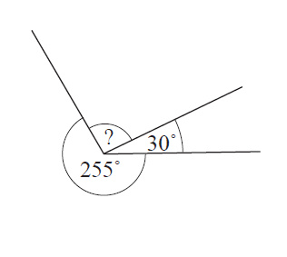
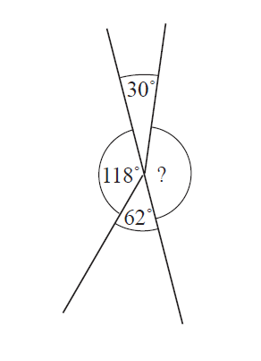
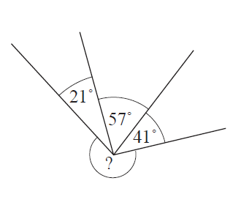
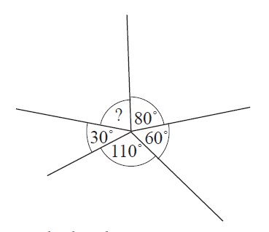
Skill Check: Angles on a Line and Angles at a Point
2. Calculate the unknown angle in each diagram.
(a)
(b)
(c)
75°
82°
144°
(d)
(e)
(f)
150°
80°
241°

Slide 24
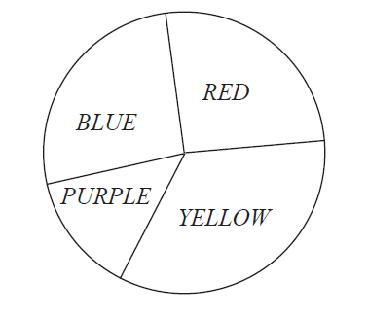
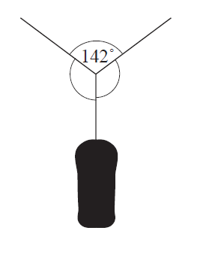
Skill Check: Angles on a Line and Angles at a Point
3. Some of the angles in the pie chart have been calculated:
Solution
Red 90°
Blue 95°
Purple 50°
360 ˚- (90˚ + 95˚ + 50˚) =
360 ˚- 235˚ =
= 125˚
What is the angle for yellow?
4. A boy hangs a punchbag on a washing line.
Find the unknown angles if both angles are the same size.
109˚
109˚
Solution
(360 ˚- 142˚)÷2 = 109˚

Slide 25
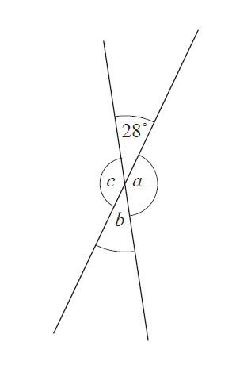
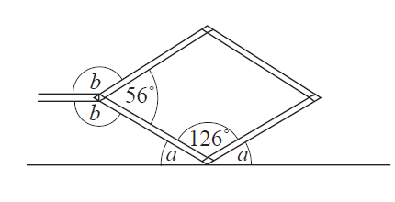
Skill Check: Angles on a Line and Angles at a Point
5. The diagram shows two straight lines. Find the angles a, b and c.
What do you notice?
Angle b = Angle a
= 152˚
Solution
Angle a = 180˚- 28˚
= 152˚
a
b
Vertically Opposite Angles are equal in size
c
Angle c = 28˚
6. The picture shown a jack, that can be used to lift up a car.
Find the angles marked a and b.
a
a
b
b
Angle a = (360˚- 56˚)÷2
= 152˚
Angle b = (180˚- 126˚)÷2 = 27˚

Slide 26
Section 4: Review
You have completed the fourth section.
If you have completed and mastered this section,
click to start the next Section
If you need more examples and interactive practice,
press here
You might also find it helpful to look at:
Essential Information: press here

Slide 27
Constructing Triangles
Here you will see how to construct triangles.
Example 1
Draw this triangle and measure the unknown angle.
Solution
First draw the base line of 8 cm.
At each end, use a protractor to draw lines at angles 50˚ and 30˚
to the line.
The intersection of these two lines is the third point of the triangle. This angle measures about 100 °.
100 °
50˚
30˚

Slide 28
Constructing Triangles
Example 2
Draw this triangle.
Solution
First draw the base line, AB, of length 9 cm.
Then set your compass so that the pencil tip is 8 cm from the point and draw an arc with its centre at A. Repeat with 7cm from B.
C
The point where the two arcs cross is the third corner of the triangle.
7 cm
8 cm
A
B

Slide 29
Skill Check: Constructing Triangles
Exercises
1. Draw these triangles accurately. In each triangle, measure the angles.
(a)
(b)
61˚
90˚
6.2 cm
5.1 cm
89˚
30˚
(c)
(d)
100˚
30˚
30˚

Slide 30
Section 5: Review
You have completed the fifth section.
If you have completed and mastered this section,
click to start the next Section
If you need more examples and interactive practice,
press here
You might also find it helpful to look at:
Essential Information: press here

Slide 31
Calculating Angles in Triangles
The interior angles of any triangle will always sum (add up) to 180 °
a
b
c
a + b + c = 180˚
Example
Find the angle marked a in the diagram opposite.
Solution
70 ˚+ 50 °= 120 °
So 180 ˚− 120 °= 60 °and a = 60°
60°

Slide 32
Calculating Angles in Triangles
The final part of this section deals with classification of triangles
Two equal angles and two equal sides
ISOSCELES TRIANGLE
All sides are the same length and all angles are 60˚
EQUILATERAL TRIANGLE
60˚
60˚
60˚
All angles and sides are different
SCALENE TRIANGLE

Slide 33
Skill Check: Calculating angles in Triangles
1. Find the unknown angle in each triangle.
(a)
(b)
(c)
25˚
63˚
50˚
(d)
(e)
(f)
37˚
125˚
48˚

Slide 34
Skill Check: Calculating angles in Triangles
2. Find the unknown angles in each of the following triangles.
10 ˚
85˚
60˚
50˚
50˚
85˚
60˚
60˚
29˚
29˚

Slide 35
Skill Check: Constructing Triangles
2. Which of these triangles can you draw?
(a)
(b)
(c)
59˚
32˚
34˚
86˚
35˚
53˚
95˚
44˚
102˚
(d)
(e)
60˚
Angles in triangles add up to 180˚
No
60˚
60˚

Slide 36
Skill Check: Calculating angles in Triangles
3. State whether each triangle below is isosceles, equilateral or scalene.
(a)
(b)
(c)
45˚
45˚
80˚
80˚
Scalene
Isosceles
Isosceles
(d)
60˚
60˚
60˚
Equilateral

Slide 37
Skill Check: Calculating angles in Triangles
4. For each triangle below, find the unknown interior angle and the marked exterior angle.
(a)
(c)
(b)
125˚
55˚
132˚
34˚
48˚
146˚
(d)
Angles on lines add up to 180˚
The two opposite internal angles add together to give the external angle
138˚
42˚
62˚ + 63˚ = 125˚

Slide 38
Skill Check: Calculating angles in Triangles
5. Explain how to find the exterior angle without having to calculate and interior angle. Find the exterior angles marked on these triangles
(a)
(b)
(c)
54˚+ 65˚ = 119˚
18˚+ 124˚ = 142˚
41˚+ 61˚ = 102˚
65˚+ 61˚ = 126˚
(d)
(e)
90˚+ 47˚ = 137˚
108˚+ 25˚ = 133˚
54˚+ 61˚ = 115˚
Rule: The two opposite internal angles add together to give the external angle

Slide 39
Skill Check: Calculating angles in Triangles
6. For each of the following triangles, draw in the exterior angles and find their total.
(a)
(b)
(c)
128˚
130˚
150˚
115˚
90˚
142˚
50˚
160˚
115˚
(d)
120˚
122˚
The total of all the external angles is 360˚
118˚

Slide 40
Skill Check: Calculating angles in Triangles
7. Find the unknown angle or angles marked in each of the following diagrams
(c)
(a)
(b)
41˚
90˚
69˚
90˚
(d)
(e)
(f)
120˚
70˚
50˚
40˚
65˚
120˚
110˚
65˚
115˚
60˚
70˚
120˚

Slide 41
Section 6: Review
You have completed the sixth section.
If you have completed and mastered this section,
click to start the next Section
If you need more examples and interactive practice,
press here
You might also find it helpful to look at:
Essential Information: press here

Slide 42
Angles in Polygons
Investigating the angle sum of a polygon
(i) Choose a corner on each polygon and radiate lines from this point to the other corners of the polygon
180˚
180˚
180˚
Quadrilateral
180˚
180˚
180˚
180˚
180˚
180˚
180˚
180˚
180˚
180˚
180˚
Pentagon
Hexagon
Heptagon
180˚
180˚
180˚
180˚
180˚
180˚
(ii) The angle sum of a triangle is 180˚
180˚
180˚
180˚
180˚
180˚
180˚
180˚
180˚
Decagon
Octagon

Slide 43
Skill Check: Angles in Polygons
(iii) Using the results on the previous slides, the angle sums are as follows:
Name
of polygon
Number
of sides
Number
of triangles
Angle Sum
of polygon
Quadrilateral
4
2
360˚
+180˚
Pentagon
5
3
540˚
+180˚
Hexagon
6
4
720˚
Heptagon
7
5
900˚
(iv) The Angle sum of a Triangle
= (3 – 2) x 180˚
= 1 x180˚ =180˚
Octagon
8
6
1080˚
Nonagon
9
7
1260˚
Decagon
10
8
1440˚
(iv) The number of Triangles =
Number of sides - 2
(v) The angle sum of a Polygon = (Number of sides – 2) x 180˚

Slide 44
Finding the internal, external and center angles
(i) To find the centre angle of a polygon radiate out lines from the centre to the opposite corners
51˚
51˚
45˚
45˚
60˚
60˚
45˚
72˚
72˚
60˚
51˚
51˚
45˚
45˚
72˚
72˚
60˚
60˚
51˚
51˚
45˚
60˚
45˚
72˚
51˚
45˚
The Centre Angle =
360˚÷ Number of sides
(ii) To find the internal angle divide the Angle Sum by the number of sides. The internal and external angles will add up to 180˚
108˚
120˚
129˚
135˚
51˚
72˚
45˚
60˚
The external Angle =
Centre Angle

Slide 45
Skill Check: Polygons
Centre Angle = 360˚÷ Number of sides
External + Internal = 180˚
Centre Angle = External Angle
All the External angles add up to 360˚
72˚
72˚
72˚
72˚
72˚
1. Calculate the size of the exterior angles of a regular polygon which has interior angles of:
(a) 150˚
30˚
(b) 175 °
5˚
(c) 162 °
18˚
(d) 174 °
6˚
2. Calculate the sizes of the exterior and interior angles of:
(a) a regular octagon
45˚, 135˚
a regular decagon.
36˚,144˚
3. (a) Calculate the size of the interior angles of a regular 12-sided polygon and find the angle sum of the polygon
Exterior Angle = 360˚÷12 = 30˚
Angle Sum = 150˚x 12 = 1800˚
Interior Angle = 180˚ - 30˚= 150˚

Slide 46
Skill Check Polygons
(a) What is the size of the interior angle of a regular 20-sided polygon?
What is the sum of the interior angles of a regular 20-sided polygon?
Calculate the size of the exterior angle of a regular pentagon.
6. The size of the exterior angle of a regular polygon is 12 °. How many sides does this polygon have?
180˚- (360˚÷ 20) = 180˚- 18˚= 162˚
162˚ x 20 = 3240˚
180˚÷ 5 =72˚
Number of sides = 360˚÷ 12 °= 30 sides
7. Calculate the number of sides of a regular polygon with interior angles of:
(a) 150 °
(b) 162 °
360˚÷ 30˚ = 12 sides
(c) 175 °
(d) 174 °
360˚÷ 5˚ = 72 sides
360˚÷ 18˚ = 20 sides
360˚÷ 6˚ = 60 sides

Slide 47
Skill Check Polygons
8. Complete the following table for regular polygons.
90˚
360˚
72˚
108˚
540˚
60˚
120˚
720˚
≈ 51˚
129˚
900˚
45˚
135˚
1080˚
40˚
140˚
1260˚
36˚
144˚
1440˚
30˚
150˚
1620˚

Slide 48
Section 7: Review
You have completed the seventh section.
If you have completed and mastered this section,
click to start the next Section
If you need more examples and interactive practice,
press here
You might also find it helpful to look at:
Essential Information: press here

Slide 49






Angles on Parallel Lines
(a) Opposite Angles
When any two lines cross, two pairs of equal angles are formed. The two angles marked a are a pair of opposite equal angles. The angles marked b are also a pair of opposite equal angles.
(a)
(b)
(b) Corresponding Angles
When a line crosses a pair of parallel lines, a = b. The angles a and b are called corresponding angles.
$$>$$
$$>$$
(c)
(c) Alternate Angles
The angles c and d are equal.
$$>$$
(d)
$$>$$
$$>$$
(d) Supplementary Angles
The angles b and c add up to 180°.
$$>$$

Slide 50
Angles on Parallel Lines
Example 1
Find the angles marked a, b and c.
Solution
There are two pairs of opposite angles here so: b = 100˚, a = c = 180˚- 100˚ = 80˚
100˚
80˚
80˚
100˚
Example 2
Find the sizes of the angles marked a, b, c and d in the diagram.
Solution
First note the two parallel lines marked with arrow heads.
so: c= b = a = 70˚, d = 180˚- b = 110˚
70˚
70˚
110˚
70˚
70˚
Note: Angles between Parallel lines add up to 180˚

Slide 51
Skill Check: Angles on Parallel Lines
1. Find the size of the angles marked a, b, c, etc.
60˚
123˚
120˚
38˚
57˚
60˚
100˚
100˚
145˚
145˚
80˚
50˚
35˚

Slide 52
Skill Check: Angles in Polygons
2. Find the size of the angles marked a, b, c, etc.
60˚
42˚
40˚
60˚
140˚
120˚
42˚
138˚
25˚
80˚
100˚
100˚
80˚
25˚
155˚
124˚
56˚

Slide 53
Skill Check: Angles on Parallel Lines
3. Find the size of the angles marked a, b, c, etc.
70˚
a = 60˚
b = 110˚
c = 70˚
d = 120˚
140˚
70˚
52˚
75˚
a = 52˚
b = 128˚
c = 52˚
d = 128˚
128˚
a = 75˚
b = 105˚
c = 75˚
d = 105˚
105˚

Slide 54
Section 8: Review
You have completed the eighth section.
If you have completed and mastered this section,
click to start the next Section
If you need more examples and interactive practice,
press here
You might also find it helpful to look at:
Essential Information: press here

