Slide 1
Supporting and Enhancing Mathematics and Statistics Unit: BIDMAS, Indices, Standard Form

Slide 2
Title
The following unit of work is divided into the following 5 sections
BIDMAS
Division Methods for Whole Numbers and Decimals
Index Notation
Rules of Indices for Multiplication and Division
Standard Form

Slide 3
BODMAS
The order in which operations must be carried out is summarised by BODMAS
Brackets first
I
Divide
Multiply
Add
Subtract
Example
Calculate (a) 16×2 + 3, (b) 16 x (2 + 3)
Solution
16 x 2 + 3 = 32 + 3 = 35 (M before A)
16 x (2+3) = 16 x 5 = 80 (B before M)
Example
Use Brackets to make the calculation correct (a) 17×5 - 3 = 34
Solution
17 x (5 – 3) = 17 x 2 = 34

Slide 4
Skill Check: BODMAS
Exercise
1. Is each of these statements true or false ?
(a) 10 ÷ 2 + 4 = 2
(b) 12 + 8 ÷ 2 = 10
F
F
(c) 13 + 12 ÷ 4 = 6
F
(d) 6 ÷ 2 + 3 = 6
T
2. Find:
(a) 3 + 4 x 8
35
(b) 8 + 3 x 6
26
(c) 8 x 6 - 4
44
(d) 12 ÷ 2 + 5
11
(e) 5 - 12 ÷ 3
1
(f) 14 ÷ 2 + 8
15
(g) 3 x 2 + 8 ÷ 4
8
(h) 3 x 6 - 15 ÷ 3
13
(i) 42 ÷ 7 + 3
9
(j) 16 ÷ 4 + 24 ÷ 6
8
(k) 8 x 2 + 5 x 3
31
(l) 8 x 6 - 45 ÷ 5
39
(m) 6 + 7 x 2 - 20 ÷ 4
15
(n) 18 x 2 – (4 + 7)
25
(o) (16 – 5) x 2 + 4
26

Slide 5
Skill Check: BODMAS
3. Decide whether each statement below is true (T) or false (F)
(a) (3 x 6) x 2 = 3 x (6 x 2)
T
(c) (4 + 2) + 7 = 4 + (2 + 7)
T
(b) (8 - 2) -1 = 8 - (2 - 1)
F
(d) (8÷4) ÷ 2 = 8÷(4 ÷ 2)
F
4. Put brackets in each statement below to make it correct
(a) 13 – 4 - 1 = 10
(b) 30 – 9 + 2 = 19
13 – (4 - 1) = 10
30 – (9 + 2) = 19
(c) 60÷6÷3 = 30
(d) 20 – 4 x 2 = 32
60 ÷ (6÷3) = 30
(20 – 4) x 2 = 32
5. Fill in the missing numbers in each of the questions below
4
(a) 0.8 + x 0.6 = 3.2
(b) x 0.5 + 6 x 0.4 = 3.9
3
0.8
(c) 0.9 + 4.8 ÷ = 6.9
(d) 2.7 ÷ – 1.4 = 1.6
0.9

Slide 6
Section 1: Review
You have completed the first section.
If you have completed and mastered this section, click to start the next Section
If you need more examples and interactive practice, press here
You might also find it helpful to look at:
Essential Information: press here

Slide 7
Skill Check: Division Problems
Care must be taken when handling divisions, particularly when they involve decimals.
Example
Find
(a) 1300 ÷ 100
(b) 17. 5 ÷ 5
(c) 63. 1÷ 4
Solution
(a) 1300 ÷ 100 = $\frac{1300}{100}$ = 13
0.35
(b) 1.75 ÷ 5 = 0.35
since
5
2
1.75
157
(c) 631 ÷ 4 gives
4
r 3
157.75
2
631
3
4
2 3 3 2
Alternatively, to get the answer in decimal form
631.00

Slide 8
Skill Check: Division Methods
Exercise
1. Find:
(a) 12 ÷ 10
1.2
(b) 4200 ÷ 10
(d) 3714 ÷ 10
(f) 6000 ÷ 100
(h) 75 000 ÷ 100
(j) 3714 ÷ 100
(k) 642 130 ÷ 10 000
420
(c) 600 000 ÷ 10
(e) 5728 ÷ 10
(g) 7000 ÷ 1000
(i) 750 ÷ 100
(k) 8412 ÷ 100
60 000
371.4
572.8
60
7
750
7.5​
37.14
84.12
64.213
2. Carry out the following divisions.
(a) 69 ÷ 3
(b) 2947 ÷ 7
(c) 2208 ÷ 12
(d) 10 530 ÷ 45
(e) 6612 ÷ 3
(f) 37 050 ÷ 5
23
(g) 4545 ÷ 9
(h) 7404 ÷ 6
(i) 13 488 ÷ 24
(j) 4284 ÷ 18
505
421
1234
184
562
234
238
2204
(k) 1792 ÷ 32
(l) 10 496 ÷ 41
56
7410
256

Slide 9
Skill Check: Division Methods
3. Carry out the following divisions.
(f) 10.24 ÷ 4
(g) 49.24 ÷ 4
(h) 714.84 ÷ 6
(i) 123.55 ÷ 5
(l) 123.84 ÷ 12
2.56
(a) 2.54 ÷ 2
(b) 87.5 ÷ 5
(c) 388.5 ÷ 15
(d) 21.63 ÷ 3
(e) 918.4 ÷ 7
1.27
12.31
17.5
25.9
119.14
7.21
24.71
131.2
10.32
4. Carry out the following divisions, giving your answers as decimals.
(a) 21 ÷ 4
5.25
(b) 81 ÷ 2
40.5
(c) 162 ÷ 4
40.5
(d) 263 ÷ 4
65.75
(e) 84 ÷ 8
10.5
(f) 241 ÷ 8
30.125
5. Answer the following using order of precedence.
9
18
(a) 12 ÷ 4 + 2 x 3
(c) 36 ÷ 6 + 24 ÷ 8 + 81 ÷ 9
(b) 15 ÷ 3 - 48 ÷ 12
1
(d) 5 x 6 + 9 ÷ 3 - 3 x 4
21

Slide 10
Skill Check: Division Problems
1. A mini chocolate bar costs 8p. How many bars can be bought with 72p?
2. A multi storey car park has 4 levels, each taking the same number of cars. When full it holds 124 cars. How many cars can park at each level?
3. A train can carry 384 passengers. If has 8 carriages, each with the same seating capacity. How many people can each carriage hold?
4. Rafiq borrows £50 from his Dad. He pays it back in 10 equal weekly instalments. How much does he pay back each week?
9 bars
124 ÷ 4 = 31 cars
384 ÷ 8 = 48
£50 ÷ 10 = £5

Slide 11
Skill Check: Division problems
5. £375.69 is raised at a jumble sale. This is divided equally between3 charities. How much does each of the charities get?
6. Grace and her 3 brothers are given £37 to share equally between them. How much do they get each?
7. Charlotte has 24 sweets. She shares them out equally between herself and her 3 friends. How many sweets do they get each?
8. Three children are paid £15 for working in a garden. They share the money equally between them. How much do they get each?
£379.69 ÷ 3 = £126.56
£37 ÷ 4 = £9.25
24 ÷ 4 = 6 sweets
£15 ÷ 3 = £5

Slide 12
Skill Check: Division Problems
8. A baker mixes 1944 grams of dough. It is used to make 12 small loaves of equal weight. How much dough is used in each loaf?
9. Rachel, Ben, Emma and Hannah are given £5.50 to share equally between them. Describe the problem they have.
10. 40 children want to go on a school trip to Wimbledon. They will be taken in minibuses that each hold 13 passengers. How many minibuses will be needed for the trip?
11. How many chocolate bars costing 23p each can I buy with £2?
12. The 'Oblivion' ride at Alton Towers takes 16 people each time it goes around. How many times must it go around if 70 people want to have a go?
1944 ÷12 = 162 g
£5.50 ÷ 4 = £1.38
40 ÷ 13 = 3.0769, 4 minibuses
£2 ÷ £0.23 = 8.7, 8 bars
70 ÷ 16 = 4.375, 5 revolutions

Slide 13
Section 2: Review
You have completed the second section.
If you have completed and mastered this section, click to start the next Section
If you need more examples and interactive practice, press here
You might also find it helpful to look at:
Essential Information: press here

Slide 14
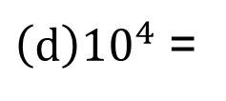
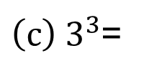
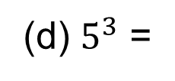
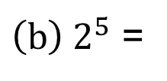
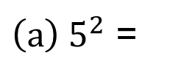
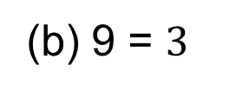
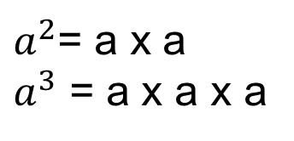
Index Notation
Here we revise the use of index notation. You will already be familiar with the notation for squares and cubes.
$a^{2}$= a x a
$a^{3}$ = a x a x a
Example 1
Calculate the value of:
${\left(a\right) 5}^{2}$ =
5 x 5
${\left(b\right) 2}^{5}$ =
2 x 2 x 2 x 2 x 2
${\left(c\right) 3}^{3}$=
3 x 3 x 3
${\left(d\right)10}^{4}$ =
10 x 10 x 10 x 10
Example 2
Copy each of the following statements and fill in the missing number or numbers:
7
(d) $5^{3}$ =
5 x 5 x 5 =
125
${ (a) 2}^{}$ = 2 x 2 x 2 x 2 x 2 x 2 x 2
2
(e) $2^{5}÷ 2^{3}$ =
32
8
=
4
(b) 9 = $3^{}$
÷
3
(c) 1000 =
10

Slide 15

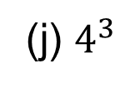

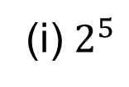



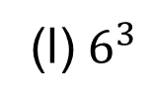

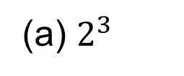
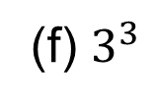

Skill Check: Index Notation
Exercise
1. Calculate
(a) $2^{3}$
8
(b) ${10}^{2}$
100
(c) $3^{2}$
9
(d) ${10}^{3}$
1000
(e) $9^{2}$
81
(f) $3^{3}$
27
(g) $2^{4}$
16
(h) $3^{4}$
81
(i) $2^{5}$
32
(j) $4^{3}$
64
(k) $5^{3}$
125
(l) $6^{3}$
216
2. Copy each of the following statements and express in index notation
(a) 10 x 10 x 10 x 10 x 10 =
(b) 3 x 3 x 3 x 3 =
$${10}^{5}$$
$$3^{4}$$
$$7^{5}$$
(c) 7 x 7 x 7 x 7 x 7 =
(d) 8 x 8 x 8 x 8 x 8 =
(e) 5 x 5 =
(f) 19 x 19 x 19 x 19 =
(g) 6 x 6 x 6 x 6 x 6 x 6 x 6 =
(h) 11 x 11 x 11 x 11 x 11 x 11 =
$$8^{5}$$
$$5^{2}$$
$${19}^{4}$$
$$6^{7}$$
$${11}^{6}$$

Slide 16
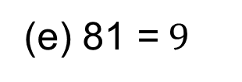
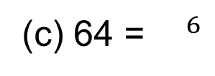
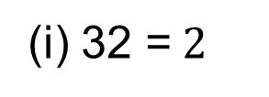
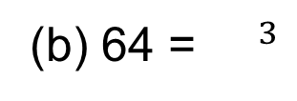
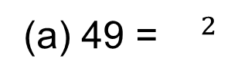
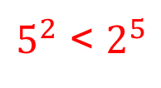
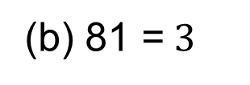
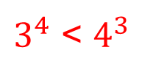
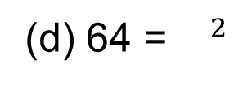
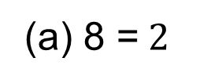
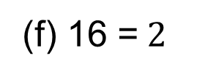
Skill Check: Index Notation
3. Copy each of the following statements and fill in the missing numbers:
3
3
6
(a) 8 =${ 2}^{}$
(d) 216 =${ 6}^{}$
(g) 1 000 000 =${ 10}^{}$
2
4
4
(e) 81 =${ 9}^{}$
(f) 625 =${ 5}^{}$
(b) 81 =${ 3}^{}$
4
5
3
(f) 16 =${ 2}^{}$
(i) 32 =${ 2}^{}$
(c) 125 =${ 5}^{}$
4. Is ${10}^{2}$ bigger than $2^{10}$ ?
${10}^{2}$ < $2^{10}$
$3^{4}$ < $4^{3}$
5. Is $3^{4}$ bigger than $4^{3}$ ?
$5^{2}$ < $2^{5}$
6. Is $5^{2}$ bigger than $2^{5}$ ?
7. Copy each of the following statements and fill in the missing numbers:
(c) 64 =${ }^{ 6}$
(a) 49 =${ }^{2}$
(b) 64 = ${ }^{ 3}$
2
7
4
(f) 243 = ${ }^{5}$
(d) 64 =${ }^{ 2}$
(e) 100 000 = $^{ 5}$
3
8
10

Slide 17
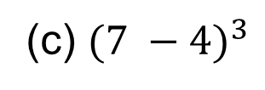
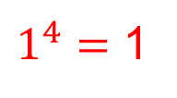
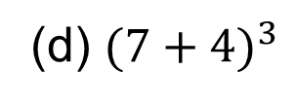
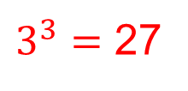
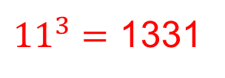
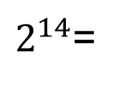
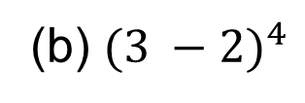
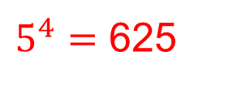
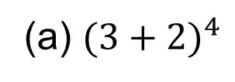
Skill Check: Index Notation
8. Calculate:
(a) $2^{2}$ +${ 2}^{3}$ =
4 + 8 = 12
(d) $2^{3}$ x ${10}^{3}$ =
8 x 1000 = 8000
(b) $2^{2}$ x $2^{3}$ =
4 x 8 = 32
(e) $3^{2}$ x $2^{2}$ =
9 x 4 = 36
(c) $3^{2}$ +$2^{2}$ =
9 + 4 = 13
(f) ${10}^{3}$ + $2^{5}$ =
1000 + 32 = 1032
9. Calculate:
(a) ${(3+2)}^{4}$
(b) ${(3 −2)}^{4}$
(c) ${(7 −4)}^{3}$
(d) ${(7+4)}^{3}$
$5^{4}=$ 625
$1^{4}=$ 1
$3^{3}=$ 27
${11}^{3}=$ 1331
10. Without using a calculator, write down the values of k and m.
64 = $8^{2}$ = $4^{k}= 2^{m}$
K = 3
m = 6
11. Complete the following without a calculator
$2^{15}$= 32 768
$2^{14}$=
16 384

Slide 18
Section 2: Review
You have completed the second section.
If you have completed and mastered this section, click to start the next Section
If you need more examples and interactive practice, press here
You might also find it helpful to look at:
Essential Information: press here

Slide 19
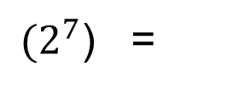
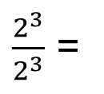
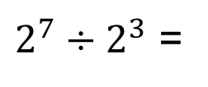
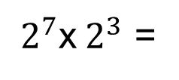
Rules for Indices
There are four rules that should be used when working with indices:
When m and n are positive integers,
1. $a^{m}$×$a^{n}$ = $a^{n+m}$
2. $a^{m}$÷$a^{n}$ =${ a}^{m−n}$ or $\frac{a^{m}}{a^{n}}$ = ${ a}^{m−n}$
3. ($a^{m})$ = $a^{mn}$
4. Using rule 2. $\frac{a^{m}}{a^{m}}$ = $a^{0}$= 1
n
Examples
$2^{7}$x${ 2}^{3}$ =
(2 x 2 x 2 x 2 x 2 x 2 x 2 ) x (2 x 2 x 2) = $2^{10}$
$2^{7}÷{ 2}^{3}$ =
$\frac{\text{2 }\text{x}\text{ 2 }\text{x}\text{ 2 }\text{x}\text{ 2 }\text{x}\text{ 2 }\text{x}\text{ 2 }\text{x}\text{ 2 }}{\text{2 }\text{x}\text{ 2 }\text{x}\text{ 2}}$ = 2 x 2 x 2 x 2 = $2^{4}$
3
${(2}^{7}$) =
${2^{7}\text{x} 2}^{7}$x${ 2}^{7}$ = $2^{7+7+7}$= $2^{21}$
$\frac{2^{3}}{2^{3}}$ =
$\frac{\text{2 }\text{x}\text{ 2 }\text{x}\text{ 2}}{\text{2 }\text{x}\text{ 2 }\text{x}\text{ 2}}$ = $2^{0 }$= 1

Slide 20
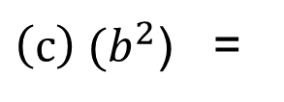
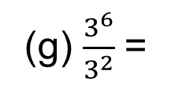
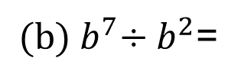
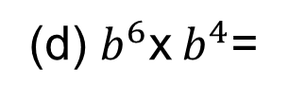
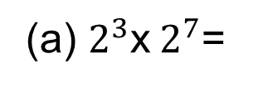
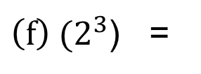
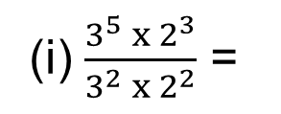
Skill Check: Rules for Indices
Exercises
1. Copy each of the following statements and fill in the missing numbers:
$$2^{10}$$
$$8^{7}$$
(g) $\frac{3^{6}}{3^{2}}$=
$$3^{4}$$
(a) $2^{3}$x${ 2}^{7}$=
(d) $8^{3}$x${ 8}^{4}$=
$$3^{11}$$
5
$$3^{10}$$
(h) $\frac{4^{7}}{4^{2}}$=
$$4^{5}$$
(b) $3^{6}$x${ 3}^{5}$ =
(e) ${(3}^{2}$) =
$$3^{3}$$
6
$$2^{18}$$
(i) $\frac{3^{5}{ x 2}^{3}}{3^{2}{ x 2}^{2}}$ =
$3^{3}$x 2
(c) $3^{7}÷{ 3}^{4}$=
${\left(f\right) (2}^{3}$) =
2. Copy each of the following statements and fill in the missing numbers:
(d) $b^{6}$x${ b}^{4}$=
$$b^{10}$$
(g) $\frac{c^{6}{ x d}^{7}}{c^{2}{ x d}^{4}}$ =
$c^{4}$x$d^{3}$
(a) $a^{3}$x${ a}^{2}$ =
$$a^{5}$$
9
$$z^{27}$$
(h) $\frac{f^{5}{ x g}^{3}}{f^{2}x g}$ =
${(b) b}^{7}÷{ b}^{2}$=
$$b^{5}$$
${\left(e\right) (z}^{3}$) =
$f^{3}$x$g^{2}$
5
(f) $\frac{q^{16}}{q^{7}}$=
$$q^{9}$$
${\left(c\right) (b}^{2}$) =
$$b^{10}$$
(i) $\frac{a^{5}{ x b}^{3}}{b^{2}{ x a}^{2}}$ =
$a^{3}$x b

Slide 21
Skill Check: Rules for Indices
4
Explain why $9^{4}$ = $3^{8}$
4. Calculate:
$3^{8 }$= ($3^{2}$) = 9 x 9 x 9 x 9 = $9^{4}$
1 + 1 = 2
1 x 1 = 1
(a) $3^{0}+4^{0}$ =
(c) $8^{0} x 3^{0}$ =
(b) $6^{0}− 7^{0}$ =
1 - 1 = 0
(d) $6^{0}+2^{0}$ - $4^{0}=$
1 + 1 - 1 = 1
5. Copy each of the following statements and fill in the missing numbers:
3
6
11
(e) ($z^{}) = z^{18}$
${(a) 3}^{6}$x${ 3}^{}$ = $3^{17}$
9
5
${(f) p}^{16}÷{ p}^{}$= $p^{7}$
${\left(b\right) 4}^{6}$x${ 4}^{}$ = $4^{11}$
8
5
(c) $\frac{a^{6}}{a^{}}$ = $a^{4}$
(g) ($p^{}) = p^{40}$
2
5
12
(d) ($a^{19}) = a^{95}$
${(h) q}^{13}÷{ q}^{}$ = q

Slide 22
Skill Check: Rules for Indices
6. Calculate
(a) $\frac{2^{3}}{2^{2}}+ 3^{0}$ =
(b) $\frac{5^{4}}{5^{2}}+\frac{6^{2}}{6^{1}}$=
25 +6 = 31
2 + 1 = 3
(d) $\frac{7^{7}}{7^{5}}− \frac{5^{9}}{5^{7}}$=
49 - 25 = 24
(c) $\frac{3^{4}}{3^{3}}− 3^{0}$ =
3 - 1 = 2
(e) $\frac{{10}^{8}}{{10}^{5}}− \frac{5^{6}}{5^{3}}$=
(f) $\frac{4^{17}}{4^{14}}−\frac{4^{13}}{4^{11}}$=
64 -16 = 48
1000 - 125 = 875
7. Copy and complete each expression
(d) (${ \frac{3^{2} x 9}{3^{3}} )}^{4}$= ($3^{}) =3^{}$
9
4
36
1
4
4
(a) ($2^{6}{x 2^{3})}^{4}$= ($2^{}) =2^{}$
(e) (${ \frac{6^{2} x 6^{8}}{6^{3}} )}^{4}$= ($6^{}) =6^{}$
(b) ( ${\frac{{ 3}^{6}}{3^{2}} )}^{5}$= ($3^{}) =3^{}$
7
4
28
4
5
20
(f) (${ \frac{7^{8}}{7^{2} x{ 7}^{3} } )}^{5}$= ($7^{}) =7^{}$
(c) (${ \frac{2^{3} x 2^{4}}{2^{7}} )}^{4}$= ($2^{}) =2^{}$
3
5
15
0
4
0

Slide 23
Section 4: Review
You have completed the fourth section.
If you have completed and mastered this section, click to start the next Section
If you need more examples and interactive practice, press here
You might also find it helpful to look at:
Essential Information: press here

Slide 24
Standard Form
Standard form is a convenient way of writing very large (or very small) numbers. It is used on a scientific calculator when a number is too large or too small to be displayed on the screen.
Example 1
Calculate:
(a) 3 x ${10}^{4}$
3 x 10 00 = 30 000
(b) 3.27 x ${10}^{3}$
3.27 x 1000 = 3270
(c) 3 ÷ ${10}^{2}$
3 ÷ 100 = 0.03
(d) 4.32 ÷ ${10}^{4}$
4.32 ÷ 10 00 = 0.000432
In standard form numbers are written as a x ${10}^{n }$ where
1< a < 10 and n is an integer
Example 2
Write the following numbers in standard form:
(a) 57200
5.72 x ${10}^{4}$
(c) 473 000
4.73 x ${10}^{5}$
(b) 7.4
7.4 x ${10}^{0}$
(d) 6 000 000
6 x ${10}^{6}$

Slide 25
Standard Form
Example 3
Calculate, writing your answer in standard form :
(a) ( 3 x ${10}^{6}$) x ( 4 x ${10}^{3}$)
(b) ( 6 x ${10}^{7}$) ÷ ( 5 x ${10}^{2}$)
(c) ( 3 x ${10}^{4}$) + ( 2 x ${10}^{5}$)
Solution
(a) ( 3 x ${10}^{6}$) x ( 4 x ${10}^{3}$)
= ( 3 x 4 ) x (${10}^{6}$ x ${10}^{3}$)
= 12 x ${10}^{9}$
= 1.2 x ${10}^{10}$
(b) ( 6 x ${10}^{7}$) ÷ ( 5 x ${10}^{2}$)
= ( 6 ÷ 5 ) x (${10}^{7}$ ÷ ${10}^{2}$)
= 1.2 x ${10}^{5}$
(c) ( 3 x ${10}^{4}$) + ( 2 x ${10}^{5}$)
= 30 000 + 200 000
= 230 000
= 2.3 x ${10}^{5}$

Slide 26
Skill Check: Standard Form
Exercise
1. Calculate
(a) 6.21 x 1000
6210
(b) 8 x ${10}^{3}$
8000
(c) 4.2 x ${10}^{2}$
420
(e) 6 ÷${10}^{2}$
(f) 3.2 ÷ ${10}^{3}$
0.0032
(d) 3 ÷ 1000
0.003
0.06
2. Write the following numbers in standard form
2 x ${10}^{2}$
200
8000
9 000 000
62 000
840 000
12 000 000 000
61 800 000 000
3 240 000
8 x ${10}^{3}$
9 x ${10}^{6}$
6.2 x ${10}^{4}$
8.4 x ${10}^{5}$
12 x ${10}^{9}$ = 1.2 x ${10}^{10}$
6.18 x ${10}^{10}$
3.24 x ${10}^{6}$

Slide 27
Skill Check: Standard Form
3. Convert each of the following numbers from standard form to the normal decimal notation
(a) 3 x ${10}^{4}$
30 000
(b) 1.72 x ${10}^{5}$
172 000
(c) 3.6 x ${10}^{4}$
36 000
(d) 6.83 x ${10}^{4}$
68 300
(e) 8.2 x ${10}^{3}$
8200
(f) 1.6 x ${10}^{4}$
16 000
(g) 1.25 x ${10}^{6}$
1 250 000
(h) 9.17 x ${10}^{3}$
9 170
4. Without using a calculator, determine:
(a) ( 4 x ${10}^{4}$) x ( 2 x ${10}^{5}$)
8 x ${10}^{9}$
(b) ( 2 x ${10}^{6}$) x ( 3 x ${10}^{5}$)
6 x ${10}^{11}$
(c) ( 6 x ${10}^{4}$) x ( 8 x ${10}^{9}$)
48 x ${10}^{13}$ = 4.8 x ${10}^{14}$
(d) ( 3 x ${10}^{8}$) x ( 7 x ${10}^{4}$)
21 x ${10}^{12}$ = 2.1 x ${10}^{13}$
(f) ( 9 x ${10}^{7}$) ÷ ( 3 x ${10}^{4}$)
3 x ${10}^{3}$
(g) ( 8 x ${10}^{5}$) ÷ ( 2 x ${10}^{2}$)
4 x ${10}^{3}$
(h) ( 4.8 x ${10}^{12}$) ÷ ( 1.2 x ${10}^{3}$)
4 x ${10}^{9}$
(i) ( 3.6 x ${10}^{8}$) ÷ ( 9 x ${10}^{3}$)
0.4 x ${10}^{5}$ = 4 x ${10}^{4}$

Slide 28
Section 5: Review
You have completed the fifth section.
If you have completed and mastered this section, click to start the next Section
If you need more examples and interactive practice, press here
You might also find it helpful to look at:
Essential Information: press here

