Slide 1
Supporting and Enhancing Mathematics and Statistics Unit: Negative Numbers

Slide 2
Negative Numbers
This unit of work is divided into the following four sections:
Negative Numbers in Context
Addition and Subtraction
Multiplication and Division
Negative Number Problems

Slide 3
Negative Numbers in Context
We extend our number system now to include negative numbers. It is useful to use a number line to illustrate this concept.
You can see, for example,
–2 < 4
–6 < –3
5 > –4
–1 > –7
Remember: ‘<’ means ‘is less than’,
‘>’ means ‘is more than’.
You can check all these by looking at their positions on the number line.
Example
Make each statement below true by using the symbols < or >.
$−$5
4
3
<
7
$−$6
<
$−$9
2
<
$−$2
<

Slide 4
Skills Check: Negative Numbers in Context
Exercises
1. What temperature is:
(a) 3°C warmer than –1°C
(b) 6°C colder than –3°C
(c) 5°C warmer than –5°C
(d) 8°C warmer than –7°C
(e) 5°C colder than –2°C
(f) 3°C colder than 1°C
(g) 6°C colder than 2°C
(h) 8°C warmer than –12°C
2. What number is:
2°C
(a) 3 more than –2
(b) 5 more than –7
(c) 5 less than –4
(d) 5 more than –20
(e)12 less than 10
1
$−$9°C
$−$2
0°C
$−$9
1°C
$−$15
$−$7°C
$−$2
$−$2°C
(f) 6 less than 1
(g) 6 more than –10
(h) 16 less than 3
$−$5
$−$4°C
$−$4
$−$4°C
$−$13
3. Write each set of numbers in order with the smallest first.
(a) 6, –7, 8, –2, –5, –10, 3
(b) 3, –2, 8, 0, –1, 1, –3
(c) 5, –7, –20, 100, –50, –90, 60
$−$10, $−$7, $−$5, $−$2, 3, 6
$−$3, $−$2, $−$1, 0, 1, 3, 8
$−$90, $−$50, $−$20, $−$7, 5, 60, 100

Slide 5
Skills Check: Negative Numbers in Context
Exercises
4. Put either a < or > sign between each pair of numbers to give a true statement.
4
<
2
$−$6
<
$−$2
$−$3
<
$−$4
2
<
$−$4
2
<
6
$−$6
<
$−$7
$−$1
<
0
$−$3
<
$−$7
5. Is each statement below true (T) or false (F)?
(g) 5 > –6
(h) –1 > 0
(i) –7 < 6
(d) –3 < 2
(e) –4 > –3
(f) 4 > 3
T
T
6 > 7
8 > –1
–6 < –7
F
T
F
F
F
T
T

Slide 6
Section 1: Review
You have completed the first section.
If you have completed and mastered this section, click to start the next Section
If you need more examples and interactive practice, press here
You might also find it helpful to look at:
Essential Information: press here

Slide 7
Adding and Subtracting
In this section we consider how to add and subtract when working with negative numbers. This can be shown by using a number line.
To add a positive number, move to the right on a number line.
To add a negative number, move to the left on a number line.
Example
(a) −3 + 8
Start at −3 and move 8 to the right:
so, −3 + 8 = 5.

Slide 8
Adding and Subtracting
Example
(b) 4 + ($−$2)
Start at 4 and move 2 to the left:
so, 4 + ($−$2) = 2
Example
(c) $−$8 + 5
Start at −8 and move 5 to the right:
so, $−$8 + 5 = $−$3

Slide 9
Adding and Subtracting
Example
(d) −1 + ($−$3)
Start at −1 and move 3 to the left:
so, −1 + ($−$3) = $−$4
Subtraction is the inverse (or opposite) of addition, so
when we subtract a positive number, move to the left on a number line;
when we subtract a negative number, move to the right on a number line.

Slide 10
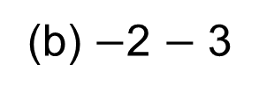
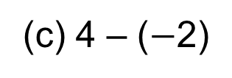
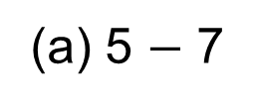
Adding and Subtracting
Example
(a) 5 $−$ 7
Start at 5 and move 7 to the left:
so, 5 $−$ 7 = $−$2
(b) $−$2 $−$ 3
Start at $−$2 and move 3 to the left:
so, $−$2 $−$ 3 = $−$5
(c) 4 – ($−$2)
Start at 4 and move 2 to the right:
so, 4 – ($−$2 ) = 6

Slide 11
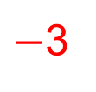
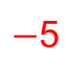
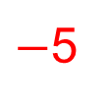
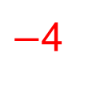
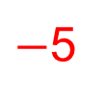
Skills Check: Adding and Subtracting
Exercises
1. Use a number line to work out the following calculations:
(a) −4 + 6
(b) −4 + 7
(c) −2 + (−3)
(d) −6 + 2
2
(e) −5 + 8
(f) 2 + (−3)
(g) −6 + 6
(h) −7 + 2
3
(i) −1 + 3
(j) −1 + (−4)
(k) −7 + 4
(l) 5 + (−5)
2
3
-1
$−$5
$−$5
0
$−$3
$−$4
$−$5
0
2. Use a number line to calculate:
4 − 6
−1 − 1
3 − (−4)
−5 − (−1)
$$−2$$
(e) 5 − 7
(f) −3 − 2
(g) 5 − (−6)
(h) 4 − 9
$$−2$$
(i) 2 − 4
(j) −4 − (−1)
(k) 8 – 12
(l) −4 − (−4)
$$−2$$
$$−2$$
$$−5$$
$$−3$$
7
11
$$−4$$
$$−4$$
$$−5$$
0

Slide 12
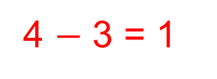
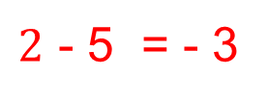
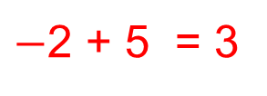
Skills Check: Adding and Subtracting
3. Write down the two possible sums that could be shown by each number line.
4 $−$ 3 = 1
4 + ($−$3) = 1
$−$2 + 5 = 3
$−$2 – ($−$5 ) = 3
$2$ - 5 = - 3
$2$ + ($−$5 ) = - 3

Slide 13
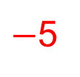
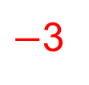
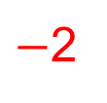
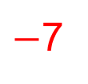
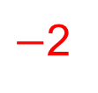
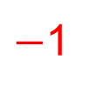
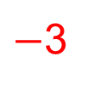
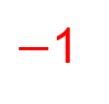
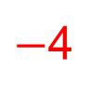
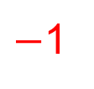
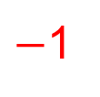
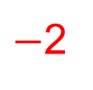
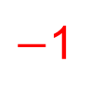
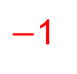
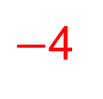
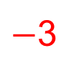
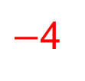
Skills Check: Adding and Subtracting
4. Copy and complete this
addition table.
5. Fill in the missing numbers
on a copy of this addition table.
0
2
4
$−$7
$−$5
$−$3
$−$1
1
$−$4
$−$3
$−$2
$−$5
$−$3
$−$1
1
3
$−$4
$−$4
$−$2
$−$1
0
$−$3
$−$1
1
3
5
$−$3
$−$3
$−$2
$−$1
1
$−$1
1
3
5
7
$−$2
$−$1
1
2

Slide 14
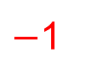
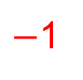

Skills Check: Adding and Subtracting
6. Copy these equations and fill in the missing numbers:
$−$3
9
$−$1
(a) 4 +..... = 1
(b) 3 − .....= −6
(c) −6 +..... = −7
$−$5
$−$1
$−$3
(d) ..... + 7 = 2
(e) ..... −7 = −8
(f) 4 −..... = 7
7. Write down the next 5 terms in each sequence:
(a) 10, 8, 6, 4, . . .
(b) −10, −7, −4, −1, . . .
(c) 19, 14, 9, 4, . . .
(d) −1, −3, −5, −7, . . .
(e) −20, −16, −12, −8, . . .
(f) −5, −10, −15, −20 . . .
(g) 18, 15, 12, 9, . . .
2, 0, $−$2, $−$4, $−$6,….
2, 5, 8, 11, 14,….
$−$1, $−$6, $−$11, $−$16, $−$21,…
$−$9, $−$11, $−$13, $−$15, $−$17,…
$−$4, 0, 4, 8, 12,….
$−$15, $−$20, $−$25, $−$35, $−$40,…
6, 3, 0, $−$3, $−$6, ….

Slide 15
Section 2: Review
You have completed the second section.
If you have completed and mastered this section, click to start the next Section
If you need more examples and interactive practice, press here
You might also find it helpful to look at:
Essential Information: press here

Slide 16
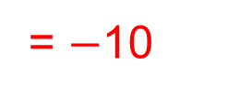
Multiplying and Dividing
In this section we look at how to multiply and divide negative numbers.
Example
Calculate (−2) + (−2) + (−2) + (−2) + (−2)
= $−$10
(−2) + (−2) + (−2) + (−2) + (−2) = 5× (−2) = $−$10
In the Example we see that
A positive number multiplied by a negative number gives a negative answer.
This table shows what happens to the sign of the answer when positive and negative numbers are multiplied:

Slide 17
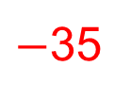
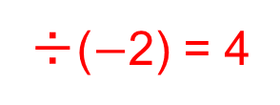
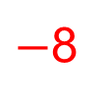
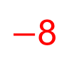

Multiplying and Dividing
Example
Work out the following:
5×(−7)
(−48) ÷ 6
$−$35
$−$35
×($−$2) = $70$
(i) 5×(−7) × ($\text{−}$2)
(ii) ((−48) ÷ 6)÷ ($\text{−}$2)
$−$8
$−$8
÷($−$2) = 4
(c) (−2)×(−3)
(d) (−10)÷(−5)
6
6
(iii) (−2)×(−3) × ($\text{−}$1)
(iv) (−10)÷(−5) × ($\text{−}$2)
×($−$1) = $−$6
2
2
×($−$2) = $−$4
It can be seen from the Example above that when you are multiplying and / or dividing:
An odd number of negative numbers will give a negative answer and an even number of negative numbers give a positive answer.
( $−$ )×( $−$ )×( $−$ )×( $−$ )
( + )

Slide 18
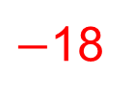
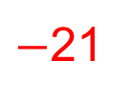
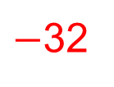
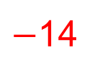
Skills Check: Negative Number Problems
1. Calculate:
(a) (−7)×2
$−$14
(b) (−4)×8
(e) (−3)×7
(h) 3×(−6)
(k) −(7)×0
$−$32
(c) (−2)×(−5)
(f) (−10)×(−4)
(i) (−7)×(−2)
(l) 8×(−5)
10
18
$−$21
40
(d) (−6)×(−3)
(g) 8×4
(j) (−4)×(−5)
32
$−$18
14
20
0
$−$40
2. Calculate:
(a) (−10)÷(−2)
5
$−$3
(b) (−15)÷5
(d) 14 ÷(−7)
(f) (−45)÷9
(h) (−100)÷(−4)
(j) 26 ÷(−13)
(l) (−42)÷7
(c) 18 ÷(−3)
(e) (−21)÷(−3)
(g) 50 ÷(−5)
80 ÷(−2)
(k) (−70)÷(−7)
$−$2
$−$6
7
$−$5
$−$10
25
$−$40
$−$2
10
$−$6

Slide 19
Skills Check: Multiplying and Dividing
3. Copy and complete these multiplication tables:
$$−1$$
$$−2$$
$$−3$$
$$−4$$
$$−4$$
0
4
8
12
$$−2$$
$$−4$$
$$−6$$
$$−8$$
$$−2$$
0
2
4
6
$$−3$$
$$−6$$
$$−9$$
$$−12$$
0
0
0
0
0
$$−4$$
$$−8$$
$$−12$$
$$−16$$
1
0
$$−1$$
$$−2$$
$$−3$$

Slide 20
Skills Check: Multiplying and Dividing
4. Copy and complete these multiplication tables:
1
3
$−$3
$−$4
2
$−$2
6
$−$5
15
20
$$−2$$
$$−6$$
4
8
$$−3$$
3
$−$6
$−$9
5. Copy these calculations, filling in the missing numbers:
$−$4
$$−2$$
(a)..... ×5 = −20
$−$20
(c) 16× ..... = −32
(b) ($−$80) ÷..... = 4
$−$4
$$−5$$
$$−8$$
(d) ..... ×(−3) = 12
(e) 40÷ ..... = −8
(f) − 32÷..... = 4
$−$6
$−$4
(g) (−8)×..... = 48
$$−8$$
(i) 100÷..... = $−$25
(h) ($−$4)×..... = 32

Slide 21
Skills Check: Multiplying and Dividing
6. Write down the next 3 terms in each sequence:
(a) 1, –2, 4, –8, 16, . . .
(b) –1, 2, –4, 8, –16, . . .
(c) 1, –10, 100, –1000, . . .
(d) 1, –3, 9, –27, . . .
(e) –1, 5, –25, 125, . . .
$−$32, 64, $−$128
32, $−$64, 128
10 000, $−$100 000, 1 000 000
81, $−$243, 729
$−$625, 3125, $−$15625
7. Make 2 copies of this multiplication table and fill in the missing numbers in 2 different ways:
1
2
3
5
$−$1
$−$2
$−$3
$−$5
1
2
3
5
$−$1
2
3
5
2
2
6
10
$−$2
2
6
10
3
3
6
15
$−$3
3
6
15
5
5
10
15
$−$5
5
10
15

Slide 22
Skills Check: Multiplying and Dividing
8. Calculate:
(a) 3×(−8)×(−4)
72
(b) (−4)×(−8)×(−2)
(d) 4×(−7)×2
(f) (−6)×(−2)×(−1)
$−$64
(c) (−2)×(−2)×(−2)
(e) (−2)×8×(−4)
$−$8
$−$56
64
$−$12
9. Calculate:
(a) $\frac{\left(−3\right) × (−4)}{(−2)}$
(b) $\frac{5 × (−6)}{(−2)}$
15
$−$6
(c) $\frac{\left(−7\right) × \left(−5\right) × (−2)}{5}$
(f) $\frac{\left(−4\right) × \left(−7\right) × 3}{(−12)}$
$−$7
$−$14
(d) $\frac{8 × \left(−9\right) × 6}{\left(−2 \right) × \left(−3\right)}$
$−$72
(e) $\frac{\left(−6\right) × (−4)}{2}$
12

Slide 23
Skills Check: Multiplying and Dividing
10. Calculate:
(−6 + 10)÷(−2)
(b) (6 +($−$8)) ×(4 $−$ 7)
(c) (($−$4) $×$ 2) + (6 $×$ ($−$9))
4÷($−$2) = $−$2
($−$2) $×$ ($−$3) = 6
$−$8 + ($−$54) = $−$62
(d) (12 − 24)÷(−2)
(e) ((−2) + 8)×((−4) + 2)
(f) (8×(−2)) − ((−4)×8)
($−$12) ÷($−$2) = 6
6 $×$ ($−$2) = $−$12
($−$16) – ($−$32) = $−$16 + 32 = 16
11. Calculate:
(a) (−6)×(−3)+($−$4)
18 + ($−$4) = 14
(b) (−5)×4 − (−3)
(c) (−11)×4 + (−8)×(−3)
$−$20 + 3 = $−$17
$−$44 + 24 = $−$20
(d) (−8) × ($−$7) − (8×7)
56 – 56 = 0

Slide 24
Section 3: Review
You have completed the third section.
If you have completed and mastered this section, click to start the next Section
If you need more examples and interactive practice, press here
You might also find it helpful to look at:
Essential Information: press here

Slide 25
Negative Number Problems
Example
Overnight, the temperature dropped from 5 °C to –14 °C. By how many degrees did the temperature fall?
One day the level of the water in a river was 30 cm above its average level. One week later it was 12 cm below its average level. How far did the water level drop in the week?
3. A chest of treasure was hidden in the year 64 BC and found in 284 AD. For how long was the chest hidden?
$−$14 – 5 =$−$19 Temperature fell by 19°C.
30 + 12 = 42 Water level dropped 42 m.
64 + 284 = 348 Chest was hidden for 348 years.
4. A scuba diver swam 96 feet beneath the surface of the lake. She then swims up 49 feet. What is her depth now ?
96 – 49 = 47 Her depth now is 47 feet.

Slide 26
Skills Check: Negative Number Problems
5. If it is 5°C outside and the temperature will drop 17°C in the next six hours, how cold will it get?
5$−$17 = $−$12 Temperature will b$e−$12 ºC.
6. It will be –12°C tonight. The weatherman predicts it will be 25ºC warmer by noon tomorrow. What will the temperature be by noon tomorrow?
$−$12 + 25 = 13 Temperature will be 13 ºC.
7. The average temperature at the South Pole is –45ºF. The average temperature on the Equator is 92ºF. How much warmer is the average temperature on the Equator than at the South Pole?
45 + 92 = 137 Average temperature is 137 ºF warmer on the Equator.
8. The elevation of Mt. Everest is 29,028 feet. The elevation of the Dead Sea is –485 feet. What is the difference in the elevation between Mt. Everest and the Dead Sea?
29 208 + 485 = 29 693 Difference in elevations
is 29 693 feet.

Slide 27
Section 4: Review
You have completed the fourth section.
If you have completed and mastered this section, click to start the next Section
If you need more examples and interactive practice, press here
You might also find it helpful to look at:
Essential Information: press here

