Slide 1
Supporting and Enhancing Mathematics and Statistics
Unit: Probability of Combined Events

Slide 2
Probability of Combined Events
The unit of work is divided into the following seven sections
Introduction to Probability
Calculating the Probability of a Single Event
Relative Frequency
Complementary Events
Estimating the Number of Outcomes
Outcomes with two Events
Probability using Listing

Slide 3
Introduction to Probability
A probability describes mathematically how likely it is that something will happen. We can talk about the probability that it will rain tomorrow or the probability that England will win their next football match.
Example 1
Which of the words,
certain, likely, unlikely or impossible,
best describes how likely each of the events below is to take place?
Solution
(a) It will rain tomorrow.
(b) It will snow tomorrow.
(c) Manchester United will win the next FA Cup.
(d) Newcastle United will win the next FA Cup.
(e) It is your teacher's birthday tomorrow.
(f) You will obtain a 7 when rolling a dice.
Likely or Unlikely
Unlikely
Likely or Unlikely
Impossible !!
Unlikely
Impossible

Slide 4

Introduction to Probability
Probability Line
E
A
C
D
B
Probability is 0 for an impossible event
Probability is 1 for a certain event
Probability is $\frac{1}{2}$ for an even chance
(for example, getting a head when you toss an unbiased coin)
Example 2
For each event below, mark an estimate of the probability that it will happen on a probability scale.
(a) It will snow on 19 August next year in London.
(b) Your maths teacher will give you homework this week.
(c) You will go to school tomorrow if it is Friday today.
(d) You will go to bed before midnight tonight.
(e) You throw an unbiased dice and get an even number.
A
B
C
D
E

Slide 5
Skill Check: Introduction to Probability
1. Use one of the words, certain, likely, unlikely or impossible, to describe each event below. Give a reason for each of your answers.
(a) You are more than 17 years old.
(b) You will miss the school bus tomorrow.
(c) Your favourite football team will win their next match.
You will arrive at school on time tomorrow.
2. The probability line shows the probability of A, B, C, D and E.
(a) Which event is certain?
(b) Which event is impossible?
(c) Which event is unlikely but possible?
(d) Which event is most likely, but not certain to occur?
E
A
B
D

Slide 6
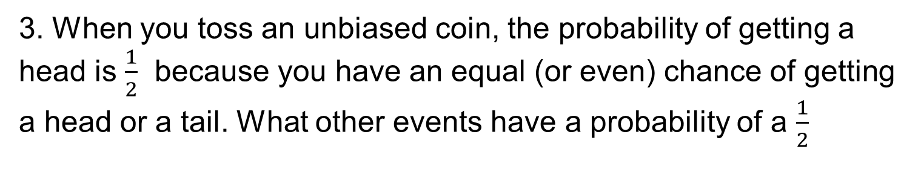
Skill Check: Introduction to Probability
3. When you toss an unbiased coin, the probability of getting a head is $\frac{1}{2}$ because you have an equal (or even) chance of getting a head or a tail. What other events have a probability of a $\frac{1}{2}$
Throwing an even number on a die
4. The events A, B, C and D have probabilities as shown on this probability line
(a) Which event is most likely to take place?
(b) Which event is most unlikely to take place?
(c) Which events are more likely to take place than event B?
(d) Which events are less likely to take place than event A?
A
D
A and C
B,C,D

Slide 7
Section 1: Review
You have completed the first section.
If you have completed and mastered this section,
click to start the next Section
If you need more examples and interactive practice,
press here
You might also find it helpful to look at:
Essential Information: press here

Slide 8
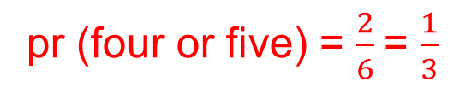
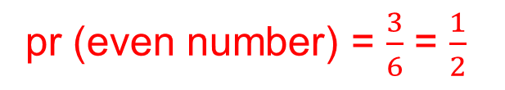
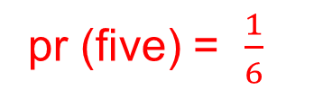
Probability of a Single Event
In this section we calculate the probabilities of single events. We consider cases where all the possible outcomes are equally likely. For example, when you roll a fair dice you are equally likely to get any of the six numbers. (The words 'fair' or 'unbiased' mean that all outcomes are equally likely.)
Probability of an event = $\frac{number of successful outcomes}{total number of outcomes}$
Example 1
When you roll a fair dice, what is the probability of getting:
(a) a five,
(b) an even number,
(c) a four or a five?
pr (five) = $\frac{1}{6}$
pr (even number) = $\frac{3}{6}$ = $\frac{1}{2}$
pr (four or five) = $\frac{2}{6}$= $\frac{1}{3}$
The possible six outcomes when you roll a dice are the scores
1, 2, 3, 4, 5, 6

Slide 9
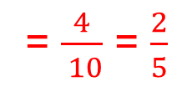
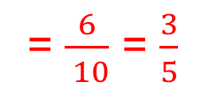
Probability of a Single Event
Example 2
A bag of sweets contains 6 mints and 4 eclairs. One sweet is taken at random from the bag. What is the probability that it is:
(a) a mint,
(b) an eclair?
Solution
The total number of possible outcomes is 10 as there are 10 sweets in the bag.
(a) As there are 6 mints in the bag, there are 6 successful outcomes.
Probability of an event = $\frac{number of successful outcomes}{total number of outcomes}$
= $\frac{6}{ 10}$ = $\frac{3}{5}$
(b) As there are 4 eclairs, there are 4 successful outcomes.
Probability of an event = $\frac{number of successful outcomes}{total number of outcomes}$
= $\frac{4}{ 10}$ = $\frac{2}{5}$

Slide 10
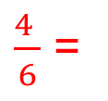
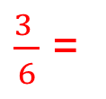


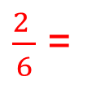











Skill Check: Probability of a Single Event
1. When you roll a fair dice, what is the probability that you obtain:
(a) an odd number,
(b) a 2,
(c) a multiple of 3,
(d) a number less than 5,
(e) a number greater than 4,
(f) a 3 or a number less than 3?
$\frac{3 }{6}$ =
$$\frac{1}{2}$$
$\frac{1 }{6}$
$\frac{2 }{6}$ =
$$\frac{1}{3}$$
$\frac{4 }{6}$ =
$$\frac{2}{3}$$
$\frac{2 }{6}$ =
$$\frac{1}{3}$$
$\frac{3 }{6}$ =
$$\frac{1}{2}$$
2. A bag contains 6 red sweets and 14 blue sweets. A sweet is taken at random from the bag. What is the probability that it is:
(a) a red sweet,
$$\frac{6}{20}$$
$$\frac{3}{10}$$
(b) a blue sweet?
$$\frac{14}{20}$$
=
$$\frac{7}{10}$$
=
3. You toss a fair coin. What is the probability that you obtain a tail?
$$\frac{1}{2}$$
There are only two possible outcomes on a fair coin, a head or a tail

Slide 11









Skill Check: Probability of a Single Event
4. The diagram shows a spinner from a game. The black arrow spins and ends up pointing to one of the four numbers. What is the probability that the arrow points to:
p(1) =
$$\frac{1}{4}$$
(a) the number 1,
(b) an even number.
(c) a multiple of 3?
p(even) =
$$\frac{1}{2}$$
p(multiple 3) =
$$\frac{1}{4}$$
5. The diagram shows a spinner that is used in a board game. When the spinner is spun, what is the probability that it lands on:
$$\frac{1}{8}$$
p(1) =
(a) 1,
(b) 2,
(c) an even number,
(d) a number less than 4?
p(2) =
$$\frac{2}{8}$$
=
$$\frac{1}{4}$$
p(even) =
$$\frac{4}{8}$$
$$\frac{1}{2}$$
=
$$\frac{5}{8}$$
p(< 4) =

Slide 12














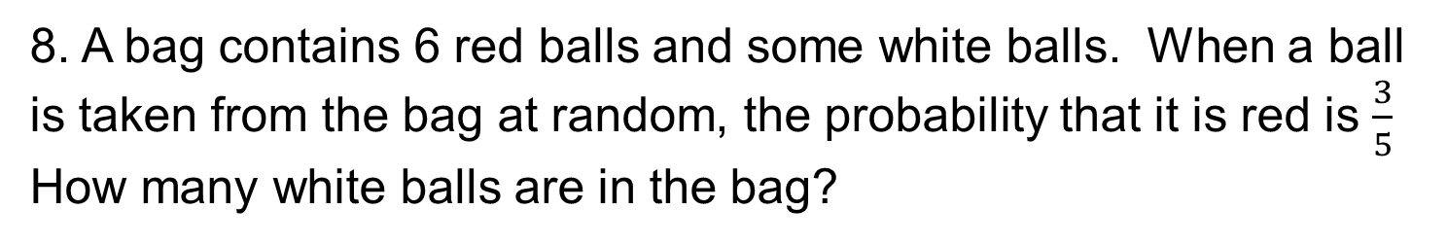


Skill Check: Probability of a Single Event
6. A bag of sweets contains 8 mints, 6 toffees and 2 boiled sweets. A sweet is taken at random from the bag. What is the probability that it is:
(a) a mint,
(b) a toffee,
(c) a boiled sweet,
(d) not a mint,
(e) not a toffee?
p(mint) =
$$\frac{8}{16}$$
$$\frac{1}{2}$$
=
$$\frac{6}{16}$$
=
$$\frac{3}{8}$$
p(toffee) =
$$\frac{2}{16}$$
$$\frac{1}{8}$$
p(boiled) =
=
$$\frac{8}{16}$$
$$\frac{1}{2}$$
$$\frac{8}{16}$$
p( not a mint) =
=
=
$$\frac{1}{2}$$
p(not a toffee) =
7. In a class there are 18 boys and 12 girls. One child is chosen at random to represent the class. What is the probability that this child is:
$$\frac{12}{30}$$
$$\frac{2}{5}$$
(b) a boy?
$$\frac{18}{30}$$
$$\frac{3}{5}$$
(a) a girl,
p(girl) =
=
p(boy) =
=
8. A bag contains 6 red balls and some white balls. When a ball is taken from the bag at random, the probability that it is red is $\frac{3}{5}$ How many white balls are in the bag?
$$\frac{1}{5}$$
$$\frac{2}{5}$$
= 4 white balls
= 2 balls

Slide 13
Section 2: Review
You have completed the second section.
If you have completed and mastered this section,
click to start the next Section
If you need more examples and interactive practice,
press here
You might also find it helpful to look at:
Essential Information: press here

Slide 14
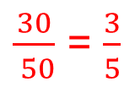
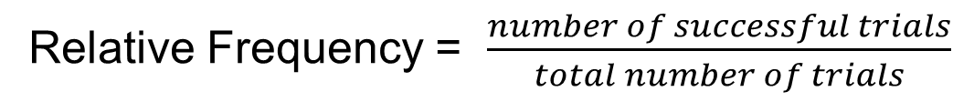
Calculating Relative Frequency
Some probabilities cannot be calculated as in the last section; for example, the probability that it will rain on 20 November cannot be found in this way. Probabilities can, however, be estimated using relative frequencies found from observations or from experiments.
Relative Frequency = $\frac{number of successful trials}{total number of trials}$
Example 1
Matthew decides to try to estimate the probability that toast lands butter-side-down when dropped. He drops a piece of buttered toast 50 times and observes that it lands butter-side-down 30 times.
Estimate the probability that the toast lands butter-side-down.
Solution
An estimate of the probability is given by the relative frequency. In this case this is:
$\frac{30}{ 50}$ = $\frac{3}{5}$

Slide 15
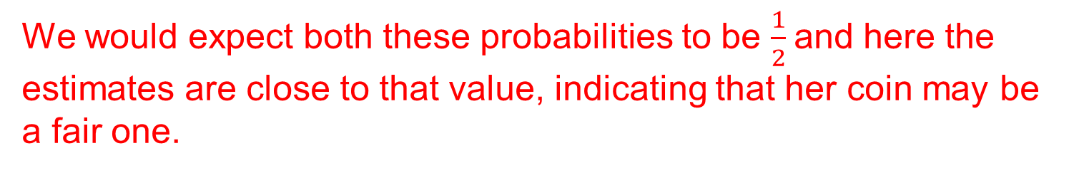
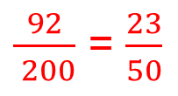
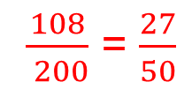
Calculating Relative Frequency
Example 2
Sarah tosses a coin 200 times. She gets 108 heads and 92 tails. Using her results, estimate the probability of obtaining:
(a) a head when the coin is tossed,
(b) a tail when the coin is tossed.
Solution
The relative frequency gives an estimate of the probability.
(a) Relative frequency =
$\frac{108}{ 200}$ = $\frac{27}{50}$
(b) Relative frequency =
$\frac{92}{ 200}$ = $\frac{23}{50}$
We would expect both these probabilities to be $\frac{1}{2}$and here the estimates are close to that value, indicating that her coin may be a fair one.

Slide 16
Calculating Relative Frequency
Example 3
Rachel was testing a coin to see if it was fair. She tossed the coin 50 times and recorded 36 HEADS. She tossed it another 50 times and recorded 32 HEADS. She continued in this way, and recorded her results on the following table:
Calculate the total frequency (total number of HEADS) after 50, 100, 150, . . . , 400 throws and also calculate, at each stage, the relative frequency.
Plot the points on a relative frequency graph, and hence estimate the probability of obtaining a head. What should be Rachel's conclusion?

Slide 17
Calculating Relative Frequency
Solution
No. of Tosses
50 100 150 200 250 300 350 400
Total Frequency
36 68 98 136 166 202 236 266
Relative Frequency
0.72 0.68 0.653 0.68 0.664 0.673 0.674 0.665
The probability looks
to be about
0.665. Her coin is
biased
(since, for a fair coin,
we would expect the
probability to be 0.5)
Relative Frequency
Pr(Head)
No. of Tosses

Slide 18

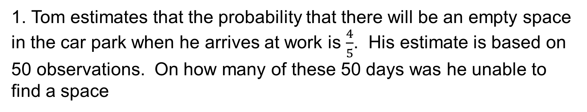
Skill Check: Calculating Relative Frequency
1. Tom estimates that the probability that there will be an empty space in the car park when he arrives at work is $\frac{4}{5}$. His estimate is based on 50 observations. On how many of these 50 days was he unable to find a space
50 – 40 = 10 days
2. Clair draws the bar chart opposite to show the results for his football team so far this season.
(a) Use the bar chart to estimate the probability that his team will win their next match.
(b) Give reasons why this estimate of the probability that they will win their next match may not be very reliable.
p(win) =
$$\frac{3}{10}$$
Only played a small number of games

Slide 19
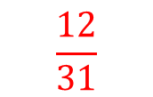
Skill Check: Calculating Relative Frequency
3. A calculator can be used to generate random digits. Halim generates 100 random digits with his calculator. He lists the results in the following table:
7
10
Based on Halim's results, estimate the probability that the calculator produces:
8
9
6
12
12
10
p(9) = 0.1
12
14
(a) 9,
(b) 2,
(c) a digit that is an odd number,
(d) a digit that is a prime number.
p(2) = 0.06
p(odd digit) =​ 0.56
p(prime number) =​ 0.40
4. If it rained on 12 days in November last year, estimate the probability that it will rain on 20 November next year.
p(rain on 20th November ) =​
$$\frac{12}{31}$$

Slide 20
Section 3: Review
You have completed the third section.
If you have completed and mastered this section,
click to start the next Section
If you need more examples and interactive practice,
press here
You might also find it helpful to look at:
Essential Information: press here

Slide 21
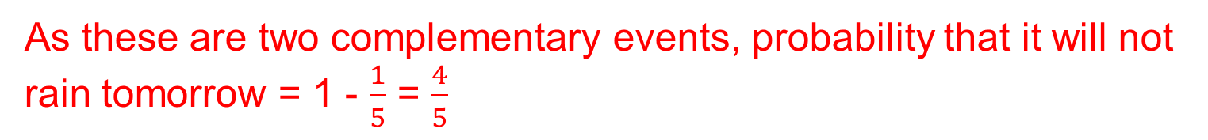
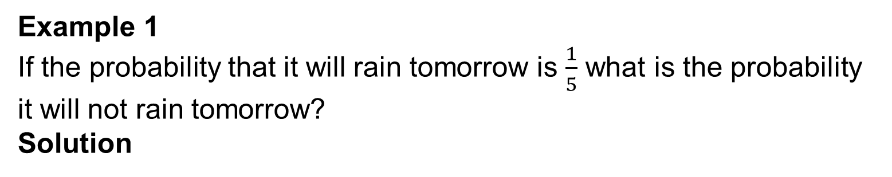
Complementary Events
Two events are described as complementary if they are the only two possible outcomes. For example, the events A and B below are complementary:
A: It rains
B: It does not rain
If A is an event and A' is the complementary event,
P(A’) + P(A) = 1
P(A’) = 1 – P(A)
Example 1
If the probability that it will rain tomorrow is $\frac{1}{5}$ what is the probability it will not rain tomorrow?
Solution
As these are two complementary events, probability that it will not rain tomorrow = 1 - $\frac{1}{5}$ = $\frac{4}{5}$

Slide 22
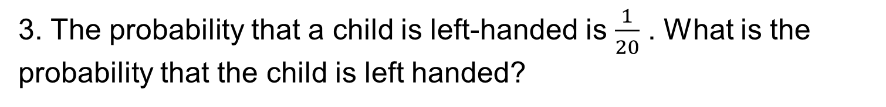
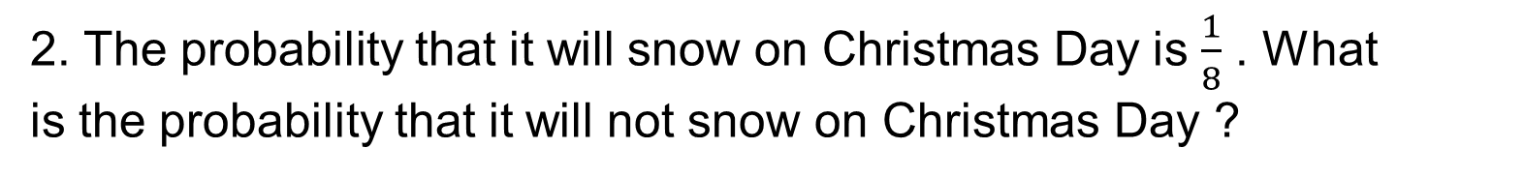



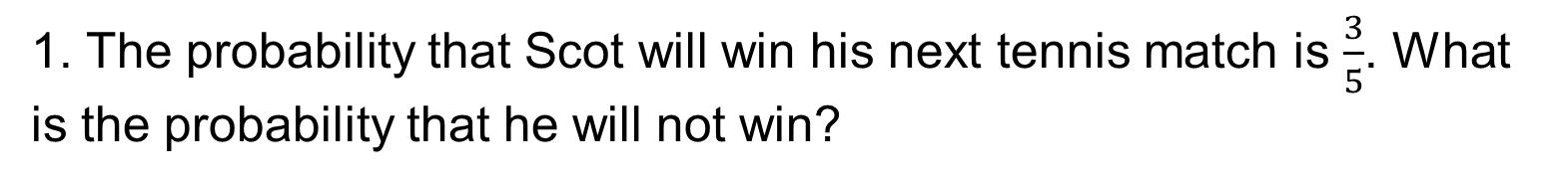

Skill Check: Complementary Events
1. The probability that Scot will win his next tennis match is $\frac{3}{5}$. What is the probability that he will not win?
$$\frac{2}{5}$$
2. The probability that it will snow on Christmas Day is $\frac{1}{8}$ . What
is the probability that it will not snow on Christmas Day ?
$$\frac{7}{8}$$
3. The probability that a child is left-handed is $\frac{1}{20}$ . What is the probability that the child is left handed?
$$\frac{19}{20}$$
4. The probability that Natasha is late for school is 0.1. What is
the probability that she is not late?
$$\frac{9}{10}$$
5. The probability that Sergio gets all his spellings correct in his next test is 0.75. What is the probability that he does not get them all correct?
0.25

Slide 23





Skill Check: Complementary Events
6. One of the numbers in the Venn diagram below is chosen at random.
$$\frac{4}{12}$$
$$\frac{1}{3}$$
(a) What is the probability that the number is in the set A?
(b) What is the probability that the number is not in the set A?
=
$$\frac{2}{3}$$
7. (a) What is the probability that you will get a prime number when you roll a fair dice
$$\frac{1}{2}$$
(b) What is the probability that you will not get a prime number when you roll a fair dice
$$\frac{1}{2}$$

Slide 24
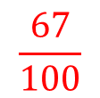
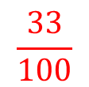


Skill Check: Complementary Events
8. In one year it rains on 12 days in the month of September.
(a) Use this information to estimate the probability that it will rain on 19 September next year.
Use your answer to (a) to make an estimate of the probability
9. A bag contains 100 balls, each marked with a number from 1 to 100. A ball is taken from the bag at random.
(a) What is the probability that the number on the ball is a multiple of 3?
What is the probability that the number on the ball is not a
$$\frac{12}{30}$$
that it will not rain on 19 September next year.
$$\frac{18}{30}$$
$$\frac{33}{100}$$
multiple of 3?
$$\frac{67}{100}$$

Slide 25
Section 4: Review
You have completed the fourth section.
If you have completed and mastered this section,
click to start the next Section
If you need more examples and interactive practice,
press here
You might also find it helpful to look at:
Essential Information: press here

Slide 26

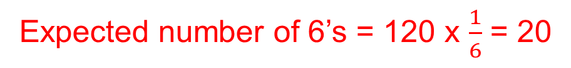
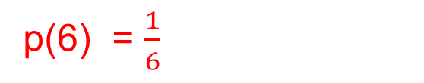
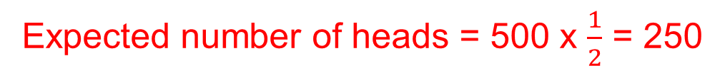
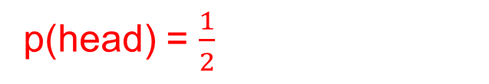
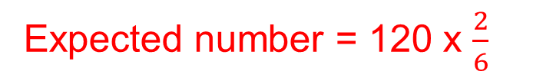
Estimating Number of Outcomes
If we know the probability of an event we can estimate the number of times we expect that event to take place.
Expected number of successful outcomes
probability
of success
total number
of outcomes
=
x
Example 1
You toss an unbiased coin 500 times. How many heads should you expect to obtain?
Solution
p(head) = $\frac{1}{2}$
Expected number of heads = 500 x $\frac{1}{2}$ = 250
Example 2
You roll a fair dice 120 times. How many times would you expect to obtain:
p(6) = $\frac{1}{6}$
Expected number of 6’s = 120 x $\frac{1}{6}$ = 20
(a) a 6,
(b) a multiple of 3
$$\frac{2}{6}$$
Expected number = 120 x $\frac{2}{6}$
p(multiple of 3) =
= 40

Slide 27
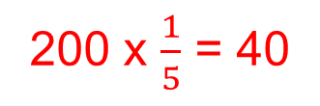
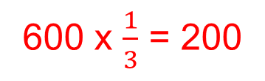
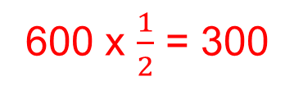
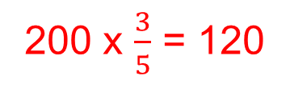
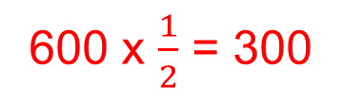
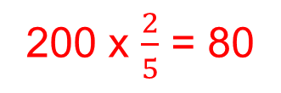
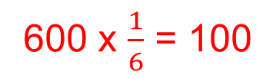
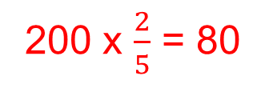
Skill Check: Estimating Number of Outcomes
1. If you roll an unbiased dice 600 times, how many times would you expect to obtain:
(a) a one,
(b) an even number,
(c) an odd number,
a number less than 3?
2. A spinner is marked with the numbers 1 to 5, each of which is equally likely to occur when the spinner is spun. If it is spun 200 times, how many times would you expect to obtain:
(a) a five,
(b) an even number,
(c) a number less than 3,
a prime number?
600 x $\frac{1}{6}$ = 100
600 x $\frac{1}{2}$ = 300
600 x $\frac{1}{2}$ = 300
600 x $\frac{1}{3}$ = 200
200 x $\frac{1}{5}$ = 40
200 x $\frac{2}{5}$ = 80
200 x $\frac{2}{5}$ = 80
200 x $\frac{3}{5}$ = 120

Slide 28

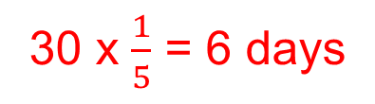
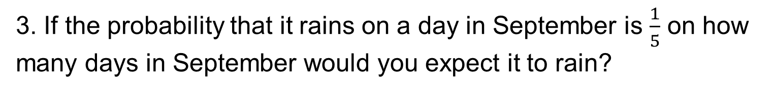
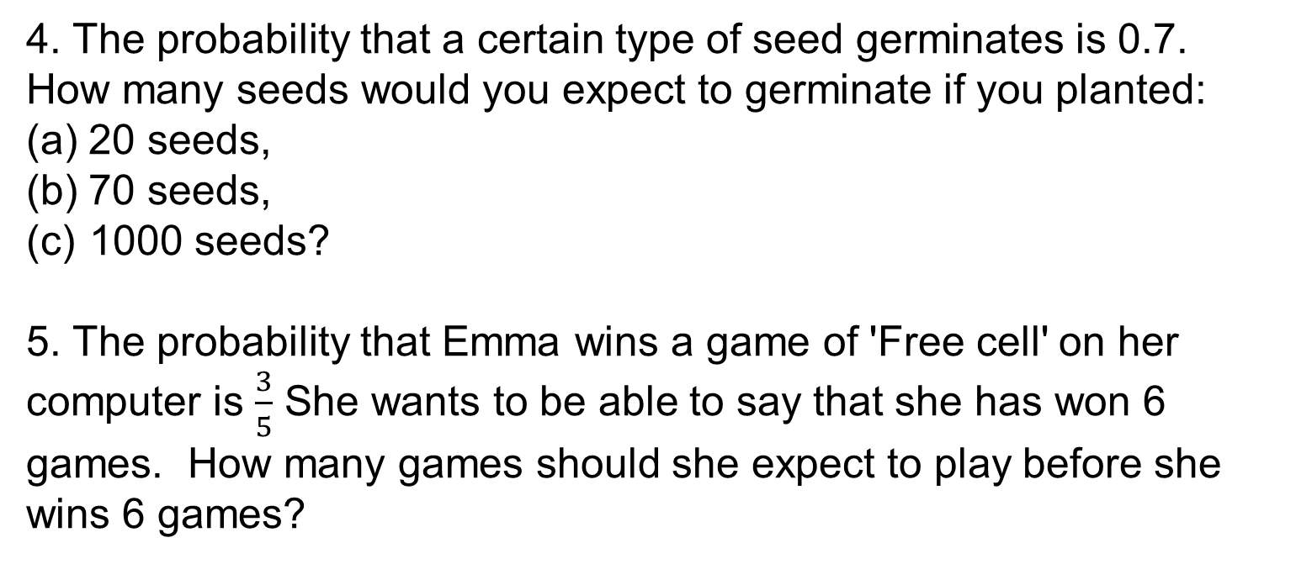
Skill Check: Estimating Number of Outcomes
3. If the probability that it rains on a day in September is $\frac{1}{5}$ on how many days in September would you expect it to rain?
30 x $\frac{1}{5}$ = 6 days
4. The probability that a certain type of seed germinates is 0.7. How many seeds would you expect to germinate if you planted:
(a) 20 seeds,
(b) 70 seeds,
1000 seeds?
5. The probability that Emma wins a game of 'Free cell' on her computer is $\frac{3}{5}$ She wants to be able to say that she has won 6 games. How many games should she expect to play before she wins 6 games?
20 x 0.7 = 14 seeds
70 x 0.7 = 49 seeds
1000 x 0.7 = 700 seeds
10 x $\frac{3}{5}$ = 6 games

Slide 29
Section 5: Review
You have completed the fifth section.
If you have completed and mastered this section,
click to start the next Section
If you need more examples and interactive practice,
press here
You might also find it helpful to look at:
Essential Information: press here

Slide 30








Two Events
Example 1
A tube of sweets contains 10 red sweets, 7 blue sweets, 8 green sweets and 5 orange sweets. If a sweet is taken at random from the tube, what is the probability that it is:
(a) red,
(b) orange,
(c) green or red,
(d) not blue ?
$$\frac{10}{30}$$
p(red) =
p(A or B)= p(A) + p(B)
p(A) = probability of A
p(B) = probability of B
$$\frac{5}{30}$$
p(orange) =
$$\frac{18}{30}$$
p(green or red) =
$$\frac{23}{30}$$
Example 2
p(not blue) =
In Hannah's purse there are three £1 coins, five 10p coins and eight 2p coins. If she takes a coin at random from her purse, what is the probability that it is:
(a) a £1 coin,
(b) a 2p coin,
(c) not a £1 coin,
(d) a £1 coin or a 10p coin ?
p(£1 coin) =
$$\frac{3}{16}$$
$$\frac{8}{16}$$
p(2p coin) =
p(not a £1 coin) =
$$\frac{13}{16}$$
p(£1 or 10p coin) =
$$\frac{8}{16}$$

Slide 31





Skill check: Two Events
1.Some of the children in a class write down the first letter of their surname on a card; these cards are shown below:
(a) One of these cards is taken at random. What is the probability that the letter on it is:
(i) W,
(ii) S or T,
(iii) J or M,
(iv) not H
(v) a vowel ?
(b) Which letter is the most likely to be chosen?
$$\frac{2}{17}$$
p(W) =
$$\frac{5}{17}$$
p(S or T) =
$$\frac{2}{17}$$
p(J or M) =
$$\frac{15}{17}$$
p(not H) =
$$\frac{4}{17}$$
p(Vowel) =
s

Slide 32











Skill check: Two Events
1. Ten children were asked to state their favourite sport. Their responses are listed in this table:
What is the probability that, if one of the children is chosen at random, their favourite sport will be:
(a) volleyball,
$$\frac{1}{10}$$
$$\frac{4}{10}$$
(b) swimming,
$$\frac{5}{10}$$
(c) volleyball or swimming?
Total
10
2. In a packet of sweets there are 20 mints, 10 fudges and 20 toffees. A sweet is taken at random from the packet. What is the probability that it is:
(a) a mint,
(b) a mint or a toffee,
a mint or a fudge,
a toffee or a fudge?
$$\frac{20}{50}$$
$$\frac{2}{5}$$
=
$$\frac{40}{50}$$
$$\frac{4}{5}$$
=
$$\frac{30}{50}$$
$$\frac{3}{5}$$
=
$$\frac{30}{50}$$
$$\frac{3}{5}$$
=

Slide 33




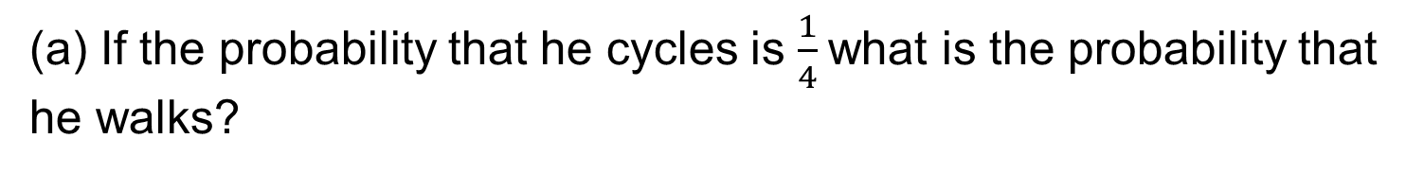
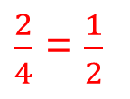
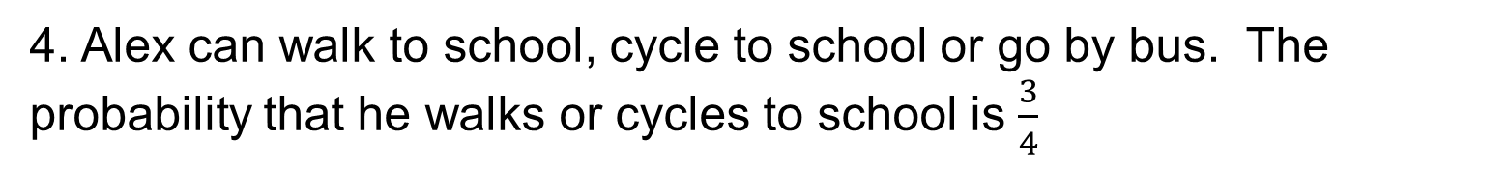


Skill check: Two Events
3. A group of students were asked their ages. These are recorded in
the table below:
What is the probability that a student selected at random from the group, is:
$$\frac{4}{40}$$
(a) age 17,
(b) age 17 or 18,
(c) age 17 or 19,
(d) age 18 or 21?
$$\frac{22}{40}$$
$$\frac{20}{40}$$
$$\frac{20}{40}$$
Total
40
4. Alex can walk to school, cycle to school or go by bus. The probability that he walks or cycles to school is $\frac{3}{4}$
If the probability that he cycles is $\frac{1}{4}$what is the probability that
he walks?
$\frac{2}{4}$ = $\frac{1}{2}$
$$\frac{1}{4}$$
(b) What is the probability that he goes by bus?
(c) What is the probability that he cycles or goes by bus?
$$\frac{1}{2}$$

Slide 34
Section 6: Review
You have completed the sixth section.
If you have completed and mastered this section,
click to start the next Section
If you need more examples and interactive practice,
press here
You might also find it helpful to look at:
Essential Information: press here

Slide 35



Probability with Listings
When two events take place at the same time, it is important to list all the possible outcomes in some way. There are three possible approaches: systematic listing, using a table or using a tree diagram.
Example 1
Caitlin and Dave each buy a chocolate bar from a vending machine that sells Aero, Bounty, and Crunchie
List the possible pairs of bars which Caitlin and Dave can choose.
Caitlin
Dave
A
A
A
A
B
C
(a) Probability of choosing an Aero and a Bounty bar
$$\frac{2}{9}$$
p(AB or BA) =
B
BB
A
B
C
(b) Probability of choosing
the same chocolate Bars
C
C
C
A
B
C
$$\frac{3}{9}$$
=
$$\frac{1}{3}$$
p(AA or BB or CC) =

Slide 36

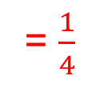
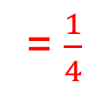



Probability with Listings
Example 2
A fair dice is rolled and an unbiased coin is tossed. Draw a table to show the possible outcomes.
Solution
(a) The probability of throwing a Head and an Even number
H1
H2
H3
H4
H5
H6
$$\frac{3}{12}$$
= $\frac{1}{4}$
T1
T2
T3
T4
T5
T6
p(H2,H4,H6) =
“There are 12 possible outcomes”
(b) The probability of throwing a Tail and a Prime number
$\frac{3}{12}$
= $\frac{1}{4}$
p(T2,T3,T5) =
(c) The probability of throwing a coin with an Even number
$$\frac{6}{12}$$
$$\frac{1}{2}$$
p(T2,T4,T6,H2,H4,H6) =
=

Slide 37






Probability with Listings
Example 3
Draw a table to show all the possible total scores when two fair dice are thrown at the same time.
Solution
There are 36 possible ways of throwing two dice
2
3
4
5
6
7
There are 6 outcomes that give a score of 7.
7
3 4 5 6 7 8
7
4 5 6 7 8 9
7
5 6 7 8 9 10
(a) The probability of getting an even score with two dice
$$\frac{18}{36}$$
7
= $\frac{1}{2}$
6 7 8 9 10 11
7
7 8 9 10 11 12
7
(b) The probability of getting a score of more than 9 with two dice
(c) The probability of getting a multiple of 3 with two dice
$$\frac{6}{36}$$
$$\frac{12}{36}$$
=$\frac{1}{3}$

Slide 38




Probability with Listings
Example 4
Use a tree diagram to show the possible outcomes when two unbiased coins A and B are tossed.
Solution
The diagram shows that there are 4 possible outcomes.
(a) p(Getting two Heads)
H
HH
p(HH) = $\frac{1}{4}$
H
HT
(b) p( At least one Head)
T
p(HT or TH or HH) = $\frac{3}{4}$
H
TH
T
(c) p(Getting a Head and
a Tail in any order)
T
TT
p(HT or TH) = $\frac{2}{4}$
= $\frac{1}{2}$
Coin A
Coin B

Slide 39






Skill Check: Probability with Listings
1. Copy and complete the table to show all possible outcomes when 2
fair coins are tossed.
Find the probability of getting:
(a) TT
$$\frac{1}{4}$$
p(TT) =
$$\frac{3}{4}$$
HH
HT
(b) At least one Tail
p(TT,TH,HT) =
TH
TT
2. Two spinners are numbered 1 to 4 as shown in the diagram:
Complete the table of outcomes
+
2
3
4
5
Find the probability of getting:
3
4
5
6
$$\frac{6}{16}$$
= $\frac{3}{8}$
4
5
6
7
(a) Total greater than 5
p(>5) =
5
6
7
8
(b) An odd total
p(odd total) =
$$\frac{8}{16}$$
= $\frac{1}{2}$

Slide 40





Skill Check: Probability with Listings
3. The two spinners shown in the diagram opposite, are spun at the same time:
(a) Draw a table to show all possible outcomes, and the total score for each outcome.
(b) How many different outcomes are there?
(c) How many outcomes give a score of 6 ?
+
Solution
2
3
4
5
6
(a) There are 15 outcomes
3
4
5
6
7
(b) There are 3 outcomes
of a score of 6
4
5
6
7
8
Find the probability of getting
p(>5) =
$$\frac{6}{15}$$
= $\frac{2}{5}$
Total score greater than 5
Total score which is a multiple of 3
Total score which is a Prime number
$$\frac{5}{15}$$
= $\frac{1}{3}$
p(multiple of 3) =
p(prime) =
$$\frac{8}{15}$$

Slide 41




Skill Check: Probability with Listings
4. In a bag there are red and blue counters. Two counters are taken out of the bag at random.
Copy and complete the tree diagram below, to show all outcomes:
Find the probability of
R
RR
Two red counters
No red counters
At least one red counter
R
p(RR) =
$$\frac{1}{4}$$
B
RB
R
BR
p(BB) =
$$\frac{1}{4}$$
B
B
BB
p(RB or BR or RR) =
$$\frac{3}{4}$$
1st Pick
2nd Pick
(d) List the 8 different of ways of removing 3 counters
RRR, RRB, RBR, BRR, BBB, BBR, BRB, RBB
(e) What is the probability of at least one red counter
1 – p(BBB) = 1 - $\frac{1}{8}$ = $\frac{7}{8}$

Slide 42






Skill Check: Probability with Listings
5. The diagram shows two spinners that are spun at the same time:
Use a table to determine the probability of obtaining a total score of:
+
$$\frac{1}{16}$$
(a) 6
p(6) =
0
1
2
3
$$\frac{1}{16}$$
(b) 0
p(0) =
1
2
3
4
(c) 1
p(1) =
$$\frac{3}{16}$$
1
3
4
5
3
4
5
6
(d) 3
p(3) =
$$\frac{4}{16}$$
6. The two spinners shown in the diagram are both spun:
(a) What is the probability that both spinners show the same colour?
p(RR,BB) =
$$\frac{2}{9}$$
RR
RB
RG
(b) What is the probability of obtaining a yellow and a red?
BR
BB
BG
p(RY) =
$$\frac{1}{9}$$
YR
YB
YG

Slide 43
















Skill Check: Probability with Listings
7. Two fair dice are rolled and the scores on each dice are multiplied together to give a total score. What is the probability of a total score:
(a) of 12,
(b) of 20,
(c) greater than 25,
(d) less than 30,
that is an even number
$$\frac{2}{36}$$
= $\frac{1}{18}$
x
p(12) =
1 2 3 4 5 6
p(20) =
$$\frac{2}{36}$$
= $\frac{1}{18}$
2 4 6 8 10 12
p(>25) =
$$\frac{3}{36}$$
= $\frac{1}{12}$
3
6
9
12
15
18
$$\frac{33}{36}$$
= $\frac{11}{12}$
4
8
12
16
20
24
p(<30) =
5
10
20
25
30
15
$$\frac{27}{36}$$
= $\frac{3}{4}$
6
12
18
24
30
36
p(even) =
Repeat the experiment but find the difference between the dice scores. Complete the table
-
What is the probability of :
0 1 2 3 4 5
p(0) =
$$\frac{6}{36}$$
= $\frac{1}{6}$
1 0 1 2 3 4
difference of 0
difference greater than 1,
difference of an odd number?
2 1 0 1 2 3
p(>1) =
$$\frac{20}{36}$$
3 2 1 0 1 2
= $\frac{5}{9}$
4 3 2 1 0 1
p(odd) =
$$\frac{18}{36}$$
= $\frac{1}{2}$
5 4 3 2 1 0

Slide 44



Skill Check: Probability with Listings
8. Three unbiased coins are tossed at the same time. Use a tree diagram to show the outcomes and determine the probability of
3 heads
(b) at least 1 head
(c) at least 2 heads.
p(3 heads) =
$$\frac{1}{8}$$
$$\frac{7}{8}$$
$$\frac{3}{8}$$
p(at least 1 head) =
p(at least 2 heads) =
H
HHH
H
T
HHT
H
H
HTH
T
HTT
T
H
TTH
H
T
T
THT
T
H
TTH
Coin A
T
TTT
Coin B
Outcomes
Coin C

Slide 45
Section 7: Review
You have completed the seventh section.
If you have completed and mastered this section,
click to start the next Section
If you need more examples and interactive practice,
press here
You might also find it helpful to look at:
Essential Information: press here

