Slide 1
Supporting and Enhancing Mathematics and Statistics Unit: Approximation and Estimation

Slide 2
Approximation and Estimation
The following unit is divided into the following five sections
Rounding to the nearest 10, 100 and 1000
Rounding to a certain number of significance
Rounding to a certain number of decimal places
Upper and Lower Bounds
Estimation

Slide 3
Rounding to the nearest 10, 100 and 1000
Example 1
A football match is watched by 56 742 people. Write this number correct to the nearest,
10 000
1000
10
(a) 10 000
(b) 1000
(c) 10
Solution
56 742 = 60 000 to the nearest 10 000.
56 742 = 57 000 to the nearest 1000.
56 742 = 56 740 to the nearest 10.
Example 2
10 230 has been rounded to the nearest 10. Write down a list of values it could have been before rounding took place
10 225, 10 226, 10 227, 10 228, 10 229, 10 230, 10 231, 10 232,
10 233, 10 234

Slide 4
Skill Check: Rounding
Exercises
1. Round each of the following numbers to the nearest 100:
(a) 108
100
(b) 199
200
(c) 3471
3500
(d) 59
100
(e) 33
0
(f) 451
500
Round the number 4 765 173 to:
(a) the nearest million,
5 000 000
(b) the nearest 10,
(d) the nearest 100.
4 765 170
(c) the nearest 1000,
4 765 000
4 765 200
3. Annie says that her rabbit has a mass of 1473 grams. Give this mass correct to:
(a) the nearest 100 grams,
(b) the nearest 10 grams,
(c) the nearest kg.
1500 grams
1470 grams
1 kg

Slide 5
Skill Check: Rounding
4. The table shows the lengths of some rivers to the nearest km.
(a) (i) Write the length of each river rounded to the nearest 100 km.
400
300
300
200
100
(ii) Which two rivers have the same length to the nearest 100 km?
The Thames and the Trent

Slide 6
Skill Check: Rounding
(b) (i) Write the length of each river rounded to the nearest 10 km.
350
350
300
220
110
(ii) Which two rivers have the same length to the nearest 10 km?
Severn and Thames
(c) There is another river which is not on the list.
It has a length of 200 km to the nearest 100 km, and a length of 150 km to the nearest 10 km. Copy and complete this sentence to give one possible length of the river to the nearest km.
154
The length of the river could be .............. km.

Slide 7
Section 1: Review
You have completed the first section.
If you have completed and mastered this section, click to start the next Section
If you need more examples and interactive practice, press here
You might also find it helpful to look at:
Essential Information: press here

Slide 8
Rounding to a certain number of significance
Example 1
Write each of the following numbers correct to 3 significant figures
47 316
303 971
20.453
0.004368
Solution
47 316 = 47 300 to 3 significant figures.
303 971 = 304 000 to 3 significant figures.
20.453 = 20.5 to 3 significant figures.
0.004368 = 0.00437 to 3 significant figures.
Significant Figures Rules
All non-zero digits are significant
Zeros are only significant if they have a non zero digit to their left
203 = 3 sf, 023 = 2 sf, 230 = 3 sf
0.034 = 2 sf, 0.0340 = 3 sf, 0.0304 = 3 sf
5.45 = 3 sf, 5.405 = 4 sf, 5.450 = 4 sf

Slide 9
Skill Check: Significant Figures
1. Write each of the following numbers correct to 3 significant figures:
(a) 37 412
37 400
(b) 84 563
84 600
(c) 261.42
261
(d) 0.3684
0.368
(e) 0.002615
0.00262
(f) 0.0025713
0.00257
(g) 3.6213
3.62
(h) 4.0071
4.01
(i) 18.3071
18.3
2. Write each of the following numbers correct to the number of significant figures stated
(a) 6.475 to 2 s.f.
6.5
(e) 16 001 to 3 s.f.
16 000
(b) 1473 to 1 s.f.
1000
(f) 148.25 to 3 s.f.
148
(c) 3681 to 2 s.f.
3700
(g) 16.999 to 3 s.f.
17.0
(d) 571.32 to 4 s.f.
571.3
(h) 38. 9712 to 2 s.f.
39

Slide 10
Skill Check: Significant Figures
3. Write the number 183.9591 correct to:
(a) 2 significant figures
180
(b) 3 significant figures
184
(c) 5 significant figures
183.96
(d) 1 significant figures
200
4. Use a calculator to carry out the following calculations. In each case, give the answer to 2 significant figures
(a) 33 ÷ 4
(c) 142 ÷ 0.8
180
8.3
(b) 22 ÷ 0.7
31
84
(e) 3.25 x 1001
3 300
(f) 62 x 47
2 900
(d) 66 x 1.27
(g) 3.41 x 0.0092
0.031
(h) 88 ÷ 0.007
13 000
(i) 42 x 1.0952
46

Slide 11
Section 2: Review
You have completed the second section.
If you have completed and mastered this section, click to start the next Section
If you need more examples and interactive practice, press here
You might also find it helpful to look at:
Essential Information: press here

Slide 12
Rounding: Decimal places
Example 1
Write each of the following numbers correct to the number of decimal places stated:
Solution
0.3741 to 2 d.p.
3.8451 to 2 d.p.
142.8315 to 1 d.p.
0.000851 to 4 d.p.
0.37 to 2 d.p.
3.85 to 2 d.p.
142.8 to 1 d.p
0.0009 to 4 d.p.
Example 2
Barry rounded up when he should have rounded down
Barry rounds the number 374.49 to 375.
(a) Explain what mistake he has made.
(b) Describe how Barry tried to round the number and then give the correct answer.
Barry looked at the end 9 and pushed the 4 next to it up to 5 then as this was 5 he pushed the next 4 up to 5. He needed to look just at the 1/10th position to give the correct answer of 374

Slide 13
Skills Check: Decimal Places and Rounding
1. What is the value of the '5' in each of these numbers?
(a) 0.45 (b) 0.54 (c) 5.74 (d) 3.415 (e) 4.258 (f) 3.502
0.05
0.5
5.0
0.005
0.050
0.500
2. Write the numbers in order, smallest first.
0.85, 0.9, 0.8, 0.58, 0.6, 0.5, 0.87
0.5, 0.58, 0.6, 0.8, 0.85, 0.87, 0.9
3. Write each of these numbers correct to 1 decimal place.
(a) 1.47 (b) 3.68 (c) 0.45 (d) 3.751 (e) 4.08 (f) 5.005
1.5
3.7
0.5
3.8
4.1
5.0
4. Write each of these numbers correct to 2 decimal places.
(a) 3.444 (b) 8.555 (c) 0.321 (d) 4.7612 (e) 0.3002 (f) 4.1050
3.44
8.56
0.32
4.76
0.30
4.11

Slide 14
Skill Check: Decimal Places
5. (a) The length of an envelope is 21 cm to the nearest cm.
What is the smallest possible real length of the envelope?
Minimum Envelope length = 20.5 cm
(b) The interval on the number line below shows all the possible real lengths of the envelope.
Write down the correct numbers for the lower and upper limits of the interval, represented on the diagram by A and B.
A = 20.5 cm
B < 21.5 cm

Slide 15
Skill Check: Decimal places
(c) The length of a card is 20.5 cm to the nearest tenth of a cm.
The interval on the number line below shows all the possible real lengths of the card. Write down the numbers represented on the number line by C, D and E.
C = 20.45 cm
D = 20.50 cm
E < 20.55 cm
(d) Can you be sure the card will fit in the
open envelope like this ?
No, Minimum Envelope length = 20.5 cm, while Maximum Card length < 20.55 cm

Slide 16
Section 3: Review
You have completed the third section.
If you have completed and mastered this section, click to start the next Section
If you need more examples and interactive practice, press here
You might also find it helpful to look at:
Essential Information: press here

Slide 17
Upper and Lower Bounds
Example 1
State the upper and lower bounds for each of the following quantities and write an inequality for the actual value in each case.
(a) 4 mm to the nearest mm.
(b) 15 kg to the nearest kg.
(c) 4.56 m to the nearest cm.
Solution
}
(a) Upper Bound = 4.5mm
Lower Bound = 3.5 mm
Value ≥ 3.5 mm and < 4.5 mm
}
(b) Upper Bound = 15.5 kg
Lower Bound = 14.5 kg
Value ≥ 14.5 kg and < 15.5 kg
(c) Upper Bound = 4.565 m
Lower Bound = 4.555 m
}
Value ≥ 4.555 m and < 4.565 m

Slide 18
Skill Check: Upper and Lower Bounds
1. The mass of a ship is stated as 47 384 tonnes to the nearest tonne. Are the following statements correct?
(a) The mass is less than 47 384.5 tonnes.
(b) The mass is greater than 47 384.4 tonnes.
Yes, Lower Boundary is 47 383.5 tonnes
Yes, the mass could be 47 384.4999 tonnes
2. At an athletics meeting, the discus throws are measured to the nearest centimetre.
Viv's best throw was measured as 35.42 m. Could Viv's throw actually have been more than 35.42 m ?
(b) Chris won the hurdles race in a time of 14.6 seconds measured to the nearest tenth of a second. Between what two values does Chris's time actually lie?
Yes, the throw could be ≥ 35.415 and < 35.425
The times ≥ 14.55 and < 14.65

Slide 19
Section 4: Review
You have completed the fourth section.
If you have completed and mastered this section, click to start the next Section
If you need more examples and interactive practice, press here
You might also find it helpful to look at:
Essential Information: press here

Slide 20
Estimation
Estimation is important because it allows you to check that the answers you obtain on a calculator are reasonable. It is easy to make a simple mistake when using a calculator or working out a problem by hand, so an estimation of the expected answer is a useful check.
One of the simplest approaches to estimation is to round all the numbers involved to 1 significant figure.
Example 1
(a) Estimate the value of 4.73×18.4
(b) Use a calculator to find 4.73×18.4
(c) Compare the estimate with the exact value.
Solution
(a) 4.73 ×18.4 ≈ 5 x 20 =100
(b) 4.73 ×18.4 = 87.032
(c) Because in (a) we rounded both numbers up, the estimate is slightly bigger than the actual value, but it does give us an idea of the size of the answer.

Slide 21
Estimation
Example 2
The correct answer to 14.1 x 18.3 is listed below, along with 3 incorrect answers.
25.803, 258.03, 2580.3, 25803
Use estimation to decide which is the correct answer.
Solution
14.1 x 18.3 ≈ 10 × 20 = 200 So the correct answer must be 258.03
Although we often round to 1 significant figure, we can sometimes produce better estimates by using other values that are still easy to work with. For example, in Example 2 above, we could have said that
14.1 x 18.3 ≈ 14 x 20 = 280 which is closer to the correct answer of 258.03
The important thing to remember is that you must be able to do the estimation calculation in your head.

Slide 22
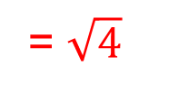
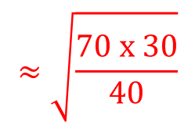
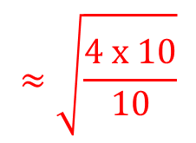
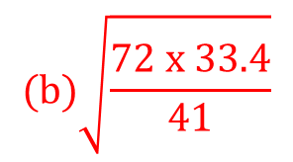
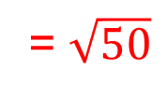
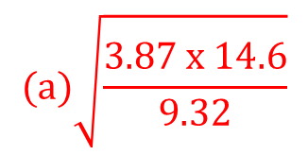
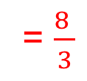
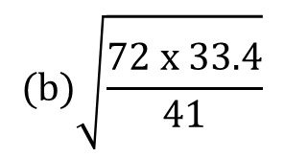
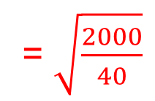
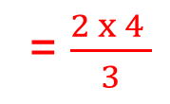
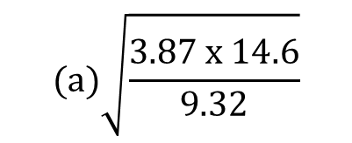
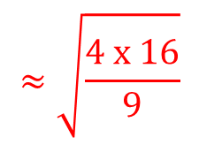
Estimation
Example 3
Estimate the value of:
$$(a)\sqrt{\frac{3.87 x 14.6}{9.32}}$$
$$(b)\sqrt{\frac{72 x 33.4}{41}}$$
Solution
$$(a)\sqrt{\frac{3.87 x 14.6}{9.32}}$$
$$≈\sqrt{\frac{4 x 10}{10}}$$
$$≈\sqrt{\frac{4 x 16}{9}}$$
= $\sqrt{4}$
or
= $\frac{2 x 4 }{3}$
= $\frac{8 }{3}$
= 2.66
= 2
Note that the actual value is 2.462 to 3 d.p.
$$(b)\sqrt{\frac{72 x 33.4}{41}}$$
$$≈\sqrt{\frac{70 x 30}{40}}$$
= $\sqrt{\frac{2100}{40}}$
= $\sqrt{\frac{2000}{40}}$
= $\sqrt{50}$
Note that 50 is between 7 and 8, but will be closer to 7 since $7^{2}$ = 49 We can therefore take 7 as our estimate.
The actual value is 7.659 to 3 d.p.

Slide 23
Estimation
You might also need to approximate when converting between different units. The following list reminds you of some of the important approximations between metric and imperial units.

Slide 24
Skill Check: Estimation
The month of December has 31 days. Estimate the number of seconds in December. Compare your estimate with the correct value.
Estimate the circumference of a circle with a radius of 20.5 cm.
A book has 326 pages with an average of 268.4 words on each page. Estimate the number of words in the book.
4. At a school the average daily amount spent by each child in the
30 days x 20 hours x 60 mins x 60 secs = 216 000 secs
3.14 x Diameter = 3 x 20 = 60 cm
300 x 250 = 3 x 25 x 1000 = 75 000 words
canteen is £1.42. There are 1264 pupils in the school. Estimate the total amount spent in the canteen each day.
1250 x £1.40 = £1400 + £350 = £1750

Slide 25
Skill Check: Estimation
5. James writes down this statement:
14.62 x 401= 586.262
Use estimation to describe why James must be wrong.
(b) Use a calculator to determine the correct answer, and then describe the mistake that James made.
14 x 400 = 10 x 400 + 4 x 400 = 4000 + 1600 = 5600
14.62 x 401 = 5862.62
6. Use estimation to decide which of the following calculations are definitely incorrect:
15.2 x 6120 = 900 240
65.224 ÷ 12.4 = 5.26
192 x 4 587 = 880 704
346.92 ÷ 2.36 = 14.7
15 x 6 000 = 90 000
60 ÷ 12 = 5
200 x 4 500 = 900 000
350 ÷2 = 175

Slide 26
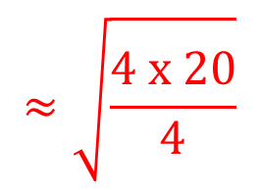
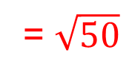
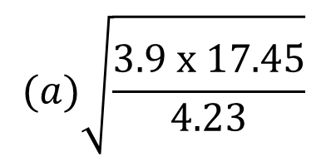
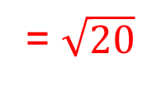
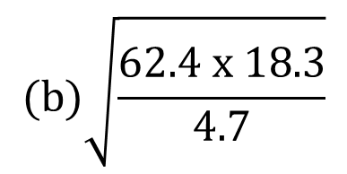
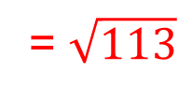
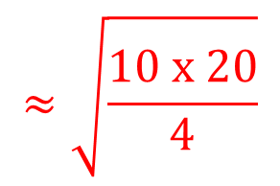
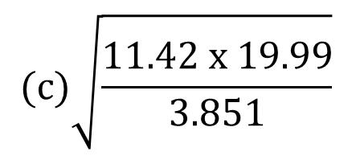
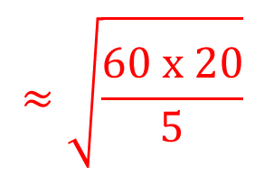
Skill Check: Estimation
7. Estimate the value of each of the following
$$(a)\sqrt{\frac{3.9 x 17.45}{4.23}}$$
$$≈\sqrt{\frac{4 x 20}{4}}$$
= $\sqrt{20}$
(Value between 4 and 5)
$$(b)\sqrt{\frac{62.4 x 18.3}{4.7}}$$
$$≈\sqrt{\frac{60 x 20}{5}}$$
= $\sqrt{240}$
(Value just under 16)
$$(c)\sqrt{\frac{11.42 x 19.99}{3.851}}$$
$$≈\sqrt{\frac{10 x 20}{4}}$$
= $\sqrt{50}$
(Value just over 7)
$$\left(d\right) \sqrt{{8.1}^{2}+{7.32}^{2}}$$
$$≈\sqrt{64+49 }$$
= $\sqrt{113}$
(Value just over 10)

Slide 27
Section 5: Review
You have completed the fifth section.
If you have completed and mastered this section, click to start the next Section
If you need more examples and interactive practice, press here
You might also find it helpful to look at:
Essential Information: press here

