Slide 1
Supporting and Enhancing Mathematics and Statistics
Unit: Volume and Surface Area of 3D Shapes

Slide 2
Volume and Surface Area
The following unit of work is divided into eight sections
Finding volume using unit cubes
Volume of cubes
Volume of cuboids and Units of Capacity
Surface area of a cuboid
Volume of a triangular prism
Surface area of a triangular prism
Volume of a cylinder
Surface area of a cylinder

Slide 3
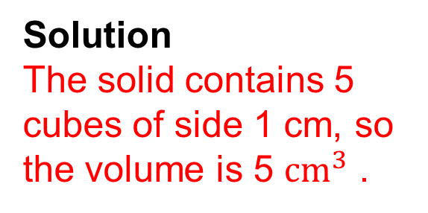
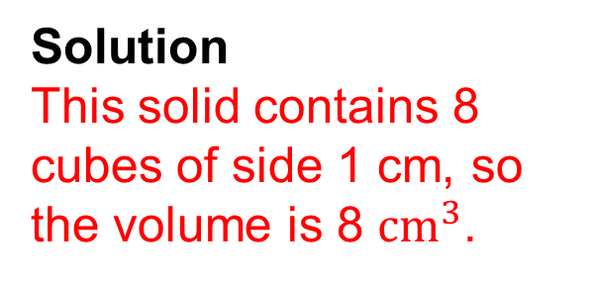
Volume: The unit cube
In this section we look at volume for the first time, by counting the number of 1 cm cubes in a solid.
The volume of this cube is 1 ${cm}^{3}$ (1 cubic centimetre)
Example 2
Example 1
Solution
The solid contains 5 cubes of side 1 cm, so the volume is 5 ${cm}^{3}$ .
Solution
This solid contains 8 cubes of side 1 cm, so the volume is 8 ${cm}^{3}$.

Slide 4
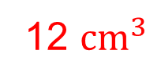
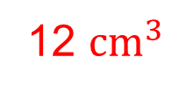
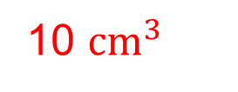
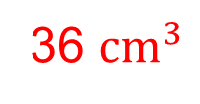
Skill Check: The Unit Cube
1. What is the volume of each of these cuboids:
(a)
(c)
12 ${cm}^{3}$
10 ${cm}^{3}$
(d)
(b)
36 ${cm}^{3}$
12 ${cm}^{3}$

Slide 5
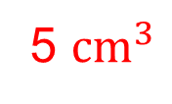
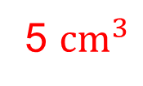
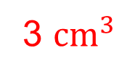
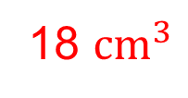
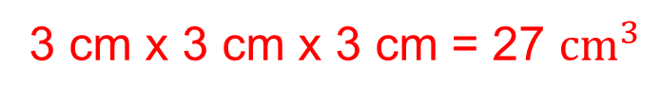
Skill Check: The Unit Cube
2. What is the volume of each of these solids:
(c)
(a)
(b)
3 ${cm}^{3}$
5 ${cm}^{3}$
5 ${cm}^{3}$
3. (a) What is the volume of the cube ?
3 cm x 3 cm x 3 cm = 27 ${cm}^{3}$
(b) The top layer is cut off.
What is the volume of the solid that remains?
18 ${cm}^{3}$

Slide 6
Section 1: Review
You have completed the first section.
If you have completed and mastered this section,
click to start the next Section
If you need more examples and interactive practice,
press here
You might also find it helpful to look at:
Essential Information: press here

Slide 7

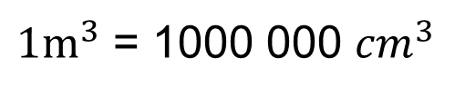
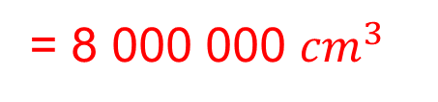
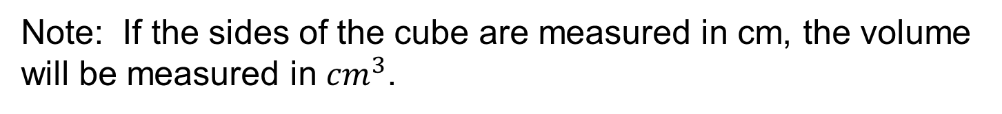
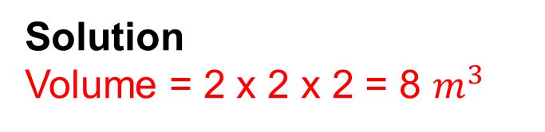
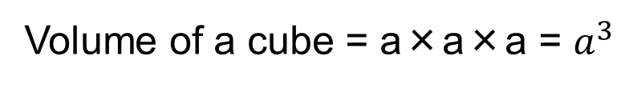
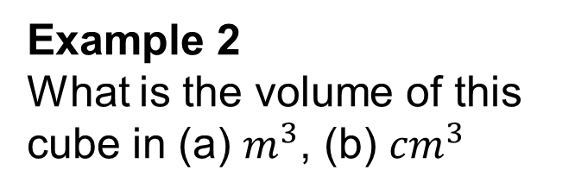
Volume of a Cube
In this section we consider the volume of a cube and the units of volume.
Volume of a cube = a×a×a = $a^{3}$
where a is the length of the each side of the cube
Note: If the sides of the cube are measured in cm, the volume will be measured in ${cm}^{3}$.
Example 2
What is the volume of this cube in (a) $m^{3}$, (b) ${cm}^{3}$
Example 1
What is the volume of this cube:
Solution
Volume = 5 x 5 x 5
= 125 ${cm}^{3}$
Solution
Volume = 2 x 2 x 2 = 8 $m^{3}$
${1m}^{3}$ = 1000 000 ${cm}^{3}$
= 8 000 000 ${cm}^{3}$

Slide 8
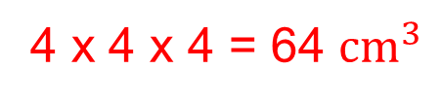
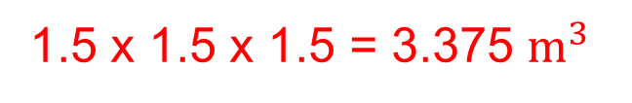
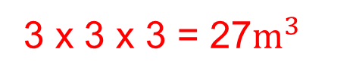
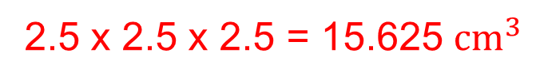
Skill Check: Volume of a cube
1. What is the volume of each of these cubes:
(a)
(c)
1.5 x 1.5 x 1.5 = 3.375 $m^{3}$
3 x 3 x 3 = 27$m^{3}$
(b)
(d)
4 x 4 x 4 = 64 ${cm}^{3}$
2.5 x 2.5 x 2.5 = 15.625 ${cm}^{3}$

Slide 9
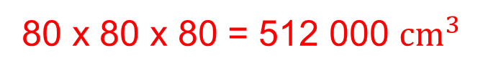
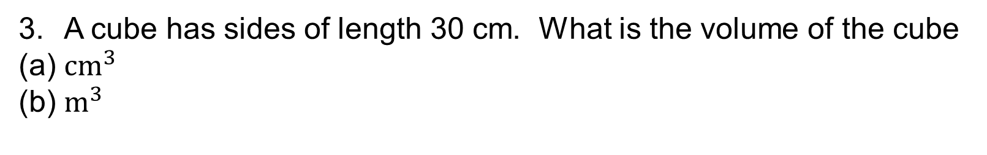
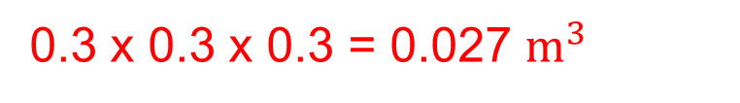
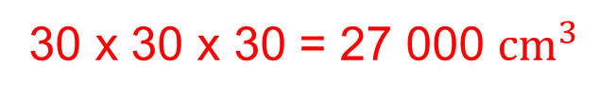
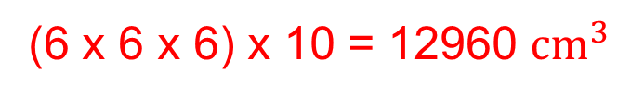
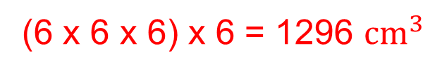
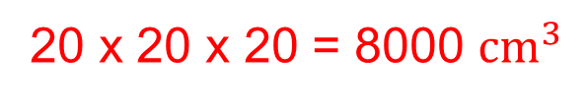
Skill Check: Volume of a cube
2. This 'staircase' is built from wooden cubes with sides of length 6 cm.
(a) What is the volume of the staircase?
(b) A similar staircase is 4 blocks high instead of 3. What is the volume of this staircase?
(6 x 6 x 6) x 6 = 1296 ${cm}^{3}$
(6 x 6 x 6) x 10 = 12960 ${cm}^{3}$
3. A cube has sides of length 30 cm. What is the volume of the cube
(a) ${cm}^{3}$
(b) $m^{3}$
30 x 30 x 30 = 27 000 ${cm}^{3}$
0.3 x 0.3 x 0.3 = 0.027 $m^{3}$
4. A large box is a cube with sides of length 80 cm. Smaller boxes, which are also cubes, have sides of lengths 20 cm.
(a) What is the volume of the large box?
(b) What is the volume of a small box?
(c) How many small boxes will fit in the large box?
80 x 80 x 80 = 512 000 ${cm}^{3}$
20 x 20 x 20 = 8000 ${cm}^{3}$
64 boxes

Slide 10
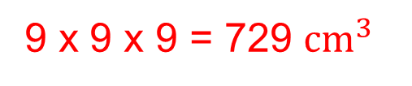

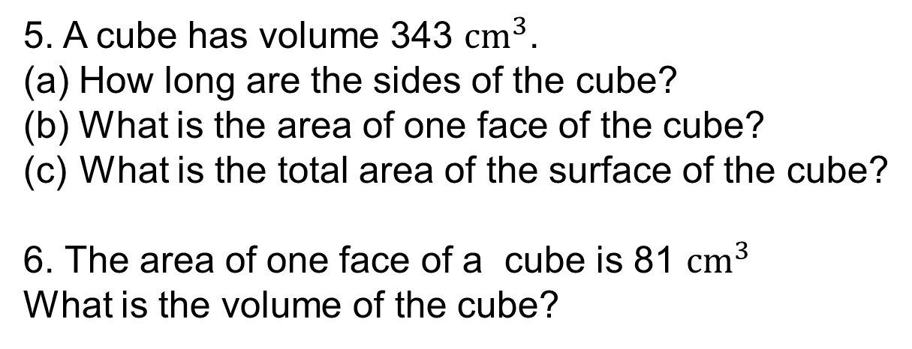
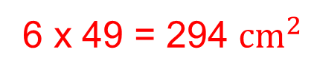
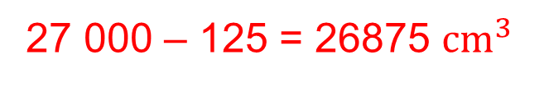
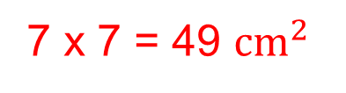


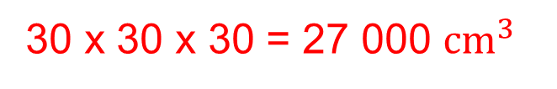
Skill Check: Volume of a cube
5. A cube has volume 343 ${cm}^{3}$.
(a) How long are the sides of the cube?
(b) What is the area of one face of the cube?
What is the total area of the surface of the cube?
6. The area of one face of a cube is 81 ${cm}^{3}$
What is the volume of the cube?
$$\sqrt[3]{343 }$$
= 7
7 x 7 = 49 ${cm}^{2}$
6 x 49 = 294 ${cm}^{2}$
$$\sqrt{81 }$$
= 9
9 x 9 x 9 = 729 ${cm}^{3}$
7. The diagram shows a cube with sides of length 30 cm. A smaller cube with sides of length 5 cm has been cut out of the larger cube.
(a) What is the volume of the large cube before the small cube is cut out?
(b) What is the volume of the small cube?
(c) What is the volume of the shape that is left?
30 x 30 x 30 = 27 000 ${cm}^{3}$
125 ${cm}^{3}$
27 000 – 125 = 26875 ${cm}^{3}$

Slide 11
Section 2: Review
You have completed the second section.
If you have completed and mastered this section,
click to start the next Section
If you need more examples and interactive practice,
press here
You might also find it helpful to look at:
Essential Information: press here

Slide 12
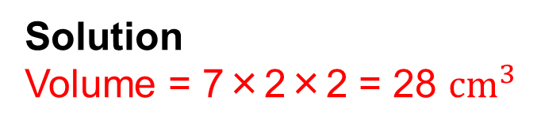
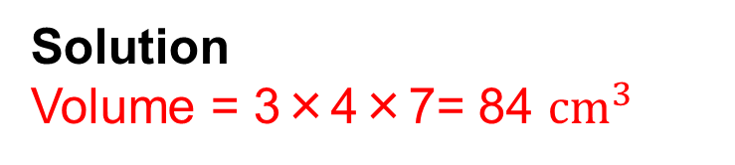
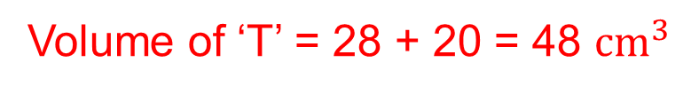
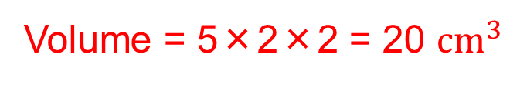
Volume of a Cuboid
We now consider the volume of any cuboid.
where a, b and c are the lengths of the sides of the cuboid
Volume = a×b×c
= abc
Example 2
A letter 'T' shape is made by sticking together 2 cuboids as shown in the diagram. What is the total volume of the letter 'T' ?
Example 1
Calculate the volume of this cuboid:
Solution
Volume = 7×2×2 = 28 ${cm}^{3}$
Volume = 5×2×2 = 20 ${cm}^{3}$
Solution
Volume = 3×4×7= 84 ${cm}^{3}$
Volume of ‘T’ = 28 + 20 = 48 ${cm}^{3}$

Slide 13
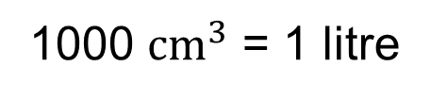
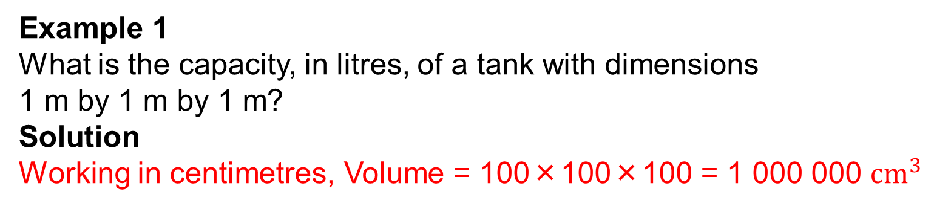
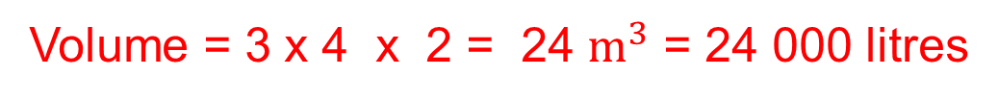
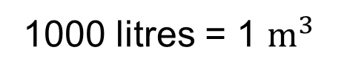
Capacity
When we refer to how much liquid a tank or container can hold, we often talk about its capacity in litres. This is another way of describing its volume.
1000 ${cm}^{3}$ = 1 litre
Example 1
What is the capacity, in litres, of a tank with dimensions
1 m by 1 m by 1 m?
Solution
Working in centimetres, Volume = 100×100×100 = 1 000 000 ${cm}^{3}$
= 1 000 litres
1000 litres = 1 $m^{3}$
Example 2
A tank measures 3 m by 4 m by 2 m. What is the capacity of the tank in litres?
Volume = 3 x 4 x 2 = 24 $m^{3}$ = 24 000 litres

Slide 14
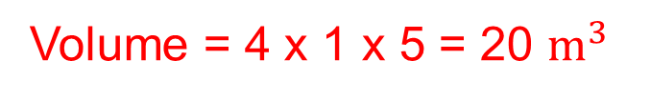
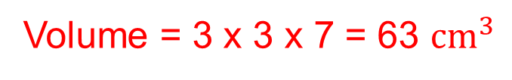
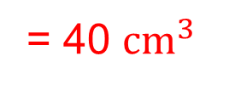
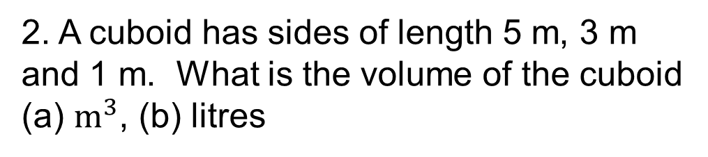
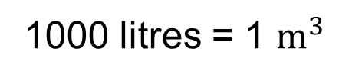
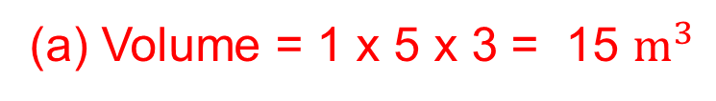
Skill Check: Volume of a Cuboid
1. Calculate the volume of each of these cuboids:
(a)
(b)
Volume = 4 x 2 x 5
= 40 ${cm}^{3}$
(c)
Volume = 3 x 3 x 7 = 63 ${cm}^{3}$
2. A cuboid has sides of length 5 m, 3 m and 1 m. What is the volume of the cuboid
(a) $m^{3}$, (b) litres
(a) Volume = 1 x 5 x 3 = 15 $m^{3}$
(b) Volume = 15 000 litres
Volume = 4 x 1 x 5 = 20 $m^{3}$
1000 litres = 1 $m^{3}$

Slide 15





Skill Check: Volume of a Cuboid
3. The diagram shows a large box and a small box, both of which are cuboids.
(a) Calculate the volume of the large box.
(b) Calculate the volume of the small box.
(c) How many of the small boxes would fit in the large box?
20 x 25 x 60 = 30 000 ${cm}^{3}$
5 x 5 x 10 = 250 ${cm}^{3}$
120 boxes
4. Calculate the volume of this solid:
Volume = 2 x 7 x 6 = 84 ${cm}^{3}$
Volume = 6 x 6 x 4 = 144 ${cm}^{3}$
Volume = 84 + 144 = 228 ${cm}^{3}$

Slide 16






Skill Check: Volume of Cuboids
5. A letter 'L' shape is made from two cuboids.
Calculate the volume of each cuboid.
(b) Calculate the volume of this letter 'L' shape.
Volume = 2 x 3 x 6 = 36 ${cm}^{3}$
Volume = 4 x 3 x 2 = 24 ${cm}^{3}$
Volume = 36 + 24 = 60 ${cm}^{3}$
6. A set of wooden building blocks contains wooden blocks that are 10 cm by 2 cm by 4 cm. The blocks are used to make the shapes below. Calculate the volume of each shape.
Volume = 10 x 2 x 4
= 80 ${cm}^{3}$
Volume = 3 x 80 = 240 ${cm}^{3}$
Volume = 3 x 80 = 240 ${cm}^{3}$

Slide 17





Skill Check: Volume of Cuboids
7. The diagram shows a wooden block that has had a square hole cut through it. Calculate the volume of wood in the block.
Volume = 5 x 5 x 8 = 200 ${cm}^{3}$
Volume = 2 x 2 x 8 = 32 ${cm}^{3}$
Volume = 200 - 32 = 168 ${cm}^{3}$
8. The diagram shows a cuboid. The area of the shaded end is 8 ${cm}^{2}$ . How long is the cuboid if its volume is:
(a) 80 ${cm}^{3}$ ,
(b) 96 ${cm}^{3}$ ,
(c) 20 ${cm}^{3}$ ?
80 ÷ 8 = 10 cm
8 ${cm}^{2}$
96 ÷ 8 = 12 cm
20 ÷ 8 = 2.5 cm

Slide 18


















Skill Check: Units of Capacity
1. Convert these volumes into ${cm}^{3}$:
(a) 2 Litres
2000 ${cm}^{3}$
(b) 5 Litres
5000 ${cm}^{3}$
(c) $\frac{1}{2}$ Litre
500 ${cm}^{3}$
(d) 0.2 Litres
200 ${cm}^{3}$
(e) 1.5 Litres
1500 ${cm}^{3}$
(f) 2.7 Litres
2700 ${cm}^{3}$
1000 ${cm}^{3}$ = 1 litre
2. Convert these volumes into litres:
(a) 3000 ${cm}^{3}$:
3 litres
(b) 7000 ${cm}^{3}$
7 litres
(c) 10 000 ${cm}^{3}$
10 litres
(d) 750 ${cm}^{3}$
0.75 litres
(e) 250 ${cm}^{3}$
0.25 litres
(f) 4900 ${cm}^{3}$
4.9 litres
3. A tank has dimensions 3 m by 3 m by 2 m. Calculate the capacity of the tank in
(a) $m^{3}$
(b) litres
18 $m^{3}$
18 000 litres
1000 litres = 1 $m^{3}$
4. A tank holds 5000 litres. Calculate the volume of the tank in $m^{3}$.
5000 ÷ 1000 = 5 $m^{3}$

Slide 19
Section 3: Review
You have completed the third section.
If you have completed and mastered this section,
click to start the next Section
If you need more examples and interactive practice,
press here
You might also find it helpful to look at:
Essential Information: press here

Slide 20








Surface Area of a Cuboid
A net can be folded up to make a solid. The diagram below shows one of the possible nets of a cube with side length x :
x
x
$x^{2}$
$x^{2}$
$x^{2}$
$x^{2}$
$x^{2}$
x
$x^{2}$
x
The net of a cube is always made up of 6 squares. Each square has an area of $x^{2}$ if the length of the side of the cube is x.
Total surface area of a cube = 6 $x^{2}$

Slide 21







Surface Area of a Cuboid
Example 1
Draw a net for the cube shown and calculate its surface area.
Solution
2 cm
2 cm
4 ${cm}^{2}$
The net is made up of 6 squares. Each square has an area of 4 ${cm}^{2}$
Surface area = 6×4 = 24 ${cm}^{2}$
4 ${cm}^{2}$
4 ${cm}^{2}$
4 ${cm}^{2}$
4 ${cm}^{2}$
4 ${cm}^{2}$

Slide 22
Surface Area of a Cuboid
The net of a cuboid is made up of 6 rectangles. The rectangles will occur in pairs as illustrated below:
For this Cuboid
and, surface area = xz +xz + xy + xy +yz + yz
= 2xz + 2xy + 2yz
= 2(xz + xy + yz)

Slide 23


Surface Area of a Cuboid
Example 2
Draw a net for the cuboid shown and calculate its surface area.
Solution
One of the possible nets for the cuboid is shown opposite, together with the area of each rectangle:
Surface area = 2+6+3+6+3+2= 22 ${cm}^{2}$
You can check your solution:
x=2 cm and y= 3 cm and z = 1 cm
so, using the formula 2 (xy + yz +xz)
Surface area = 2 (2 x 3 + 3 x 1 + 2 x 1)
= 2( 6 + 3 + 2)
= 22 ${cm}^{2}$

Slide 24
















Skill Check: Surface Area
1. Calculate the surface area of each of the following cuboids:
(a)
(b)
7 ${cm}^{2}$
16 ${cm}^{2}$
7 ${cm}^{2}$
16 ${cm}^{2}$
4 ${cm}^{2}$
4 ${cm}^{2}$
Area = 2( 4 +16 +16 ) = 72 ${cm}^{2}$
Area = 2( 4 + 7 + 7 ) = 36 ${cm}^{2}$
(c)
(d)
5 ${cm}^{2}$
300 ${cm}^{2}$
3 ${cm}^{2}$
220 ${cm}^{2}$
3.75 ${cm}^{2}$
165 ${cm}^{2}$
Area = 2( 5 + 3 + 3.75 ) = 23.5 ${cm}^{2}$
Area = 2( 165 + 220 + 300 ) = 1370 ${cm}^{2}$

Slide 25








Skill Check: Surface Area
2. Without drawing a net, calculate the surface area of a cube with sides of
(a) 10 cm
Area = 6 x 100 = 600 ${cm}^{2}$
(b) 9 cm
Area = 6 x 81 = 486 ${cm}^{2}$
3. The surface area of a cube is 24 ${cm}^{2}$ . Calculate the length of the sides of the cube
Side length = $\sqrt{(24÷6)}$
=$\sqrt{4 }$
= 2
4. The surface area of this cuboid is 102 ${cm}^{2}$ .What is the length marked x ?
Area RHS and LHS = 2 x 13.5 = 27 ${cm}^{2}$
Area Top and Base = 2 x 4.5x = 9x
4.5x
Area Front and Back = 2 x 3x = 6x
13.5 ${cm}^{2}$
3x
27 + 9x + 6x = 102
15x = 75,
x = 5

Slide 26
Section 4: Review
You have completed the fourth section.
If you have completed and mastered this section,
click to start the next Section
If you need more examples and interactive practice,
press here
You might also find it helpful to look at:
Essential Information: press here

Slide 27


Volume of a Triangular prism
We now look at how to find the volume of a triangular prism. You will need to remember how to find the area of a triangle in order to do this:
Area of a Triangle = $\frac{1}{2}$ × base × perpendicular height
= $\frac{1}{2}$ × b × h
A triangular prism has the same triangular cross-section throughout its length.
Volume of triangular prism = area of cross-section × length
Volume = $\frac{1}{2}$ × b × h x l

Slide 28




Volume of a Triangular Prism
Example 1
The diagram opposite shows a triangular prism. The area of the end of the prism is 10 ${cm}^{2}$.
Calculate the volume of the prism, if:
(a) l = 5 cm
(b) l = 2 m
Solution
(a) Volume = area of cross-section × length
= 10 × 5 = 50 ${cm}^{3}$
2 m = 200 cm
Volume = area of cross-section × length
= 10 × 200 = 2000 ${cm}^{3}$ = 2 litres
Example 2
Calculate the volume of this triangular prism:
Area of cross-section = $\frac{1}{2}$x 4 x 6 = 12 ${cm}^{2}$
Volume = area of cross-section × length = 12 × 8 = 96 ${cm}^{3}$

Slide 29




Skill Check: Volume of a Triangular Prism
1. Calculate the volume of each of these triangular prisms:
(a)
(b)
Volume = 5 x 6 = 30 ${cm}^{3}$
Volume = ( $\frac{1}{2}$x 3 x 6 ) x 8 = 72 ${cm}^{3}$
(c)
(d)
Volume = 7.2 x 5 = 36 ${cm}^{3}$
Volume = ( $\frac{1}{2}$x 4 x 2 ) x 6 = 24 ${cm}^{3}$

Slide 30




Skill Check: Volume of a Triangular Prism
2. Two identical triangular prisms are stuck together to form a rectangular block. One prism is shown opposite.
(a) What is the volume of this prism?
(b) What is the volume of the rectangular block formed when the two prisms are stuck together?
86 ${cm}^{3}$
2 x 86 = 172 ${cm}^{3}$
Solution
Area of cross-section = $\frac{1}{2}$x 5 x 4.5 = ${cm}^{2}$
Volume = area of cross-section × length = 11.25 × 8 = 86 ${cm}^{3}$
3. The volume of this triangular prism is 63 ${cm}^{3}$
Find the length of the prism if the area of the shaded end is 10.5 ${cm}^{2}$ .
Length = 63 ÷ 10.5 = 6 cm

Slide 31









Skill Check: Volume of a Triangular Prism
4. The triangular prism opposite has a volume of 84 ${cm}^{3}$.
(a) What is the area of the shaded end of the prism
(b) If the length was increased to 6 cm, what would now be the volume of the prism?
Area = 84 ÷ 4 = 21 ${cm}^{2}$
21 ${cm}^{2}$
Volume = 21 x 6 = 126 ${cm}^{3}$
5. A model house is made by sticking a triangular prism on top of a rectangular block, as shown in the diagram.
Calculate the volume of the model house.
75 ${cm}^{3}$
Solution
Volume prism = ( $\frac{1}{2}$x 3 x 4 ) x 12.5 = 75 ${cm}^{3}$
150 ${cm}^{3}$
Volume block = 3 x 4 x 12.5 = 150 ${cm}^{3}$
Volume house = 75 + 150 = 225 ${cm}^{3}$

Slide 32


Skill Check: Volume of a Triangular Prism
6. A triangular prism has a triangular hole cut in it. Calculate the volume of the prism after the hole has been cut out.
15 ${cm}^{3}$
135 ${cm}^{3}$
Solution
Volume large triangular prism = ( $\frac{1}{2}$x 9 x 6 ) x 5 = 135 ${cm}^{3}$
Volume small triangular prism = ( $\frac{1}{2}$x 3 x 2 ) x 5 = 15 ${cm}^{3}$
Volume triangular prism = 135 – 15 = 120 ${cm}^{3}$

Slide 33
Section 5: Review
You have completed the fifth section.
If you have completed and mastered this section,
click to start the next Section
If you need more examples and interactive practice,
press here
You might also find it helpful to look at:
Essential Information: press here

Slide 34

Surface Area of a Triangular prism
We now look at how to find the surface area of a triangular prism. You will need to remember how to find the area of a triangle in order to do this:
Area of a Triangle = $\frac{1}{2}$ × base × perpendicular height
= $\frac{1}{2}$ × b × h
A triangular prism has the same triangular cross-section throughout its length.
Surface Area
= 2 x Area of triangular
cross-section
+
Area of the 3 surrounding rectangular sides

Slide 35



Surface Area of a Triangular Prism
Example 1
Find the area of the triangular prism opposite
Solution
14 mm
13 mm
Area of Triangular ends
12 mm
13 mm
$\frac{1}{2}$x 10 x 12 = 60 ${mm}^{2}$
10 mm
Area of Base
13 mm
10 x 14 = 140 ${mm}^{2}$
13 mm
Area of sides
14 x 13 = 182 ${mm}^{2}$
Surface Area of Triangular prism = 2 x 60 + 140 + 2 x 182 = 624 ${mm}^{2}$

Slide 36











Skill Check:
Exercise
1. Find the Surface Area of the triangular Prisms
Solution
Area of Triangles = 9 x 8 = 72${ cm}^{2}$
Area of RHS = 10 x 5 = 50 ${cm}^{2}$
Area of LHS = 9 x 5 = 45 ${cm}^{2}$
Area of Base = 8 x 5 = 40 ${cm}^{2}$
Surface Area = 72 + 50 + 45 + 40 = 207 ${cm}^{2}$
Solution
Area of Triangles = 3 x 4 = 12 ${cm}^{2}$
Area of RHS = 5 x 11= 55 ${cm}^{2}$
Area of LHS = 3 x 11 = 33 ${cm}^{2}$
Area of Base = 4 x 11 = 44 ${cm}^{2}$
Surface Area = 6 + 55 + 33 + 44 = 144 ${cm}^{2}$

Slide 37
Section 6: Review
You have completed the sixth section.
If you have completed and mastered this section,
click to start the next Section
If you need more examples and interactive practice,
press here
You might also find it helpful to look at:
Essential Information: press here

Slide 38



Volume of a Cylinder
A cylinder is a prism with a circular cross-section.
Volume of cylinder = A×h
= π $r^{2}$ h
Example 1
Calculate the volume cylinder shown in the diagram.
Solution
The radius of the base of the cylinder is 3 cm.
Volume = π$r^{2}$h
π = 3.14
= 3.14 x 3 x 3 x 8 = 226.08 ${cm}^{3}$

Slide 39






Skill Check: Volume of Cylinders
1. Look at the dimensions of the following cylinders:
56.52 ${cm}^{3}$
50.24 ${cm}^{3}$
28.26 ${cm}^{3}$
π = 3.14
Without doing any calculations, decide which cylinder you think has the greatest volume.
Determine the volume of each cylinder and see if you were correct.
Cylinder A will have the greatest volume as it has the largest base for the water to spread over.
A = 56.52 ${cm}^{3}$
B = 50.24 ${cm}^{3}$
C = 28.26 ${cm}^{3}$

Slide 40





Skill Check: Volume of Cylinders
2. The following diagrams show two cylinders, A and B:
Volume = π$r^{2}$h
62.8 ${cm}^{3}$
62.8 ${cm}^{3}$
π = 3.14
(a) Show that both cylinders have the same volume.
Volume of cylinder A = 3.14 x 2 x 2 x 5 = 62.8 ${cm}^{3}$
Volume of cylinder A = 3.14 x 20 = 62.8 ${cm}^{3}$
Volume of cylinder B = 3.14 x 4 x 4 x 1.25 = 62.8 ${cm}^{3}$
Volume of cylinder B = 3.14 x 20 = 62.8 ${cm}^{3}$

Slide 41




Skill Check: Volume of Cylinders
3. A cylinder has volume 300 ${cm}^{3}$ and height 9 cm. Calculate the diameter of the cylinder.
Solution
Volume = π$r^{2}$h
π = 3.14
Volume of cylinder = 3.14 x r x r x 9 = 300 ${cm}^{3}$
$r^{2}$ = 300 ÷(3.14 x 9) = 10.62 2.d.p.
r =$\sqrt{10.62}$
= 3.26 cm
Diameter = 2 x 3.26 = 6.52 cm
4. The diagram shows the cross-section of a
clay pipe. The length of the pipe is 40 cm.
Calculate the volume of clay needed to make the pipe.
Solution
Volume of outer cylinder = 3.14 x 5 x 5 x 40 = 3140 ${cm}^{3}$
Volume of inner cylinder = 3.14 x 4 x 4 x 40 = 2009.6 ${cm}^{3}$
Volume of clay = 3140 – 2009.6 = 1130.4 ${cm}^{3}$

Slide 42
Section 7: Review
You have completed the seventh section.
If you have completed and mastered this section,
click to start the next Section
If you need more examples and interactive practice,
press here
You might also find it helpful to look at:
Essential Information: press here

Slide 43


Surface Area of a cylinder
The total surface area of the cylinder can be determined by splitting it into 3 parts
The curved surface can be opened out to form a rectangle. The length of one side is equal to the height, h, of the cylinder; the other is equal to the circumference of the cross-section, 2π r .
Total area = area of curved surface + area of top + area of bottom
= 2 πrh + π$r^{2}$+ π$r^{2}$
Surface Area = 2 πrh + 2 π$r^{2}$

Slide 44

Skill Check: Surface Area of a Cylinder
Example 1
Calculate the surface area of the cylinder shown in the diagram.
π = 3.14
Solution
The radius of the base of the cylinder is 3 cm.
Surface area = 2 πrh + 2 π$r^{2}$
= (2×3.14×3×8) + (2 x 3.14 x 3 x 3) = 207.24 ${cm}^{2}$
Example 2
The diagram shows a sheet of card that is to be used to make the curved surface of a cylinder of height 8 cm.
3.5 cm
(a) Calculate the radius of the cylinder.
(b) Calculate the area of ends of the cylinder.
Solution
(a) 2 πr = 22 cm
r = 22 ÷ ( 2 x 3.14) = 3.5 cm 1.d.p.
(b) Area of end = π$r^{2}$ = 3.14 x 3.5 x 3.5 = 38.465 ${cm}^{2}$

Slide 45




Skill Check: Surface Area of a Cylinder
1. Calculate the total surface area of the following cylinder:
π = 3.14
Surface area = 2 πrh + 2 π$r^{2}$
= (2×3.14×2.8×7.2) + (2 x 3.14 x 2.8 x 2.8)
= 126.6048 + 49.2352
= 175.84 ${cm}^{2}$
2. Find the surface area of the two cylinders, A and B:
Surface area = 87.92 ${cm}^{2}$
Surface area = 131.88 ${cm}^{2}$

Slide 46

Skill Check: Surface Area of a Cylinder
3. The curved surface of a cylinder is to be made from a rectangular sheet of material which is 18 cm by 32 cm.
(a) Explain why two different cylinders could be made from this sheet.
(b) Calculate the radius of each of the cylinders.
(c) Calculate the surface area of each cylinder.
32 cm
Solution
π = 3.14
18 cm
h = 18 cm
2 πr = 32
r = 32 ÷( 2 x 3.14 ) = 5.1 cm 1 d.p.
Surface Area = (2×3.14×5.1×18) + (2 x 3.14 x 5.1 x 5.1 ) = 739.8 ${cm}^{2}$
2 πr = 18
r = 18 ÷( 2 x 3.14 ) = 2.9 cm 1 d.p.
h = 32 cm
Surface Area = (2×3.14×2.9×32) + (2 x 3.14 x 2.9 x 2.9 )
= 635.598 ${cm}^{2}$

Slide 47





Skill Check: Surface Area of a Cylinder
4. A cylinder has volume 250 ${cm}^{3}$ and base radius 6 cm.
(a) Calculate the height of the cylinder.
(b) Calculate the total surface area of the cylinder.
π = 3.14
(a) Volume = π$r^{2}$h = 3.14 x 6 x 6 x h = 250 ${cm}^{3}$
h = 250÷( 3.14 x 6 x 6 ) = 2.21 2. d.p.
(b) Surface Area = (2×3.14×6×2.21 ) + (2 x 3.14 x 6 x 6) = 309.4 ${cm}^{2}$
5. Calculate the total surface area of the shape shown.
Surface Area of inner curve = (2×3.14×3×15) + (2 x 3.14 x 3 x 3)
= 339.2 ${ cm}^{2}$
Surface Area of outer curve = (2×3.14×6×15) + (2 x 3.14 x 6 x 6)
= 791.28${ cm}^{2}$
Area of front and back = 2 x ( (3.14 x 6 x 6) – (3.14 x 3 x 3) )
= 169.56 ${ cm}^{2}$
Total Surface Area = 339.2 + 791.28 + 169.56
= 1 300.04 ${cm}^{2}$

Slide 48
Section 8: Review
You have completed the eighth section.
If you have completed and mastered this section,
click to start the next Section
If you need more examples and interactive practice,
press here
You might also find it helpful to look at:
Essential Information: press here

