Slide 1
Supporting and Enhancing Mathematics and Statistics
Unit: Fractions

Slide 2
Title
The unit of work is divided into the following seven sections
Fractions
Equivalent Fractions
Fractions of amounts
Improper Fractions
Adding and Subtracting Fractions
Multiplying fractions
Dividing Fractions

Slide 3

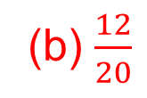
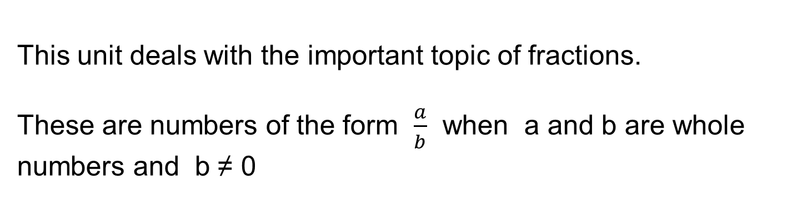
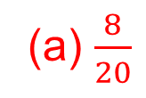
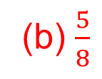
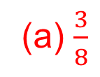
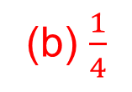
Fractions
This unit deals with the important topic of fractions.
These are numbers of the form $\frac{a}{b}$ when a and b are whole numbers and b ≠ 0
Example
What fraction of the shape is (a) shaded (b) unshaded
Solution
(a) $\frac{3}{4}$
(b) $\frac{1}{4}$
(a) $\frac{3}{8}$
(b) $\frac{5}{8}$
(a) $\frac{8}{20}$
(b) $\frac{12}{20}$

Slide 4

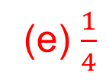
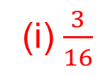

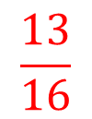
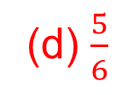
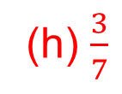



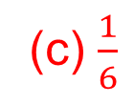
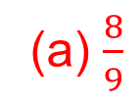


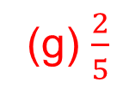

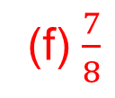


Skill Check: Fractions
Exercise
Solution
What fraction of the shapes
(a) shaded (b) unshaded
(a) $\frac{8}{9}$
(b) $\frac{3}{8}$
(c) $\frac{1}{6}$
$\frac{1}{9}$
$\frac{5}{8}$
$$\frac{5}{6}$$
(d) $\frac{5}{6}$
(e) $\frac{1}{4}$
(f) $\frac{7}{8}$
$$\frac{1}{6}$$
$$\frac{3}{4}$$
$$\frac{1}{8}$$
(g) $\frac{2}{5}$
(h) $\frac{3}{7}$
(i) $\frac{3}{16}$
$$\frac{3}{5}$$
$$\frac{4}{7}$$
$$\frac{13}{16}$$

Slide 5
Skill Check:
Exercise
Copy each of these shapes and shade the fraction stated

Slide 6





Skill Check: Fractions
Exercise
Copy each of these shapes and shade the fraction stated
Shade the fraction stated
$$\frac{1}{2}$$
$$\frac{1}{4}$$
$$\frac{1}{3}$$
$$\frac{1}{6}$$
$$\frac{1}{12}$$

Slide 7
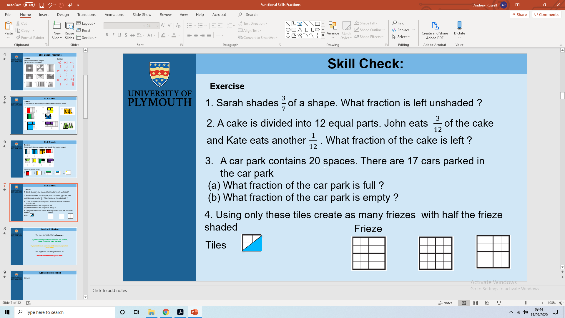


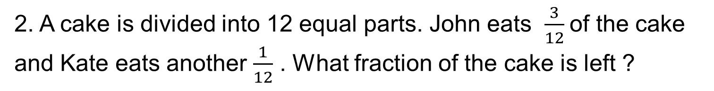

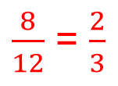
Skill Check: Fractions
Exercise
1. Sarah shades $\frac{3}{7}$of a shape. What fraction is left unshaded ?
$$\frac{4}{7}$$
2. A cake is divided into 12 equal parts. John eats $\frac{3}{12}$of the cake and Kate eats another $\frac{1}{12}$ . What fraction of the cake is left ?
$\frac{8}{12}$ = $\frac{2}{3}$
A car park contains 20 spaces. There are 17 cars parked in the car park
(a) What fraction of the car park is full ?
(b) What fraction of the car park is empty ?
$$\frac{17}{20}$$
$$\frac{3}{20}$$
4. Using these tiles create as many Friezes with half the Frieze shaded
Tiles
Frieze
Example

Slide 8
Section 1: Review
You have completed the first section.
If you have completed and mastered this section,
click to start the next Section
If you need more examples and interactive practice,
press here
You might also find it helpful to look at:
Essential Information: press here

Slide 9


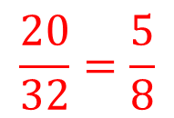

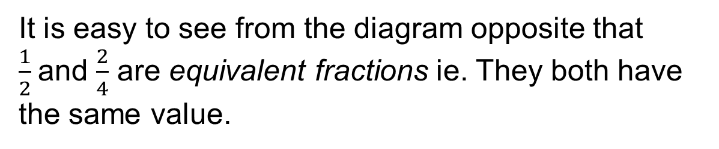

Equivalent Fractions
It is easy to see from the diagram opposite that $\frac{1}{2}$and $\frac{2}{4}$ are equivalent fractions ie. They both have the same value.
Another way of looking at this is to note that the fractions are at the same place on a number line
0
$$\frac{1}{2}$$
1
0
$$\frac{1}{4}$$
$$\frac{2}{4}$$
$$\frac{3}{4}$$
1
Example
Use the diagram below to shade $\frac{5}{8}$ of the rectangle in different ways
Solution
Shade any 20 of the 32 triangle
$$\frac{20}{32}=\frac{5}{8}$$

Slide 10
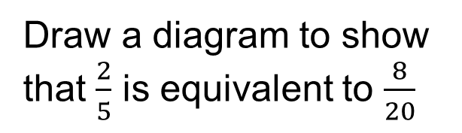
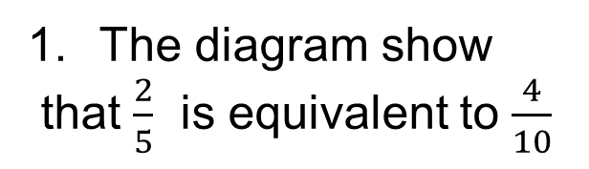
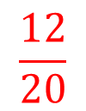
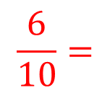
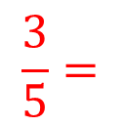
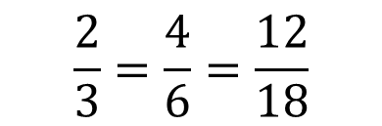
Skill check: Equivalent Fractions
Exercise
The diagram show
that $\frac{2}{5}$ is equivalent to $\frac{4}{10}$
Draw a diagram to show that $\frac{2}{5}$ is equivalent to $\frac{8}{20}$
2. Use the diagram opposite to show that
$$\frac{2}{3}=\frac{4}{6}=\frac{12}{18}$$
3. Write down the equivalent fractions shown by these diagrams
$$\frac{3}{5}=$$
$$\frac{6}{10}=$$
$$\frac{12}{20}$$

Slide 11
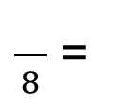
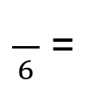


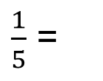
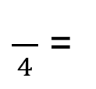





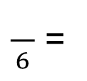






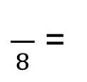



Skill Check: Equivalent Fractions
Exercise
Use the “Fraction Wall” to fill in the missing numbers
2
3
4
5
6
7
$\frac{1}{2}$ =
$\frac{}{4}$ =
$\frac{}{6}$ =
$\frac{}{8}$ =
$\frac{}{10}$ =
$\frac{}{12}$ =
$\frac{}{14}$
(a)
2
3
4
5
$\frac{1}{3}$ =
$\frac{}{6}$ =
$\frac{}{9}$ =
$\frac{}{12}$ =
$\frac{}{15}$
(b)
2
3
4
(c)
$\frac{1}{4}$ =
$\frac{}{8}$ =
$\frac{}{12}$ =
$\frac{}{16}$
$\frac{1}{5}$ =
3
2
$\frac{}{15}$
(d)
$\frac{}{10}$ =
2
$$\frac{1}{6}=\frac{}{12}$$
(e)
2
(f)
$$\frac{1}{7}=\frac{}{14}$$
2
$$\frac{1}{8}=\frac{}{16}$$
(g)

Slide 12
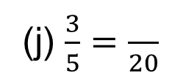



































Skill Check: Equivalent Fractions
Exercises
5. Write down the missing numbers
10
9
6
4
(c) $\frac{5}{7}=\frac{}{14}$
(d) $\frac{3}{4}=\frac{}{12}$
(a) $\frac{3}{4}=\frac{}{8}$
(b) $\frac{2}{5}=\frac{}{10}$
6
6
4
6
(f) $\frac{2}{3}=\frac{}{9}$
(g) $\frac{3}{8}=\frac{}{16}$
(h) $\frac{2}{7}=\frac{}{14}$
(e) $\frac{2}{5}=\frac{}{15}$
12
15
15
15
(l) $\frac{3}{8}=\frac{}{40}$
(i) $\frac{3}{4}=\frac{}{20}$
(j) $\frac{3}{5}=\frac{}{20}$
(k) $\frac{5}{7}=\frac{}{21}$
6. Insert either < or > into each of the pairs to make it correct
(a) $\frac{1}{2}$
$$\frac{1}{3}$$
(b) $\frac{1}{4}$
$$\frac{1}{5}$$
(c) $\frac{1}{6}$
$$\frac{1}{7}$$
(d) $\frac{1}{10}$
$$\frac{1}{9}$$
(e) $\frac{1}{2}$
$$\frac{2}{3}$$
(f) $\frac{3}{4}$
$$\frac{2}{3}$$
>
>
>
<
<
>
(g) $\frac{2}{5}$
$$\frac{1}{2}$$
(h) $\frac{7}{10}$
$$\frac{7}{8}$$
(i) $\frac{5}{7}$
$$\frac{3}{5}$$
(j) $\frac{5}{6}$
$$\frac{5}{7}$$
(k) $\frac{2}{3}$
$$\frac{5}{7}$$
(l) $\frac{4}{5}$
$$\frac{5}{6}$$
<
<
>
>
<
<

Slide 13




















Skill Check: Equivalent Fractions
Exercises
7. Write down the missing numbers
1
2
3
1
(a) $\frac{15}{30}=\frac{}{2}$
(b) $\frac{6}{9}=\frac{}{3}$
(c) $\frac{9}{12}=\frac{}{4}$
(d) $\frac{3}{12}=\frac{}{4}$
2
2
3
(h) $\frac{14}{21}=\frac{}{3}$
4
(f) $\frac{16}{40}=\frac{}{5}$
(g) $\frac{30}{50}=\frac{}{5}$
(e) $\frac{8}{18}=\frac{}{9}$
11
2
1
18
(l) $\frac{132}{216}=\frac{}{18}$
(i) $\frac{16}{24}=\frac{}{3}$
(j) $\frac{17}{51}=\frac{}{3}$
(k) $\frac{144}{200}=\frac{}{25}$
6. Write each set of fractions in increasing order
$$\frac{3}{5},\frac{2}{7},\frac{5}{6},\frac{4}{9}$$
$$\frac{2}{7},\frac{4}{9},\frac{3}{5},\frac{5}{6}$$
(a)
$$\frac{1}{7},\frac{1}{9},\frac{1}{3},\frac{1}{10}$$
$$\frac{1}{10},\frac{1}{9},\frac{1}{7},\frac{1}{3}$$
(c)
(b)
$$\frac{2}{3},\frac{3}{5},\frac{4}{7},\frac{2}{9}$$
$$\frac{2}{9},\frac{4}{7},\frac{3}{5},\frac{2}{3}$$
(d)
$$\frac{3}{7},\frac{1}{9},\frac{5}{7},\frac{5}{9}$$
$$\frac{1}{9},\frac{3}{7},\frac{5}{9},\frac{5}{7}$$

Slide 14








































Skill Check: Equivalent Fractions
Exercises
8. Write each fraction in its simplest form
$$\frac{1}{3}$$
(b) $\frac{15}{20}=$
$$\frac{3}{5}$$
(c) $\frac{20}{25}=$
$$\frac{4}{5}$$
(d) $\frac{9}{13}=$
$$\frac{9}{13}$$
(a) $\frac{8}{24}=$
(f) $\frac{40}{64}=$
$$\frac{5}{8}$$
(g) $\frac{9}{36}=$
$$\frac{1}{4}$$
(h) $\frac{80}{200}=$
$$\frac{2}{5}$$
(e) $\frac{21}{28}=$
$$\frac{3}{4}$$
$$\frac{3}{5}$$
$$\frac{1}{3}$$
(l) $\frac{55}{88}=$
$$\frac{5}{8}$$
(i) $\frac{132}{500}=$
$$\frac{33}{125}$$
(j) $\frac{24}{40}=$
(k) $\frac{18}{54}=$
9. State whether the following are true (T) or false (F)
(a) $\frac{3}{7}$
$$\frac{3}{8}$$
(b) $\frac{3}{8}$
$$\frac{36}{88}$$
(c) $\frac{11}{44}$
$$\frac{1}{4}$$
(d) $\frac{5}{8}$
$$\frac{1}{2}$$
>
T
=
F
=
T
>
T
(e) $\frac{3}{8}$
$$\frac{1}{2}$$
(f) $\frac{1}{6}$
$$\frac{1}{7}$$
(i) $\frac{8}{9}$
$$\frac{7}{8}$$
(j) $\frac{9}{10}$
$$\frac{10}{11}$$
>
F
<
F
>
T
<
T

Slide 15
Section 2: Review
You have completed the second section.
If you have completed and mastered this section,
click to start the next Section
If you need more examples and interactive practice,
press here
You might also find it helpful to look at:
Essential Information: press here

Slide 16










Fractions of Amounts
We now start to use fractions in a practical way
Example
Solution
(a) Find $\frac{1}{5}$of £30
(a) $\frac{1}{5}$ x £30 = £30 ÷ 5 = £6
(b) Find $\frac{4}{5}$of £30
(b) $\frac{4}{5}$ x £30 = £30 ÷ 5 x 4 = £24
2. In a test there are 30 marks. Nasir gets $\frac{3}{5}$ of the marks. How many marks does he get?
$\frac{3}{5}$ x 30 = (30 ÷ 5) x 3 = 18 marks
3. In a school $\frac{1}{2}$ of the pupils are girls. There are 382 pupils in the school. How many girls are there in the school?
$\frac{1}{2}$ x 382 = 382 ÷ 2 = 191 girls
4. In a class there are 32 pupils. Of these, $\frac{3}{8}$ come to school by bus. How many pupils come to school by bus ?
$\frac{3}{8}$ x 32 = (32 ÷ 8) x 3 = 12 pupils

Slide 17
























Skills Check: Fractions of Amounts
Exercise
1. Find
(a) $\frac{1}{2}$of 12
(b) $\frac{1}{4}$of 8
2
(c) $\frac{1}{5}$of 15
3
(d) $\frac{1}{3}$of 12
4
6
(e) $\frac{1}{5}$of 30
6
(f) $\frac{1}{4}$of 40
(g) $\frac{1}{7}$of 14
2
(h) $\frac{1}{8}$of 64
8
10
(i) $\frac{1}{8}$of 40
5
(j) $\frac{1}{3}$of 24
8
(k) $\frac{1}{4}$of 32
8
(l) $\frac{1}{9}$of 36
4
2. Find
(a) $\frac{3}{4}$of 24
18
(a) $\frac{4}{5}$of 20
16
(a) $\frac{3}{7}$of 14
6
(a) $\frac{2}{9}$of 18
4
(a) $\frac{3}{5}$of 15
9
(a) $\frac{7}{9}$of 45
35
(a) $\frac{5}{6}$of 30
25
(a) $\frac{4}{7}$of 28
16
(a) $\frac{3}{8}$of 64
(a) $\frac{5}{9}$of 36
(a) $\frac{3}{5}$of 45
27
(a) $\frac{7}{8}$of 56
49
24
20

Slide 18




Skill Check:
Exercise
3. In a school $\frac{3}{10}$, of the pupils have pets. There are 510 pupils in the school.
How many have pets ?
How many of them do not have pets ?
(510 ÷10) x 3 = 153 pets
510 – 153 = 357
4. There are 20 houses in a street and $\frac{3}{4}$ of them have a satellite TV. How many of these houses do not have a satellite TV ?
20 – 15 = 5 TV’s
5. Rachel has 360 stamps in her stamp collection,. $\frac{5}{8}$ of these stamps are foreign . How many foreign stamps has she got ?
(360÷8) x 5 = 225 Stamps
6. In a school there are 550 pupils. If $\frac{3}{50}$ of the pupils are left handed, how many right handed pupils are there in the school ?
(550÷50) x 3 = 33 Left handed
550 - 33 = 517 Right handed

Slide 19
Section 3: Review
You have completed the third section.
If you have completed and mastered this section,
click to start the next Section
If you need more examples and interactive practice,
press here
You might also find it helpful to look at:
Essential Information: press here

Slide 20





Improper Fractions
So far we have worked with fractions of the form $\frac{a}{b}$ where a < b
eg. $\frac{3}{4},\frac{2}{7},\frac{5}{6},…$
We also need to work with what are sometimes called vulgar or improper fractions which are of the form $\frac{a}{b}$ where a > b
eg.
$$\frac{4}{3},\frac{7}{2},\frac{6}{5},…$$
Example
Show that $\frac{13}{4}$ and 3 $\frac{1}{4}$ are equivalent
This contains 13 quarters
3 $\frac{1}{4}$

Slide 21







Skill Check: Improper Fractions
Exercise
1. Write each of the numbers represented below in two different ways
(a) 1 $\frac{1}{2}$ and $\frac{3}{2}$
(b) 1 $\frac{3}{4}$ and $\frac{7}{4}$
(c) 1 $\frac{1}{3}$ and $\frac{4}{3}$
(d) 2 $\frac{1}{5}$ and $\frac{11}{5}$
(e) 2 $\frac{5}{8}$ and $\frac{21}{8}$
(f) 3 $\frac{1}{4}$ and $\frac{13}{4}$
(g) 1 $\frac{4}{9}$ and $\frac{13}{9}$

Slide 22












Skill Check : Improper Fractions
Exercise
2. Draw diagrams for these mixed numbers and write as improper
$$\frac{6}{5}$$
(a) 1 $\frac{1}{5}$
$$\frac{9}{4}$$
(b) 2 $\frac{1}{4}$
$$\frac{10}{3}$$
(c) 3 $\frac{1}{3}$
3. Draw diagrams for these improper fractions and write as mixed
(a) $\frac{7}{2}$
3 $\frac{1}{2}$
(b) $\frac{7}{3}$
2 $\frac{1}{3}$
(c) $\frac{16}{5}$
3 $\frac{1}{5}$

Slide 23








































Skill Check: Improper Fractions
4. Convert these improper fractions to mixed numbers
(a) $\frac{9}{2}$
(e) $\frac{18}{5}$
3 $\frac{3}{5}$
4 $\frac{1}{9}$
(b) $\frac{4}{3}$
1 $\frac{1}{3}$
(c) $\frac{5}{3}$
1 $\frac{2}{3}$
(d) $\frac{12}{5}$
2 $\frac{2}{5}$
(f) $\frac{9}{7}$
1 $\frac{2}{7}$
(g) $\frac{11}{9}$
1 $\frac{2}{9}$
(h) $\frac{9}{4}$
2 $\frac{1}{4}$
(i) $\frac{8}{5}$
1 $\frac{3}{5}$
(j) $\frac{22}{9}$
2 $\frac{4}{9}$
5. Convert these mixed numbers to improper fractions
(a) 1 $\frac{3}{5}$
$\frac{8}{5}$
(b) 4 $\frac{1}{2}$
$$\frac{9}{2}$$
(c) 2 $\frac{1}{4}$
$$\frac{9}{4}$$
(d) 6 $\frac{1}{2}$
$$\frac{13}{2}$$
(e) 7 $\frac{1}{3}$
$$\frac{22}{3}$$
(f) 5 $\frac{2}{3}$
$$\frac{17}{3}$$
(g) 8 $\frac{3}{7}$
$$\frac{59}{7}$$
(h) 4 $\frac{2}{5}$
$$\frac{22}{5}$$
(i) 7 $\frac{1}{5}$
$$\frac{36}{5}$$
(j) 3 $\frac{5}{9}$
$$\frac{32}{9}$$

Slide 24





























Skill Check: Improper Fractions
7. Write these fractions in order of increasing size
6 $\frac{1}{2},$
$$\frac{17}{3}$$
$$\frac{18}{5}$$
$$\frac{17}{3}$$
$\frac{18}{5},$
3 $\frac{1}{4},$
5 $\frac{1}{3},$
3 $\frac{1}{4}$
5 $\frac{1}{3}$
6 $\frac{1}{2}$
3 $\frac{3}{5}$
5 $\frac{2}{3}$
8. Write out each of these pairs of fractions, inserting either < or > or =
into each one to make it correct
(a) 2 $\frac{3}{5}$
$$\frac{13}{5}$$
(b) 3 $\frac{4}{7}$
$$\frac{26}{7}$$
(c) 3 $\frac{7}{8}$
(d) 6 $\frac{1}{2}$
$$\frac{22}{3}$$
=
<
<
4
<
(e) 4 $\frac{1}{4}$
$$\frac{19}{4}$$
(f) $\frac{2}{5}$
$$\frac{1}{2}$$
(g) $\frac{7}{10}$
$$\frac{7}{8}$$
(h) $\frac{2}{3}$
$$\frac{5}{6}$$
<
<
<
<

Slide 25








Skill Check: Improper Fractions
9. Explain why 3 $\frac{5}{8}$ = $\frac{58}{16}$
3 $\frac{5}{8}$ = $\frac{29}{8}$
$\frac{29}{8}$ = $\frac{58}{16}$
10. In an office there are 2 $\frac{1}{2}$ packets of paper. There are 500 sheets of paper in each full packet. How many sheets of paper are there in the office?
2 $\frac{1}{2}$
X 500 = 500 + 500 + 250 = 1250
11. A young child is 44 months old. Find the age of the baby in years as a mixed number
$$\frac{44}{12}=$$
3 $\frac{8}{12}$
= 3 $\frac{2}{3}$
years old

Slide 26
Section 4: Review
You have completed the fourth section.
If you have completed and mastered this section,
click to start the next Section
If you need more examples and interactive practice,
press here
You might also find it helpful to look at:
Essential Information: press here

Slide 27












Adding and Subtracting Fractions
In this section we consider how to add and subtract fractions. The key step in this process is to make sure that both fractions have the same denominator.
Example
$\frac{1}{5}$ + $\frac{2}{5}$
= $\frac{3}{5}$
+
=
Example
$$\frac{4}{6}$$
$\frac{5}{6}$ - $\frac{1}{6}$
-
=
=
= $\frac{2}{3}$
Example
$\frac{1}{4}$ + $\frac{2}{5}$
= $\frac{13}{20}$
$$\frac{1}{4}$$
+
$$\frac{2}{5}$$
=
$$\frac{5}{20}$$
$$\frac{8}{20}$$
$$\frac{13}{20}$$
+
=

Slide 28






















Adding and Subtracting Fractions
Example
$\frac{2}{3}$ - $\frac{1}{4}$
= $\frac{5}{12}$
$$\frac{2}{3}$$
-
$$\frac{1}{4}$$
$$\frac{8}{12}$$
$$\frac{3}{12}$$
$$\frac{5}{12}$$
=
-
=
Example
Solution
(a) 3 $\frac{1}{3}$ +1 $\frac{1}{8}$
3 + 1 + $\frac{1}{3}$ + $\frac{1}{8}$
= 4 + $\frac{1}{3}$ + $\frac{1}{8}$
= 4 + $\frac{8}{24}$ + $\frac{3}{24}$
= 4 $\frac{11}{24}$
(b) 4 $\frac{3}{8}$ -1 $\frac{3}{4}$
$\frac{35}{8}$ - $\frac{7}{4}$
= $\frac{35}{8}$ - $\frac{14}{8}$
= $\frac{21}{8}$
= 2 $\frac{5}{8}$
(c) 2 $\frac{2}{3}$ +1 $\frac{1}{2}$
$\frac{8}{3}$ + $\frac{3}{2}$
= $\frac{16}{6}$ + $\frac{9}{6}$
= $\frac{25}{6}$
= 4 $\frac{1}{6}$

Slide 29
















































Skill Check: Adding and subtracting Fractions
Exercise
1. Calculate (Same Denominator)
(a) $\frac{3}{7}+ \frac{1}{7}=$
$$\frac{4}{7}$$
(b) $\frac{3}{8}+ \frac{1}{8}=$
$$\frac{4}{8}$$
(c) $\frac{1}{9}+ \frac{7}{9}=$
$$\frac{8}{9}$$
(d) $\frac{3}{10}+ \frac{7}{10}=$
$$\frac{10}{10}$$
(e) $\frac{1}{5}+ \frac{3}{5}=$
$$\frac{4}{5}$$
(f) $\frac{2}{7}+ \frac{4}{7}=$
$$\frac{6}{7}$$
(g) $\frac{1}{4}+ \frac{3}{4}=$
$$\frac{4}{4}$$
(h) $\frac{5}{8}− \frac{3}{8}=$
$$\frac{2}{8}$$
(i) $\frac{7}{9}− \frac{5}{9}=$
$$\frac{2}{9}$$
(j) $\frac{9}{10}− \frac{7}{10}=$
$$\frac{2}{10}$$
(k) $\frac{8}{11}− \frac{3}{11}=$
$$\frac{5}{11}$$
(l) $\frac{4}{15}− \frac{2}{15}=$
$$\frac{2}{15}$$
2. Calculate (Different Denominators)
(a) $\frac{1}{3}+ \frac{1}{2}=$
$$\frac{5}{6}$$
(b) $\frac{3}{4}+ \frac{2}{3}=$
$$\frac{17}{12}$$
(c) $\frac{1}{5}+ \frac{1}{4}=$
$$\frac{9}{20}$$
(d) $\frac{3}{5}+ \frac{2}{3}=$
$$\frac{19}{15}$$
(e) $\frac{5}{8}+ \frac{1}{4}=$
$$\frac{28}{32}$$
(f) $\frac{1}{3}+ \frac{1}{6}=$
$$\frac{9}{18}$$
(g) $\frac{4}{5}+ \frac{2}{7}=$
$$\frac{38}{35}$$
(h) $\frac{1}{7}+ \frac{2}{3}=$
$$\frac{17}{21}$$
$$\frac{32}{21}$$
(k) $\frac{5}{6}− \frac{1}{2}=$
$$\frac{4}{12}$$
(l) $\frac{7}{8} − \frac{3}{4}=$
$$\frac{4}{32}$$
(i) $\frac{1}{2}+ \frac{1}{10}=$
$$\frac{12}{20}$$
(j) $\frac{6}{7}+ \frac{2}{3}=$

Slide 30




























Skill Check: Adding and subtracting Fractions
3. A birthday cake is divided into 12 equal parts. Andrew eats of the cake $\frac{3}{12}$and Timothy eats $\frac{1}{12}$ of the cake
What fraction of the cake is left ?
How many pieces of cake are left?
(a) $\frac{8}{12}$
(b) 8 pieces
4. A garden has an area of $\frac{3}{4}$ hectare. The owner buys an extra $\frac{3}{5}$of a hectare of land
What is the area of the garden now
How much more land is needed to create a 2 hectare garden
$\frac{3}{4}+\frac{3}{5}=\frac{27}{20}$ = 1.35 hectares
5. Calculate (Different Denominators)
2 – 1.35 = 0.65 hectares
(c) 4$\frac{2}{5}+3\frac{1}{2}=$
7$\frac{9}{10}$
(d) 1$\frac{4}{7}+1\frac{3}{8}=$
2 $\frac{53}{56}$
(a) 1$\frac{1}{2}+1\frac{1}{3}=$
2$\frac{5}{6}$
(b) 1$\frac{3}{4}+2\frac{1}{2}=$
4$\frac{2}{8}$
(e) 1$\frac{1}{2}− \frac{2}{3}=$
$$\frac{5}{6}$$
(f) 3$\frac{1}{4}−1\frac{3}{5}=$
(g) 2$\frac{1}{2}−1\frac{3}{8}=$
1$\frac{1}{8}$
(h) 4$\frac{1}{7}+3\frac{2}{3}=$
7$\frac{17}{21}$
1$\frac{13}{20}$
(i) 4$\frac{3}{5}−2\frac{7}{8}=$
1$\frac{29}{40}$
(j) 6$\frac{1}{4}−1\frac{2}{5}=$
4$\frac{17}{20}$
(k) 3$\frac{1}{2}−1\frac{3}{4}=$
1$\frac{6}{8}$
(l) 5$\frac{1}{4}−2\frac{1}{2}=$
2$\frac{6}{8}$

Slide 31
Section 5: Review
You have completed the fifth section.
If you have completed and mastered this section,
click to start the next Section
If you need more examples and interactive practice,
press here
You might also find it helpful to look at:
Essential Information: press here

Slide 32
























Multiplying Fractions
In this section we extend the ideas from Section 3, where we multiplied fractions by numbers, to now include multiplying fractions by fractions.
Example
(a) $\frac{1}{3}$of £24
$\frac{24}{3}$ = £8
(b) $\frac{2}{5}$of £40
$\frac{1}{5}$ of £40 = £8 $\frac{2}{5}$ of £40 = £16
(c) $\frac{3}{7}$of 35 m
$\frac{35}{7}$ x 3 = 15 m
Example
$$\frac{2}{5}$$
$$\frac{3}{4}$$
= $\frac{6}{20}$
= $\frac{3}{10}$
(c)
2$\frac{1}{4}$
x
3$\frac{1}{3}$
= $\frac{9}{4}$
$$\frac{10}{3}$$
= $\frac{90}{12}$
(a)
x
x
= 7 $\frac{6}{12}$
= 7 $\frac{1}{2}$
1$\frac{3}{4}$
$$\frac{2}{3}$$
$$\frac{2}{3}$$
= $\frac{7}{6}$
= 1 $\frac{1}{6}$
Multiply the numerators, multiply the denominators
(b)
x
= $\frac{7}{4}$
x
= $\frac{14}{12}$

Slide 33










































Skill Check: Multiplying Fractions
Exercise
1. Calculate
(a) $\frac{1}{5}$ X 15
(b) $\frac{1}{8}$ X 32
(c) $\frac{7}{8}$ X 16
14
(d) $\frac{3}{7}$ X 14
6
3
4
(e) $\frac{3}{4}$ X 28
(f) $\frac{4}{5}$ X 30
24
(g) $\frac{5}{7}$ X 21
15
(h) 24 X $\frac{5}{8}$
15
21
(i) 18 X $\frac{5}{9}$
10
(j) 66 X $\frac{2}{3}$
44
(k) 34 X $\frac{4}{17}$
8
(l) $\frac{5}{19}$ X 57
15
2. Calculate
(a) $\frac{1}{2}$ X $\frac{1}{3}$
$$\frac{1}{6}$$
(b) $\frac{1}{2}$ X $\frac{1}{2}$
$$\frac{1}{4}$$
(c) $\frac{1}{3}$ X $\frac{1}{4}$
$$\frac{1}{12}$$
(d) $\frac{2}{3}$ X $\frac{3}{4}$
$$\frac{6}{12}$$
(e) $\frac{3}{7}$ X $\frac{4}{5}$
$$\frac{12}{35}$$
(f) $\frac{3}{8}$ X $\frac{3}{4}$
$$\frac{9}{32}$$
(g) $\frac{4}{7}$ X $\frac{2}{9}$
$$\frac{8}{63}$$
(h) $\frac{6}{7}$ X $\frac{3}{8}$
$$\frac{18}{56}$$
(i) $\frac{5}{6}$ X $\frac{5}{7}$
$$\frac{25}{42}$$
(j) $\frac{3}{10}$ X $\frac{3}{7}$
$$\frac{9}{70}$$
(k) $\frac{1}{2}$ X $\frac{3}{19}$
$$\frac{3}{38}$$
(l) $\frac{4}{11}$ X $\frac{2}{3}$
$$\frac{8}{33}$$
(m) $\frac{2}{7}$ X $\frac{9}{9}$
$$\frac{18}{63}$$
(n) $\frac{5}{8}$ X $\frac{7}{9}$
$$\frac{35}{72}$$
(o) $\frac{4}{9}$ X $\frac{8}{7}$
$$\frac{32}{63}$$

Slide 34
























Skill Check: Multiplying Fractions
Exercise
3. Calculate
(c) 1$\frac{3}{4}$ x $\frac{2}{5}$
$\frac{7}{4}$ x $\frac{2}{5 }$
= $\frac{14}{20}$
(a) $\frac{3}{4}$ x 1$\frac{1}{2}$
$\frac{3}{4}$ x $\frac{3}{2 }$
= $\frac{9}{8}$
(b) $\frac{2}{3}$ x 4$\frac{1}{2}$
$\frac{2}{3}$ x $\frac{9}{2 }$
= $\frac{18}{6}$
(d) 4$\frac{1}{2}$ x 2$\frac{3}{5}$
$\frac{9}{2}$ x $\frac{13}{5 }$
= $\frac{117}{10}$
(e) 1$\frac{1}{2}$ x 1$\frac{1}{2}$
$\frac{3}{2}$ x $\frac{3}{2 }$
= $\frac{9}{4}$
(f) 1$\frac{1}{3}$ x 1$\frac{1}{2}$
$\frac{4}{3}$ x $\frac{3}{2 }$
= $\frac{12}{6}$
4. Calculate the area of the rectangles
(a)
(b)
$\frac{3}{8}$ x $\frac{2}{1 }$ = $\frac{6}{8}$
$\frac{5}{6}$ x $\frac{3}{1 }$ = $\frac{15}{6}$
(c)
(d)
1$\frac{1}{4 }$ x 1$\frac{1}{4 }$
= $\frac{5}{4}$x $\frac{5}{4}$
$\frac{3}{4}$ x 2$\frac{1}{2 }$ = $\frac{3}{4}$ x $\frac{5}{2 }$ = $\frac{15}{8}$
= $\frac{25}{16}$

Slide 35











Skill Check: Multiplying Fractions
5. A cake recipe requires $\frac{3}{4}$ kg of flour. How much flour is needed to make:
(a) 2 cakes,
(b) 6 cakes,
(c) 10 cakes?
$\frac{6}{4}$ =1$\frac{1}{2}$
$\frac{18}{4}$ = 4$\frac{1}{2}$
$\frac{30}{4}$ = 7$\frac{1}{2}$
A large company makes £$\frac{ 3}{5}$ million profit They spend $\frac{1}{4}$ of this on new equipment.
(a) How much does the company spend on new equipment ?
(b) How much is left?
$\frac{3}{5}$ x $\frac{1 }{4}$ =$\frac{3}{20}$
$\frac{3}{5}$ x $\frac{3}{4}$ = $\frac{9}{20}$
7. A petrol can holds 3 $\frac{1}{2}$ litres.Sanjit fills up a lawn mower and uses $\frac{1}{3}$ of the petrol from the full can.
$\frac{1}{3}$ x $\frac{7}{2}$= $\frac{7}{6}$=1 $\frac{1}{6}$
(a) How much petrol does the lawn mower hold?
(b) How much petrol is left in the can?
$\frac{2}{3}$ x $\frac{7}{2}$= $\frac{14}{6}$=2 $\frac{1}{3}$
(c) How much petrol has he now used?
$\frac{7}{2}$ - $\frac{7}{6}$= $\frac{28}{12}$= 2 $\frac{1}{3}$

Slide 36
Section 6: Review
You have completed the sixth section.
If you have completed and mastered this section,
click to start the next Section
If you need more examples and interactive practice,
press here
You might also find it helpful to look at:
Essential Information: press here

Slide 37





Dividing Fractions
In this section we consider how to divide fractions and whole numbers by either whole numbers or fractions.
Example 1
(a) $\frac{1}{4}$÷3
You can deal with this problem by thinking about the fraction being divided into 3 parts
For each of these parts is $\frac{1}{12}$of the whole, so
$\frac{1}{4}$÷3 = $\frac{1}{12}$
We can also obtain the result in this way :
$\frac{1}{4}$÷3 = $\frac{1}{4}$ x $\frac{1}{3}$= $\frac{1}{12}$
Which uses the rule
$\frac{a}{b}$÷c = $\frac{a}{b}$ x $\frac{1}{c}$
Keep Change Flip

Slide 38














Dividing Fractions
Example 2
Calculate 4 ÷ $\frac{1}{3}$
The diagram shows 12 $\frac{1}{3}$ s, so
4 ÷ $\frac{1}{3}$ =12
Example 3
Calculate
(a)
$\frac{3}{4}$ ÷ $\frac{1}{5}$
= $\frac{3}{4}$x $\frac{5}{1}$
= $\frac{15}{4}=3\frac{3}{4}$
We are using the rule
(b)
$\frac{5}{7}$ ÷ $\frac{2}{3}$
= $\frac{5}{7}$x $\frac{3}{2}$
= $\frac{15}{14}=1\frac{1}{14}$
$\frac{a}{b}$ ÷ $\frac{c}{d}$
= $\frac{a}{b}$x $\frac{d}{c}$
(c)
$\frac{3}{4}$ ÷ $\frac{9}{10}$
= $\frac{3}{4}$x $\frac{10}{9}$
= $\frac{30}{36}=\frac{5}{6}$

Slide 39











































Skill Check: Dividing Fractions
Exercise
1. Calculate
$$\frac{1}{6}$$
(b) $\frac{3}{4} ÷2$
$$\frac{3}{8}$$
(c) $\frac{1}{8} ÷2$
$$\frac{1}{16}$$
(d) $\frac{3}{4} ÷4$
$$\frac{3}{16}$$
(a) $\frac{1}{2} ÷3$
(e) $\frac{5}{8} ÷3$
$$\frac{5}{24}$$
(f) $\frac{4}{5} ÷2$
(g) $\frac{6}{7} ÷3$
(h) $\frac{5}{5} ÷9$
$$\frac{5}{45}$$
$$\frac{4}{10}$$
$$\frac{6}{21}$$
2. Calculate
(b) 9$÷\frac{1}{3}$
27
(c) 8$÷\frac{1}{3}$
24
(d) 2$÷\frac{1}{4}$
8
(a) 6$÷\frac{1}{2}$
12
(e) 5$÷\frac{2}{3}$
$$\frac{15}{2}$$
(f) 4$÷\frac{3}{4}$
$$\frac{16}{3}$$
(g) 8$÷\frac{1}{7}$
56
(h) 5$÷\frac{5}{7}$
$\frac{35}{5}$ = 7
3. Calculate
(a) $\frac{1}{2} ÷\frac{1}{3}$
$$\frac{3}{2}$$
$$\frac{9}{10}$$
$$\frac{12}{10}$$
(b) $\frac{3}{8} ÷\frac{1}{2}$
$$\frac{6}{8}$$
(c) $\frac{3}{5} ÷\frac{2}{3}$
(d) $\frac{4}{5} ÷\frac{2}{3}$
$$\frac{25}{14}$$
$$\frac{9}{16}$$
(e) $\frac{3}{11} ÷\frac{1}{8}$
$$\frac{24}{11}$$
(f) $\frac{1}{7} ÷\frac{1}{3}$
$$\frac{3}{7}$$
(g) $\frac{5}{7} ÷\frac{2}{5}$
(h) $\frac{1}{8} ÷\frac{2}{9}$

Slide 40






















Skill Check: Dividing Fractions
Exercise
4. By using improper fractions, calculate:
(a) 1$\frac{1}{2} ÷3\frac{1}{4}$
$\frac{3}{2}$ X $\frac{4}{13}$= $\frac{12}{26}$
= $\frac{6}{13}$
(d) 3$\frac{1}{2} ÷1\frac{1}{2}$
$\frac{7}{2}$ X $\frac{2}{3}$= $\frac{14}{6}$
= 2$\frac{1}{ 3}$
(b) 3$\frac{1}{2} ÷1\frac{1}{4}$
$\frac{7}{2}$ X $\frac{4}{5}$= $\frac{28}{10}$
= 2 $\frac{4}{5}$
(e) 5$\frac{1}{2} ÷\frac{2}{3}$
$\frac{11}{2}$ X $\frac{3}{2}$= $\frac{33}{4}$
= 8 $\frac{1}{4}$
(c) 1$\frac{5}{8} ÷\frac{5}{7}$
$\frac{13}{8}$ X $\frac{7}{5}$= $\frac{91}{40}$
= 2$\frac{11}{ 40}$
(f) 5$\frac{1}{5} ÷\frac{5}{7}$
$\frac{26}{5}$ X $\frac{7}{5}$= $\frac{182}{25}$
= 7 $\frac{7}{25}$
5. Ahmed has $\frac{3}{4 }$kg of sweets. He divides these into 3 equal parts so that he can share them with his two brothers. What fraction of a kg does each boy get ?
$\frac{3}{4}÷3= \frac{3}{12}$ = $\frac{1}{4}$kg
6. Sandra has a $\frac{1}{4 }$ litre of orange squash to make 10 drinks. How much orange squash should she put in each drink ?
$$\frac{1}{4}÷10=\frac{1}{40}$$
litre

Slide 41







Skill Check: Dividing Fractions
Exercise
7. A cake uses 3 times as much flour as a small cake. A large cake needs 1 $\frac{1}{8}$ kg of flour. How much does a small cake need ?
1 $\frac{1}{8 }$÷3 = $\frac{9}{ 8 }$ x $\frac{1}{3}$= $\frac{9}{24}=\frac{3}{8}$
kg
8. A piece of leather is 20cm wide and 45cm long
How many bookmarks 2 $\frac{1}{2}$ cm wide , can be
made if the leather is
cut as shown, to make bookmarks 20cm long
cut the other way to make bookmarks 45 cm long
45÷ 2$\frac{1}{ 2 }$ = 45 x $\frac{2}{5}$
= $\frac{90}{5}$ = 18 bookmarks
20÷ 2$\frac{1}{ 2 }$ = 20 x $\frac{2}{5}$
= $\frac{40}{5}$ = 8 bookmarks

Slide 42
Section 7: Review
You have completed the seventh section.
If you have completed and mastered this section,
click to start the next Section
If you need more examples and interactive practice,
press here
You might also find it helpful to look at:
Essential Information: press here

