Slide 1
Supporting and Enhancing Mathematics and Statistics
Unit: Plans and Elevations

Slide 2
Co-ordinates
This unit of work is divided into the following three sections
Common 2D and 3D Shapes
2D representation of 3D shapes
Plans and Elevations

Slide 3
Common 2D and 3D shapes
You have already met many 2-D shapes; here are some with which you should already be familiar:
Triangle: 3 straight edges
Equilateral Triangle
3 equal sides and
3 equal angles ( = 60°)
Isosceles Triangle
2 equal sides and
2 equal angles
One angle = 90°
Right- angled Triangle

Slide 4
Common 2D and 3D shapes
Quadrilaterals : 4 straight sides
4 equal sides and
4 right angles
Square
Rectangle
Opposite sides equal and
4 right angles
Rhombus
4 equal sides; opposite
sides parallel
One pair of opposite
sides parallel
Trapezium
Both pairs of opposite
sides equal and parallel
Parallelogram
Kite
Two pairs of adjacent
sides equal

Slide 5
Common 2D and 3D shapes
Hexagon
6 sides (equal if regular)
Pentagon
5 sides (equal if regular)
Heptagon
7 sides (equal if regular)
Octagon
8 sides (equal if regular)

Slide 6
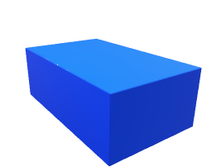
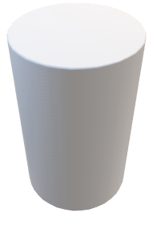
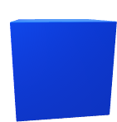

Common 2D and 3D shapes
There are also several 3-D shapes with which you should be familiar:
Cube
All side lengths equal (square faces), and
all angles right angles
Cuboid
Faces are combination of rectangles (and squares); all angles right angles
Cylinder
Circular base
Sphere
All points on surface equidistant from centre

Slide 7
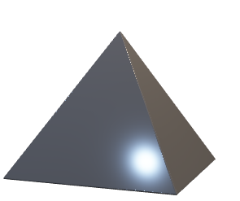
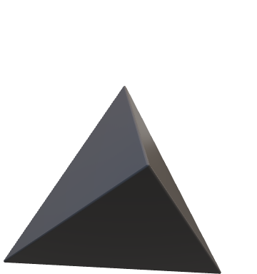
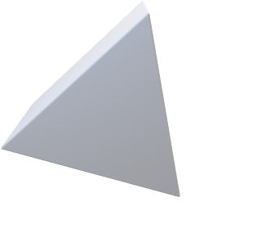
Common 2D and 3D shapes
Common 3D Shapes (continued)
Prism
Cross-section remains
(triangular)
the same throughout
Tetrahedron
All four faces are triangular
Pyramid
(square-based)
All slant edges are equal in length in
a right pyramid

Slide 8
Common 2D and 3D shapes
Example 1
What is the name of the 2-D shape with 4 sides and with opposite angles equal?
Solution
The shape has to be a parallelogram.
(Note: this shape can also be a square, rhombus)
Example 2
Draw accurately:
(a)
(a) a rhombus with sides of length 4 cm and one angle 120 °,
(b) a kite with sides of length 3 cm and 4 cm, and smallest angle 60 °. Measure the size of each of the other angles.
84 °
(b)
108 °
108 °
Note that the smallest angle, 60 °, must be between the two longest sides.
60 °
The other angles are approximately 108 °, 108 ° and 84 °.

Slide 9
Skill Check: Common 2D and 3D shapes
Exercises
What could be the name of the 2-dimensional shape with 4 sides, which has all angles of equal sizes?
What is the name of a 6-sided, 2-dimensional shape which has sides of equal lengths?
Draw a parallelogram with sides of lengths 3 cm and 4 cm and with smallest angle equal to 60 °.
Can a 4-sided, 2-dimensional shape have 4 sides of equal lengths, and not be a square?
Square, Rectangle
Hexagon
120 °
60 °
3 cm
60 °
120 °
4 cm
Yes, Rhombus

Slide 10
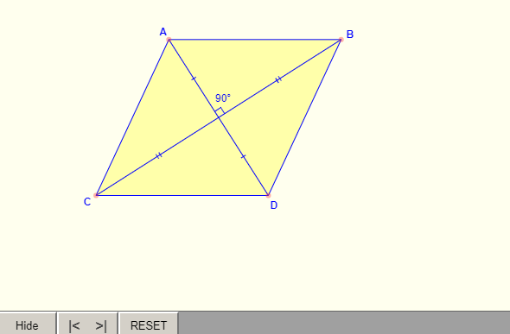
Skill Check: Common 2D and 3D shapes
5. Can a 4-sided, 2-dimensional shape have 4 angles of equal size, and not be a square?
Name all possible 4-sided, 2-dimensional shapes that have at least
2 sides of equal lengths.
Name all possible 4-sided, 2-dimensional shapes that have at most
Yes: rectangle
Square, rectangle, rhombus, parallelogram, kite
2 sides of equal lengths.
Trapezium
8. Draw a quadrilateral with diagonals that cross at 90˚
Square, Rhombus, Kite
https://www.mathopenref.com/rhombusdiagonals.html

Slide 11
Section 1: Review
You have completed the first section.
If you have completed and mastered this section,
click to start the next Section
If you need more examples and interactive practice,
press here
You might also find it helpful to look at:
Essential Information: press here

Slide 12
2D representation of 3D shapes
In this section we explore how to draw 3-D shapes, either on squared paper or on isometric (triangular spotty) paper. Examples of each for a 2 cm cube, are shown below :
Example 1
Draw a cuboid with sides of lengths 5 cm, 3 cm and 2 cm.
Solution
The diagrams below show three of the possible ways of drawing a
2 cm × 3 cm × 5 cm cuboid.
(b)
(c)
(a)
5 cm
5 cm
3 cm
5 cm
3 cm
2 cm
2 cm
3 cm
2 cm

Slide 13
2D representation of 3D shapes
Example 2
A triangular prism has a cross-section that is a right-angled triangle with base 4 cm and height 5 cm. The length of the prism is 8 cm.Draw the prism.
Solution
First draw the cross-section of the prism. Then draw two lines of length 8 cm, parallel to each other. Complete the triangle at the other end of the prism.
Note: Lines parallel on the object are parallel on the diagram.
8 cm
5 cm
8 cm
4 cm

Slide 14
2D representation of 3D shapes
Example 3
Draw this prism on isometric paper:
Solution
4 cm
5 cm
2 cm

Slide 15
Skill Check: 2D presentation of Shapes
On isometric paper, draw a cube with sides of length 4 cm.
On isometric paper, draw a cuboid with sides of lengths 3 cm, 2 cm and 4 cm.
Three cubes with sides of length 2 cm are put side-by-side to form a cuboid. Draw this cuboid on isometric paper.
A cuboid has sides of lengths 3 cm, 6 cm and 2 cm. Draw three possible views of the cuboid on isometric paper.
5.
The cuboid opposite may be cut in half to form two triangular prisms. Draw one of these prisms on isometric paper.

Slide 16
Section 2: Review
You have completed the second section.
If you have completed and mastered this section,
click to start the next Section
If you need more examples and interactive practice,
press here
You might also find it helpful to look at:
Essential Information: press here

Slide 17
Plans and Elevations
The plan of a solid is the view looking down from above.
Side and front elevations are drawn as if looking at the solid from the side or the front, where the front is taken to be the face nearest to you
Plan
Side Elevation
Front Elevation
Elevations
Example 1
Draw the plan and elevations of this cuboid:

Slide 18
Plans and Elevations
Example 2
Draw the plan, front elevation and left side elevation for this shed:
3 m
4 m
---------
Plan
4 m
---------------------------
---------------
3 m
-----------
3 m
2 m
-----------
3 m
Side Elevation
Front

Slide 19
Skill Check: Plans and Elevations
1. Draw the plan and elevations of the triangular prism shown:
Solution
2 cm
-------------------------------
4 cm
------------------------------
-----------
--------
Plan
--------
4 cm
----------------------
------------------------------
4 cm
4 cm
-----------
2 cm
Side Elevation
Front

Slide 20
Skill Check: Plans and Elevations
2. Draw the plan and elevations of the building shown, which is 4 m high:
Solution
-----------------------------
------------------------------
------
Plan
------
-----------
----------
---------------
------
-------
Front
Side Elevation

Slide 21
Skill Check: Plans and Elevations
3. The diagram shows a tissue box. The opening in the centre of the top of the box is 8 cm by 4 cm. Draw three elevations
Solution
Plan
Front
Side Elevation

Slide 22
Section 3: Review
You have completed the third section.
If you have completed and mastered this section,
click to start the next Section
If you need more examples and interactive practice,
press here
You might also find it helpful to look at:
Essential Information: press here

